Slide 1
COLUMBUS STATE COMMUNITY COLLEGE
Board of Trustees
Strategic Planning Update
July 19, 2012

Slide 2
AGENDA
10 Minutes | Welcome & Context Setting Review of Strategic Planning Process
20 Minutes | Summary of Emerging Themes from the Planning Process
30 Minutes | Board Reflections & Feedback

Slide 3
DEFINITION OF TERMS
Vision (The “What,” “When” and “Where”)
The value we will have created for our stakeholders as a result of our work; what we will have accomplished from their perspectives at a defined point in the future
Mission (The “Why”)
Our role as an organization that aligns us with & directs us toward our vision
Values (The “Who”)
The principles & cultural attributes that define us and how we operate

Slide 4
OBJECTIVES
To develop a strategic vision of the future describing the value Columbus State will be delivering to its stakeholders including students & alumni, central Ohio educators, employers & leaders, and Columbus State faculty, administrators & staff
To redefine the College’s statements of mission and values in light of its strategic vision

Slide 5
PROCESS UPDATE
Current Environment Assessment
Input from Board at its October 2011 retreat
Input from College community at the October 2011 In-Service
Dr. Harrison’s environmental scan
Interviews with 12 local business, community and educational leaders
Review of national studies and initiatives including:
Achieving the Dream
Reclaiming the American Dream (AACC)
Time is the Enemy (Complete College America)
A Stronger Nation through Higher Education (Lumina Foundation)

Slide 6
PROCESS UPDATE (con’t)
Strategic Planning Steering Committee (33 members) is guiding the process
Deep dive into environmental assessment
Explored implications of emerging themes
Now formulating:
a vision for Columbus State’s impact on the community
Columbus State’s mission/role in realizing its vision
Columbus State’s values
Obtained input from President’s Cabinet and College Planning Forum
Coordinating with Ologie’s branding work
Soliciting student and alumni feedback during August focus groups
Developing infrastructure to coordinate implementation & integrate this work with other key initiatives, e.g., Achieving the Dream
Results will be presented to Columbus State’s Board this fall

Slide 7
HIGHLIGHTS OF CURRENT ENVIRONMENT ASSESSMENT

Slide 8
EXTERNAL STAKEHOLDER INTERVIEWS
Business & Community Leaders:
Tanny Crane/CEO, Crane Group
Alex Fisher/CEO, Columbus Partnership
Mike Keller/CIO, Nationwide Insurance
Pat Losinski/CEO, Columbus Metropolitan Library
Jeff Lyttle/VP, Community Relations, JP Morgan Chase
Rich Rosen/Executive Director, Indigo Strategies
Dwight Smith/CEO, Sophisticated Systems
Poe Timmons/CFO, Dispatch Printing Company
K-12:
Gene Harris/Superintendent, Columbus City Schools
Steve Dackin/Superintendent, Reynoldsburg City Schools
Higher Ed:
Dolan Evanovich/VP, Strategic Enrollment Planning, The Ohio State University
David Decker/President, Franklin University

Slide 9
WHAT WE ASKED
As you think about the needs of your organization and about central Ohio employers in general, how would you describe the employees that will be required to compete successfully in the coming years?
What are the major opportunities that Columbus State can help you and other employers address as the College seeks to educate employees who will support central Ohio’s growth and competitiveness?
Similarly, what are the threats on the horizon for you and other central Ohio employers that Columbus State can help address?
What are your current perceptions of Columbus State, through any direct or indirect experience you have had with the school, its programs & initiatives, students & graduates (i.e., what are its strengths/assets & limitations/weaknesses)?
How would you describe the unique role and impact that Columbus State could/should fulfill in central Ohio?
What do you see as the key strategic and organizational priorities that Columbus State must address to be successful in its efforts to fulfill this role successfully?

Slide 10
CHARACTERISTICS of SUCCESSFUL EMPLOYEES
Specific skills are impossible to predict because of the rapid pace of change and must be addressed based on market needs
The ability to forecast and develop programs to address skills requirements is a critical competency for Columbus State
Certain skills & competencies are certain to be important
Foundational skills: problem-solving, analytical thinking, communication, technology literacy, adaptability, performing on teams, leadership, entrepreneurship
Work readiness: reliability, follow-through, interpersonal skills
Central Ohio must have a sufficient pool of job-ready talent trained for industry-specific needs to achieve Columbus2020 goals…

Slide 11
OPPORTUNITIES FOR COLUMBUS STATE
“The Era of the Community College”
Economics make sense
“Just in time” delivery of education and training to meet needs of market
Critical player in the region’s economic development engine
Columbus State is uniquely positioned - - no one else can do this!
Be the thought leader and mobilizer on workforce development in Central Ohio
Fully integrate with the community and its employers to understand, predict and respond to Central Ohio’s workforce needs on an ongoing basis

Slide 12
OPPORTUNITIES FOR COLUMBUS STATE (con’t)
Partner with the region’s K-12 systems to help them ready their graduates to enter college and the workforce
Develop new model of remedial education that brings skills to basic level while providing visible success toward student’s career goals
Increase completion rates once students are enrolled
Create multiple pathways to workforce success for high school graduates
Create multiple pathways to workforce success for employees
Develop best-in-class industry-specific programs for growing markets

Slide 13
CHALLENGES & THREATS
Increasing cost and decreasing funding of higher education
Insufficient readiness of high-school students for work or college
Collaboration across educational spectrum and public/private sector not historically strong
Competition from well funded for-profits, especially for online options
Changing demographics of student population
Shortages of labor for critical jobs might cause employers to go elsewhere
The stakes are very high - - successful economic development requires an educated & skilled population

Slide 14
PERCEPTIONS OF COLUMBUS STATE: Strengths
Leadership approach is well received
Bold vision
Willing to take strategic risks
Listening to the community
Collaborative
Seat at the Columbus Partnership table
Accessible, affordable and open to all
Ability to expand/contract capacity
Focus on skills that people want and need to learn
Reducing stigma of community college

Slide 15
PERCEPTIONS OF COLUMBUS STATE: Limitations
Need to increase community & employer engagement dramatically
Need to reinforce Columbus State’s presence and vital relevance
Need to dramatically increase capacity for undertaking new initiatives and getting them done
Data collection and analysis capabilities
Amount of time required for remedial education
Completion rates and financial-aid “burn” rates

Slide 16
UNIQUE ROLE/IMPACT FOR COLUMBUS STATE
Workforce development
Align regional educational model downstream & upstream
Prepare new entrants to job market and college, particularly those from Central Ohio school districts
Re-skill existing workforce to meet needs of the market
Just in time delivery of education and training
Bridge to skilled employment, skilled workforce
Forecaster and translator of workforce needs to the community

Slide 17
DEVELOPING COLUMBUS STATE’S VISION, MISSION & VALUES

Slide 18
DEVELOPING COLUMBUS STATE’S VISION
Defining the vision as what will be true for its stakeholders as a result of Columbus State’s work, or the impact Columbus State will have delivered to its stakeholders, complete the following sentence:
Because of Columbus State Community College and its partnerships with students, educators and employers, _________________________________________________ ___________________________________________________________________________________________________________________________________________________________________________________________________________ .

Slide 19
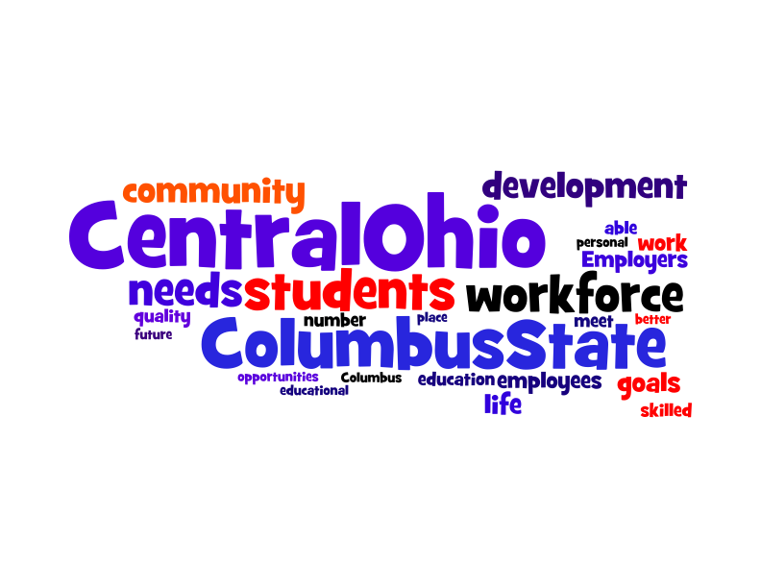

Slide 20
INPUT ON COLUMBUS STATE’S VISION
Words:
Community/Workforce/Together/Central Ohio/Region
Learn/Grow/Succeed/Participate/Contribute/Thrive
Engaged/Relevant/Socially responsible/Skilled/Educated/Prosperous
Opportunity
Concepts:
Active verbs
Speak to present and future
Include individual and collective
Define “community” broadly
Describe the outcome, not the process
Process isn’t linear

Slide 21
COLUMBUS STATE’S MISSION
With this emerging vision in mind, and defining the mission as Columbus State’s role as an organization, or the institutional purpose aligning us with & directing us toward our vision:
What are the key words or concepts that must be
included in Columbus State’s mission statement?

Slide 22
INPUT ON COLUMBUS STATE’S MISSION
Words:
Inspire/Connect/Transform lives/Successful/Uplift
Catalyst/Education/Learning/Opportunity/Life transitions/Deserves
Relevance/Access (local, global & cultural)
Community/Region/Workforce/Partnerships
Collaborative/Inclusive/Responsive
Concepts:
Leading force for change; “at the table”
Community problem-solver
Front door to education/Connecting dreams and opportunities/Pathway to personal and professional goals
Utilizing our diversity
Access with expectations
Individual impact, industry impact, community impact

Slide 23
COLUMBUS STATE’S VALUES & CULTURE
What do you value most about Columbus State? **
“” From October 2011 In-Service

Slide 24
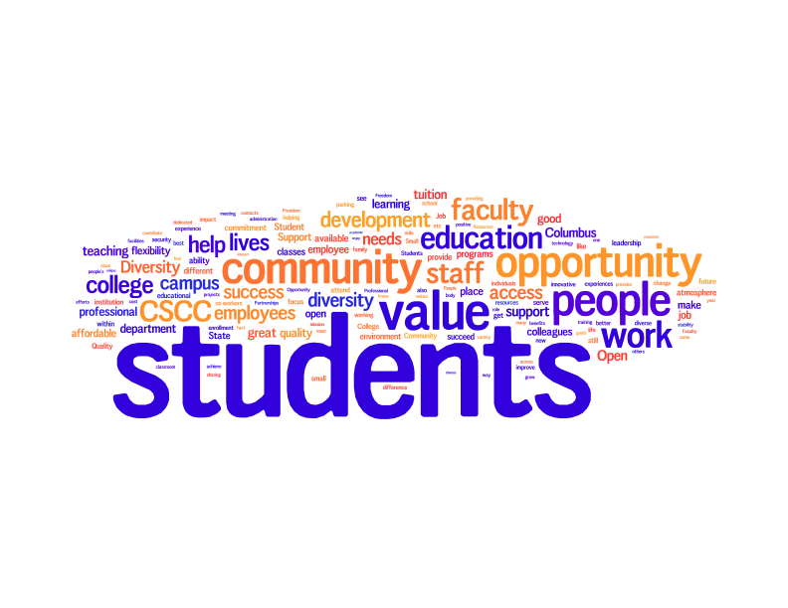

Slide 25
COLUMBUS STATE’S VALUES & CULTURE
With the emerging vision & mission in mind, what are the five most important values or cultural attributes that Columbus State must manifest in order to realize its vision and fulfill its mission?

Slide 26
FEEDBACK ON VALUES
Concepts:
Dynamic/creative/open/active/strategic/innovative/adaptable
Student-centered/responsive/accommodating/engaging/individualized
Compassionate/respectful/nurturing/communicative/honest/consistent/high integrity
Diverse/culturally competent/open to all/accessible & affordable/accept & value each individual/inclusive/welcoming/collegial
Committed to excellence/evidence-driven/rigorous/high-quality
Collaborative/engaged with partners, collaborators & the community
Committed to and vigorously passionate about our shared vision
Socially responsible stewards
Strong/self-confident

Slide 27
BOARD REFLECTIONS
Reflecting on the work has been done to date:
Are there words or concepts from the Vision/Mission/Values input that seem more relevant than others?
Is there anything you expected to see that is missing?
Do you have any additional thoughts that can help shape the group’s thinking?

Slide 28
THE PROCESS
VISION
MISSION
VALUES
Priorities
Priorities
SUPPORTERS
INHIBITORS
CURRENT
REALITY

