Slide 1


Money Management Family Budgeting
Duane Donaldson, CPA
CSCC – BP – Finance
October 23, 2024
ddonaldson7@cscc.edu

Slide 2

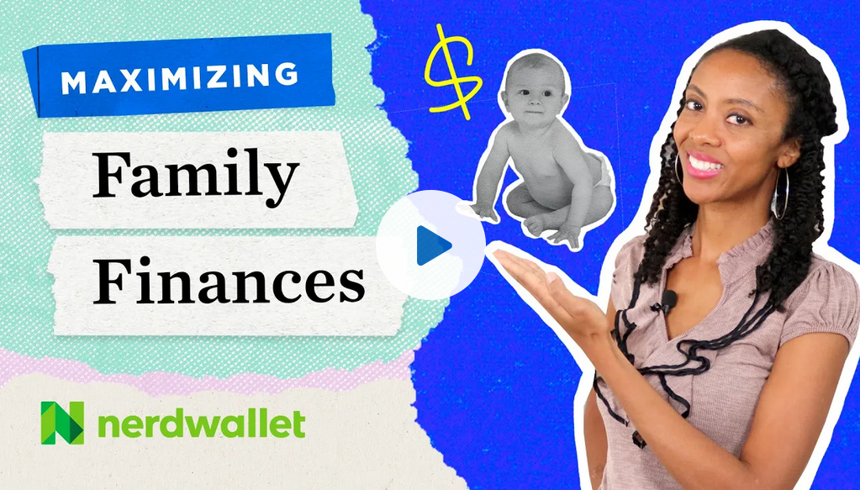
What will we learn?
Why plan ahead?
The Financial Planning Process
Budgeting Techniques
The foundation

Slide 3

Issues & Opportunities - Why do we plan ahead?
Today
Food
Clothes
Shelter (rent)
Transportation (car)
Tuition, books, technology
Insurances
Emergency fund ($1,000)
Vacation
Next 1 to 5 Years
Another car
Obtain first home / save for one
Save for retirement (get started)
Pay off / down debts:
College
Car
Home
No Credit Cards please ☺
Lender’s require it

Slide 4

Issues & Opportunities - Why do we plan ahead?
Down the Road
Gifts to others / family – special things to help others out
Pay kids college
Pay off the house
Pay cash for cars / appliances
Multiple vacations annually
Leave a legacy
Non-profits / charities
Trust for the family
Lenders still require it

Slide 5
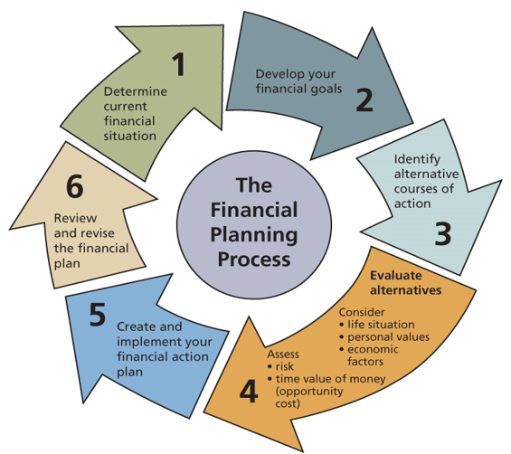
The Financial Planning Process

Slide 6
Step #1 - Determine Current Position
What is your monthly cash flow? (BUDGET)
Cash flow, monthly budget, net income/(loss) (period of time)
Income – multiple sources? (earn)
Expenses (fixed & variable) (spend)
What are your “balances”? (NET WORTH)
Balance sheet, net worth statement (point in time)
Assets – what you OWN
Liabilities – what you OWE
Net Worth – Assets minus Liabilities (equity)

Slide 7

Step #2 - Develop Financial Goals
Assess yourself
Why do you feel the way you do about money?
KNOW yourself so others can assist (your FINANCIAL TEAM)
Risks – income/job, personal, inflation, interest rates, liquidity
SMART Goals
S – Specific (numerical, objective)
M – Measurable (dollar value, time, score)
A – Action-oriented (tasks)
R – Realistic (logical / makes sense)
T – Time-oriented (day, week, month, year, etc.)

Slide 8
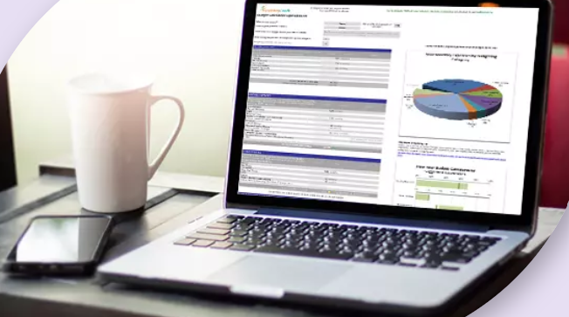
Step #3 - Alternative Courses of Action
Possible courses of action
Same course
Expand / contract current course
New course
Creative decision making
Gain new ideas
Discuss with professionals / others with experience

Slide 9
Step #4 - Evaluate Alternatives
Opportunity Cost
Trade-off of what you give up
Evaluation Risk
Income – your job
Personal – health, safety, location
Interest – good time to borrow? (car / house)
Inflation – general economy
Liquidity – cash poor & house or car rich? Big house, no furniture?

Slide 10
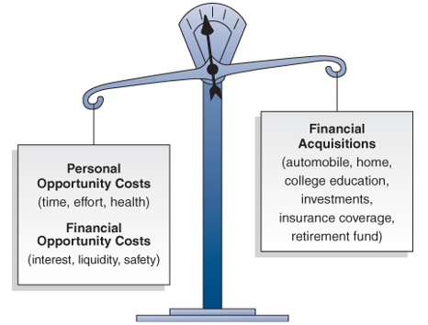
Step #4 - Evaluate Alternatives (Cont’d)

Slide 11
Step #5 - Implement the Plan
Written
Share with others (spouse, parents, professionals)
How will you prioritize……..
Income creation – more work, better work
Expense reduction
Put your plan in action
Professionals? – insurance, broker, agents
Make decisions & live with them

Slide 12

Step #6 - Review & Revise the Plan
Assess your decisions
At least annually,
More often when
Newer at this process
Social factors change
Economic factors change
Personal situation changes
If you fail to plan………you plan to fail !!

Slide 13
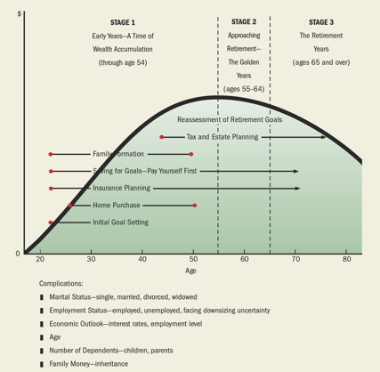
Influences & Timing of Personal Financial Planning

Slide 14
Key Factors to Financial Success
Save for the future
Emergency fund – next 1-2 months ($1,000)
Things Change fund – 3-6 months living expenses (budget)
Long-term – home, kids’ education, retirement
Maintain LOW debt levels
Invest in QUALITY assets (let assets work for YOU)
Be nimble – have options (life happens)
Be safe, but not TOO safe (take educated risk)
Communicate – let others in on your plan (TEAMS win)
Build your “team” – the best teams win !!

Slide 15
YOUR LIFE & LIFESTYLE - How to Make it Work
What are YOUR most important factors that YOU will consider in making an economic life plan
Career ?
Family – timing / size ?
Home – city, suburb, country ?
Geography (where you will live) ?
How long to work vs. “retirement” (what IS retirement?) ?
Recreation / vacation ?
Personal activities ?
Other …………………..

Slide 16
What Successful People “DO” Do !
Invest in what you know)
Pay yourself 1st = SAVE / INVEST
Save 15% of their earnings
Set up emergency funds
Budget – in writing & share it
Know their risk profile
Keep GREAT relationships
Limit “bad” debt – it’s a threat
Plan their work, then work their plan

Slide 17
Budget - How to Make it Work
Defines savings & spending
Don’t run out of money before you run out of month
Spend WISELY (think it through, you worked hard for it)
Follow your budget / “the plan”
Develop GREAT HABITS (can’t fake this)
Retain records, review spending constantly
Focus on your GOALS (S.M.A.R.T.)
Have DISCIPLINE (if won’t work if you don’t work)
Pay yourself first (auto deductions)

Slide 18



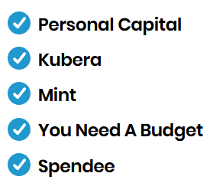


Financial Apps

Slide 19
Cash Flow Statement - Budget, Income Stmt.
Income (inflow)
Wages / salaries
Commissions
Business income (side hustle?)
Gifts (money from others)
Grants (free money)
Scholarships (free money)
Investment income (later in life)
Expenses (outflow)
Fixed – rent/mortgage, health prem., loans, savings (pay yourself)
Variable – food, clothing, utilities, home & car maintenance, household items, etc.
Surplus/Deficit
(Optimize THIS)
Income - Expenses

Slide 20
Budget to Borrow the minimum
Incoming | Outgoing
Grants | Tuition & Fees
Scholarships | Books & Supplies
Work-study | Housing
College Savings Plan | Transportation
Family Assistance | Food
Individual Income | Health Care
Loans | Entertainment
 | Loan Costs
$$$ | $$$
And think about how you will finance your WHOLE college time
Notes:
Show them our PFP high school budget form from FMGT 1101

Slide 21
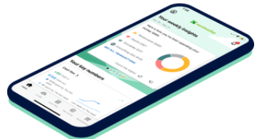
FAMILY BUDGET Let’s do a “budget”
Income & Withholdings
Pay yourself 1st
Redo expenses until bottom line is positive
Track it to actual monthly for 1 year
Weekly or Monthly-to-Actual

Slide 22

Budget
Weekly
OR
Monthly w/actual comparison
Divide your income among needs, wants & debt repayment, and savings using the 50/30/20 budget ? (automate savings?)
“We all have an incredible opportunity to create wealth for ourselves and to create financial freedom, but we have to have a strategy around that, we can’t just wing it.” Duane Donaldson ☺

Slide 23
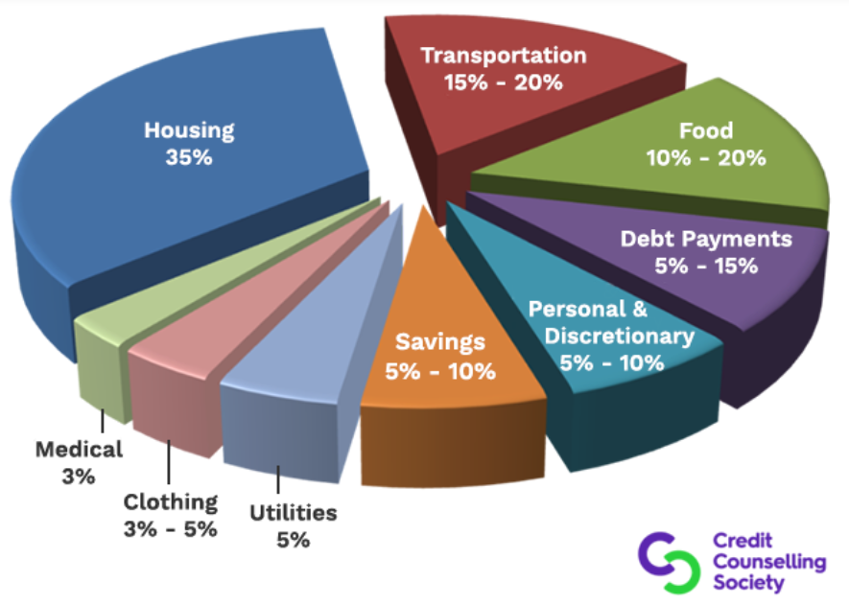
Costs of Living by Category (A Guideline)

Slide 24
Money Management Family Budgeting
Thank You
Questions?
Duane Donaldson, CPA
CSCC – BP – Finance
October 23, 2024
ddonaldson7@cscc.edu

