Slide 1



CSCC MEANS BUSINESS and How to Succeed Financially in College & Life Series presents: Holiday Budgeting
Dr. Jack Popovich
Finance Professor
jpopovic@cscc.edu

Slide 2
Agenda
What is your money story? Who is your money mentor? (Holidays and general)
Why do people overspend??? Cycle of Financial Illiteracy
Goals, Behaviors & Habits of Financial Wellness and Literacy
Budgeting in General
Budgeting for Holidays
Tips for Holidays
Summary
Questions

Slide 3
What is your money story?
Your money “mentor” - Who is the person (or people) who has had the most influence on you when it comes to money? What did they teach you about money?
What money lessons otherwise, did you get from your:
Parents
Parents’ relatives (aunts, uncles, cousins, grandparents)
Friends
Neighbors
What were your holidays like???????
Notes:
What messages from your mentor?

Slide 4
Mysidia
Mysidia is 22. Her parents earn $40,000 per year and she lives with them. She works odd jobs for cash while in school and her parents let her keep the money. She has $400 saved up in the bank and has $3,000 in credit card debt.
Mysidia wants to buy her parents, siblings, and friends nice gifts. Her friends all get each other large gifts in the $300 range, and she feels socially pressured to keep up
What should she do? How can she make this work?

Slide 5
Joshua
Joshua is 28. His single mother earned $10,000 per year and he is the second oldest of 5 children. Holidays were meager when he was young. He usually got socks.
Joshua now has two children. He wants them to have more than he did. He expresses his love by giving them big Christmas gifts
Joshua makes $22 an hour ($44,000 per year). Last year he spent over $6,000 on Christmas gifts for his children. He has $20,000 in credit card debt.
What should he do?

Slide 6
Nathaniel
Nathaniel is 24. He lives with roommates and earns $35,000 per year. He has $20,000 in student loans.
Nathaniel saw a great commercial for a really nice necklace he wants to buy his girlfriend for $2,200.
He knows he can’t really afford this necklace, but it is on sale and the commercial really reminded him of how much he loves her.
What should he do?

Slide 7
Erica
Erica is 30 and is married to Mason. They earn a combined $70,000 per year and have a daughter. They have no credit card debt, but no savings either. They do not have 401ks or other retirement accounts. They really know they should be saving for their daughter’s college and retirement.
They purchased a new 97-inch TV last month for $6,800. They didn’t need it, but Erica saw it and had to have it.
They have financial goals but each time they start getting serious about savings, one of them sees something they really MUST have.
What should she do?

Slide 8
Why do people overspend on the holidays?
Social Pressure:
Keeping up with others' spending
Gift-giving expectations
Emotional Spending:
Expressing love and care
Retail therapy
Marketing and Advertising:
Holiday sales and promotions
Emotional appeals
Lack of Budgeting:
Impulsive purchases
Ignoring financial goals
Can we see our four example people here?

Slide 9
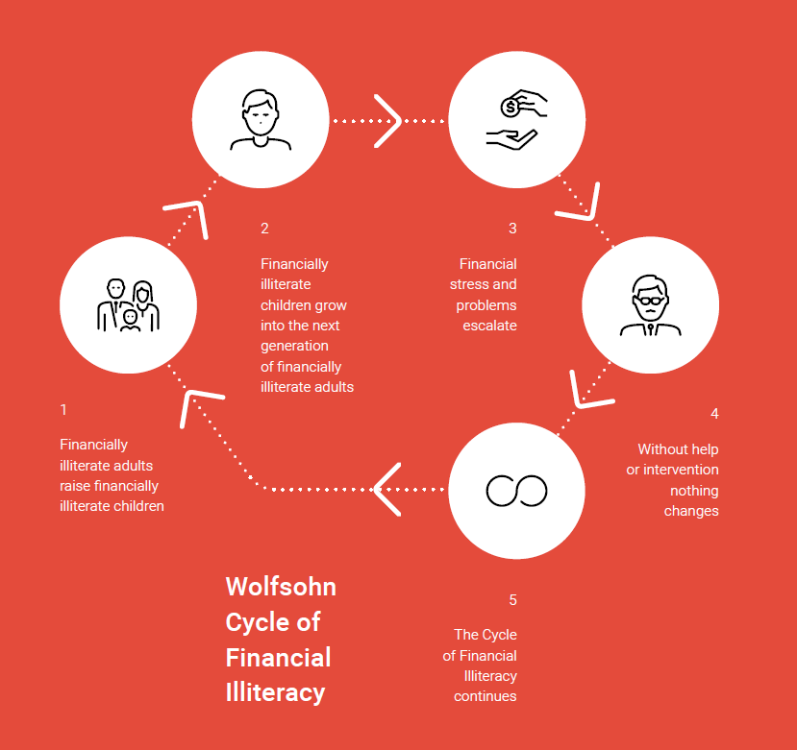
This can happen at ANY income level
Do you consider yourself well-educated about money?
How do you think about spending?
About Holiday Spending?
Financially uneducated grow into the next generation of financially uneducated adults
Financial stress and problems continue to escalate
Financially uneducated adults raise financially uneducated children
Without help or intervention nothing changes
The cycle of financial Illiteracy continues
Notes:
People learn from parents – good or bad.
Next generation can change and break the cycle.
Get a mentor

Slide 10
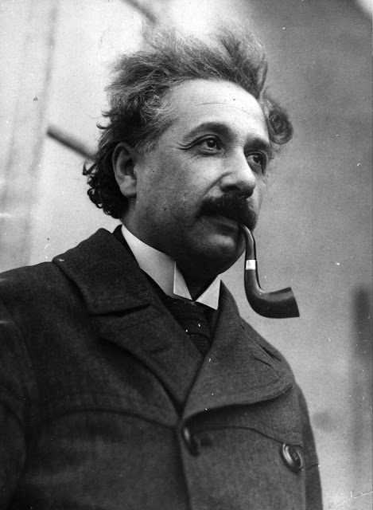
Holidays can mess up a budget. You need smart behaviors and habits
Now is the time to create good money habits. THIS YEAR
To succeed financially, you will need to reflect on your feelings, attitudes, and beliefs about your money. THEN PLAN!!
Do you have a bank account?
Do you use any financial apps? For budgeting? Investing? Banking? Credit score?
Ever heard of “Pay Yourself First”?
Do you have an emergency fund?
Do you have a budget?
This Photo by Unknown Author is licensed under CC BY-SA

Slide 11


Avoid general bad decisions
Avoid going bananas at the holidays! (and payday lenders, auto title loans, consumer credit, credit cards)
Build up your credit (score) in college
Avoid all debt if you can, but if you must, student loans have pretty low interest rates. Only borrow what you need.
HOW??? BUDGETING
Create your holiday budget during Thanksgiving weekend.

Slide 12
The seven holiday “tips”
1-Set a Budget:
Determine your spending limit: Decide how much you can afford to spend on gifts, decorations, travel, and entertainment.
Allocate funds: Divide your budget among different categories, such as gifts, food, travel, and decorations.
2-Create a Shopping List:
Prioritize: Focus on gifts for close family and friends.
Set Spending Limits: Assign a specific budget to each person on your list.
Avoid Impulse Purchases: Stick to your list and avoid buying unnecessary items.
3-Shop Smart:
Compare Prices: Look for deals and discounts online and in-store.
Use Coupons and Promo Codes: Take advantage of savings opportunities.
Buy in Bulk: Consider buying items in bulk, especially non-perishable goods.
4-DIY Gifts:
Personal Touch: Homemade gifts can be thoughtful and cost-effective.
Reduce Expenses: Consider baking cookies, making crafts, or writing personalized letters.

Slide 13
The seven holiday “tips”
5-Reduce Non-Essential Spending:
Cut Back on Unnecessary Expenses: Limit dining out, entertainment, and other non-essential costs during the holiday season.
Cook at Home: Prepare meals at home instead of eating out to save money.
6-Use Cash or Debit Cards:
Avoid Overspending: Set a cash limit for your holiday shopping.
Track Spending: Monitor your spending closely to stay within your budget.
7-Be Mindful of Debt:
Avoid Credit Card Debt: Pay off your credit card balance each month to avoid high-interest charges.
Consider Alternative Payment Methods: Use payment plans or buy now, pay later options responsibly.

Slide 14

Holiday “tips” 1 & 5 - Budget
1-Set a Budget:
Determine your spending limit: Decide how much you can afford to spend on gifts, decorations, travel, and entertainment.
Allocate funds: Divide your budget among different categories, such as gifts, food, travel, and decorations.
5-Reduce Non-Essential Spending:
Cut Back on Unnecessary Expenses: Limit dining out, entertainment, and other non-essential costs during the holiday season.
Cook at Home: Prepare meals at home instead of eating out to save money.

Slide 15
Create a normal month budget
Living Expenses
Savings / retirement account
Rent/Mortgage
Furniture, appliances, TVs, etc.
Other Debt/Credit card payments
Tool payments
Other Living Expenses (utilities)
Tuition and books, fees, student loan payments
. Total Housing Expenditures
Clothing and Personal Care
New Clothes
Cleaning, Laundry
Personal Care--Hair Care
Other Clothing and Personal Care Expenses
. Total Clothing and Personal Care Expenditures
Transportation
Car Payments, Gas, Parking,
Automobile Registration/Tags/Stickers
Repairs
Bus Pass / Other Transportation
. Total Transportation Expenditures
Recreation
Movies, Theater, Sporting Events, Club Memberships, Hobbies
Vacations & Gifts
. Total Recreation Expenditures
Medical & Insurance Expenditures
Doctor, Dentist
Prescription Drugs and Medicines
Car, Health, Life, Disability, Liability Insurance
. Total Medical & Insurance Expenditures
Other Expenditures
Child Care
Other Expenses - DEFINE

Slide 16
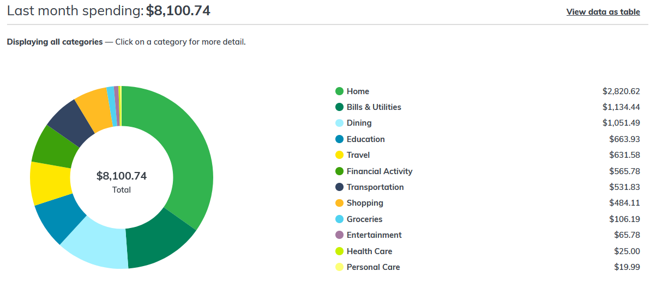
Normal Budget-Graph (Bank)

Slide 17
Incoming | Outgoing
Grants | Tuition, Fees, Books
Scholarships | SAVINGS
Work-study | Housing / Food
College Savings Usage | Transportation
Family Assistance | GIFTS
Individual Income | Health Care / Insurance
Loans | Entertainment
 | Loan Costs
$$$ | $$$
Make a Plan
https://www.cscc.edu/services/financial-aid/types-of-aid/loans.shtml
Notes:
Don’t’ take out the max loan

Slide 18
Some Living Expenses - Normal
Savings / retirement account | 200
Rent/Mortgage | 1200
Golf and Other Hobbies | 100
Other Debt/Credit card payments | 200
GIFTS | Set aside monthly 50
Other Living Expenses (utilities) | 200
Entertainment and restaurants | 600
. Total Housing Expenditures | 2650
Make a (short) Plan for the holidays
Some Living Expenses – Nov/Dec
Savings / retirement account | 200
Rent/Mortgage | 1200
Golf and Other Hobbies | 0
Other Debt/Credit card payments | 200
GIFTS | 650
Other Living Expenses (utilities) | 200
Entertainment and restaurants | 100
. Total Housing Expenditures | 2650
Notes:
Don’t’ take out the max loan

Slide 19

Can budget with….
Paper
Spreadsheets (excel, google sheets)
https://docs.google.com/spreadsheets/u/0/ (https://docs.google.com/spreadsheets/d/1rpEWqgzRaIeuIvn2iSNM6zakubjB8OtJX3gg4CjtT8w/edit#gid=1695479590)
Budget templates (prepared sheets)
https://www.nerdwallet.com/article/finance/free-budget-spreadsheets-templates
https://create.microsoft.com/en-us/templates/budgets
Apps
One of mine: https://docs.google.com/spreadsheets/d/1DbqN7qsdOkNqY7YK_5u1cQAdttcRqTaaUuMvNkstDfA/edit?usp=sharing
This Photo by Unknown Author is licensed under CC BY-SA

Slide 20

Holiday “tip” 2 – The actual gifts
2-Create a Shopping List:
Prioritize: Focus on gifts for close family and friends.
Who really needs a gift? Tell people not to buy you anything!!
Set Spending Limits: Assign a specific budget to each person on your list.
Know your budget for EACH person
Avoid Impulse Purchases: Stick to your list and avoid buying unnecessary items.
We all do this… Don’t! Create that list and budget before or during thanksgiving.

Slide 21
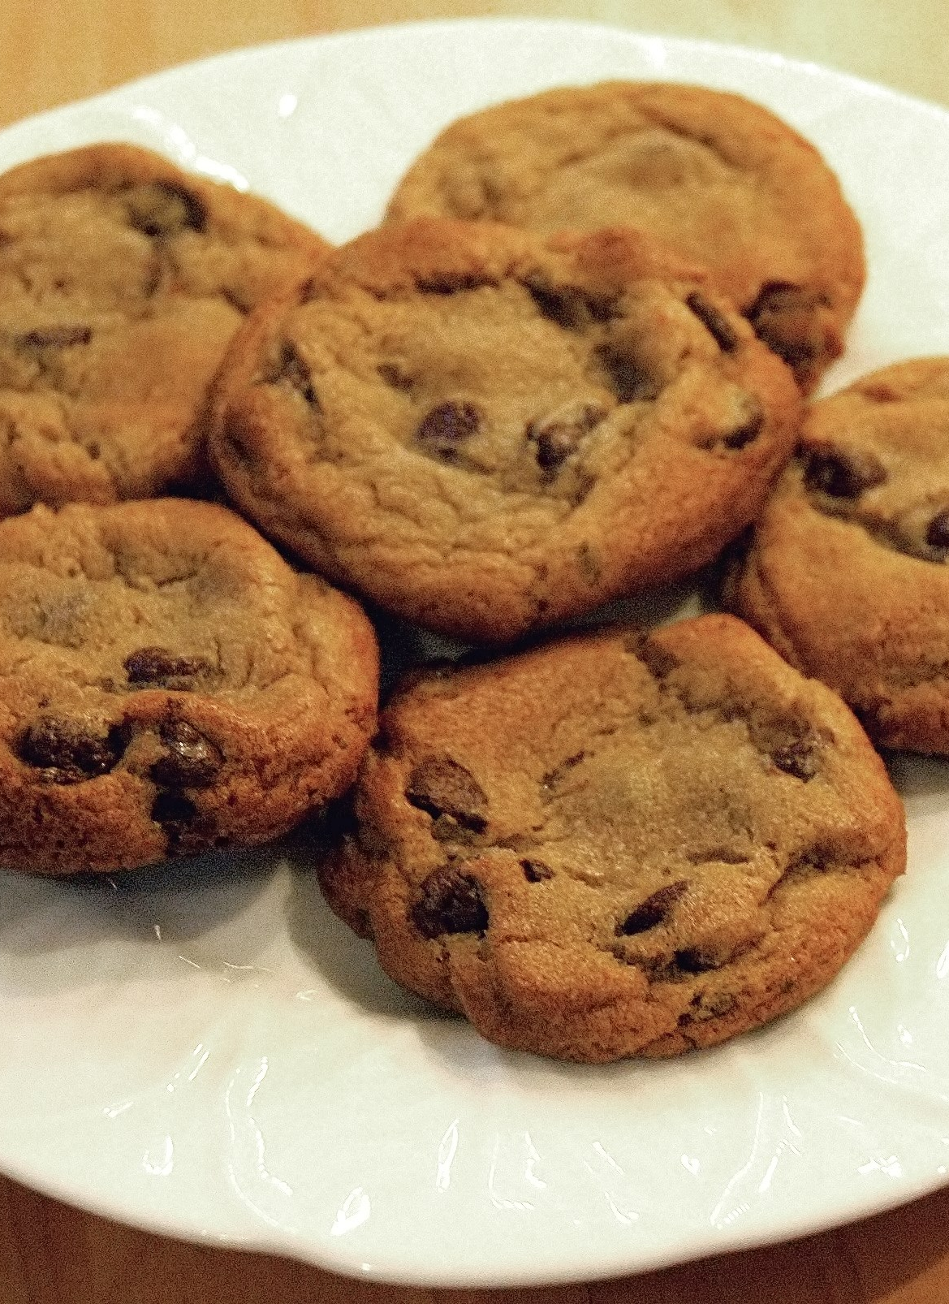
Holiday “tips” 3 & 4– Be creative (w/in reason)
3-Shop Smart:
Compare Prices: Look for deals and discounts online and in-store.
Use Coupons and Promo Codes: Take advantage of savings opportunities.
Buy in Bulk: Consider buying items in bulk, especially non-perishable goods. (Maybe)
4-DIY Gifts:
Personal Touch: Homemade gifts can be thoughtful and cost-effective.
Reduce Expenses: Consider baking cookies, making crafts, or writing personalized letters.
This Photo by Unknown Author is licensed under CC BY-SA

Slide 22

Don’t add DEBT!!!!
6-Use Cash or Debit Cards:
Avoid Overspending: Set a cash limit for your holiday shopping.
Track Spending: Monitor your spending closely to stay within your budget.
7-Be Mindful of Debt:
Avoid Credit Card Debt: Pay off your credit card balance each month to avoid high-interest charges.
Consider Alternative Payment Methods: Use payment plans or buy now, pay later options responsibly.

Slide 23
Try?
Living Expenses
Savings / retirement account
Rent/Mortgage
Furniture, appliances, TVs, etc.
Other Debt/Credit card payments
GIFTS
Other Living Expenses (utilities)
Tuition and books, fees, student loan payments
. Total Housing Expenditures
TOTAL GROUP
Clothing and Personal Care
New Clothes
Cleaning, Laundry
Personal Care--Hair Care
Other Clothing
. Total Clothing and Personal Care
Transportation
Car Payments, Gas, Parking,
Automobile Registration/
Repairs
Total Transportation Expenditures
TOTAL GROUP
Recreation
Movies, Theater, Sporting Events, Club Memberships, Hobbies
Vacations
. Total Recreation Expenditures
Medical & Insurance Expenditures
Doctor, Dentist
Prescription Drugs and Medicines
Car, Health, Life, Disability, Liability Insurance
. Total Medical & Insurance Expenditures
Other Expenditures
Child Care
Other Expenses - DEFINE
TOTAL GROUP
LIST - PERSON | AMT
1
2
3
4
5
6
7
8
TOTAL GROUP

Slide 24

SUMMARY: DON’T OVERSPEND
Marketing and Advertising:
Holiday sales and promotions
Emotional appeals
Lack of Budgeting:
Impulsive purchases
Ignoring financial goals
Social Pressure:
Gift-giving expectations
Emotional Spending:
Expressing love and care
Retail therapy
Keeping up with others' spending
This Photo by Unknown Author is licensed under CC BY-SA

Slide 25

SUMMARY: DO HOLIDAY TIPS
Set a budget
Create shopping list
Shop Smart (Compare Prices)
DIY Gifts
Reduce non-essential spending
Use cash or debit card
Beware of DEBT
Maybe: Regift? Carefully?

Slide 26


