Slide 1


Time Management
Jorie Schwartz, Professor
Social Work and Human Services

Slide 2

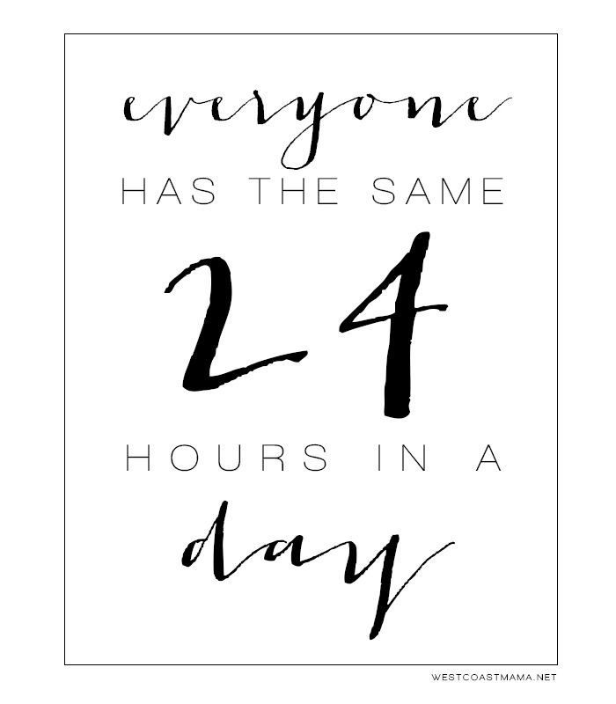
How do you spend yours?
time with family
studying
classes
working
social life
watching TV
volunteering
sleeping
self-care?

Slide 3


Time Management
Does this word sound scary or overwhelming to you?
It’s simply the practice of making the most of your time and energy.
Who doesn’t need that?

Slide 4

The Benefits of Time Management
There are many! Not to mention it’s an important professional practice.
You are more productive.
You reduce your stress and avoid melt downs
You improve your self-esteem.
You achieve balance in your life.
You feel more confident in your ability to get things done.
You reach your goals.

Slide 5
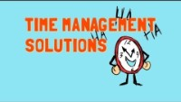
Let’s Begin Thinking of Strategies
Notes:
https://www.youtube.com/watch?v=VUk6LXRZMMk (4:10)
After the video have students complete the Wellcast Day Planner handout. Discuss.

Slide 6
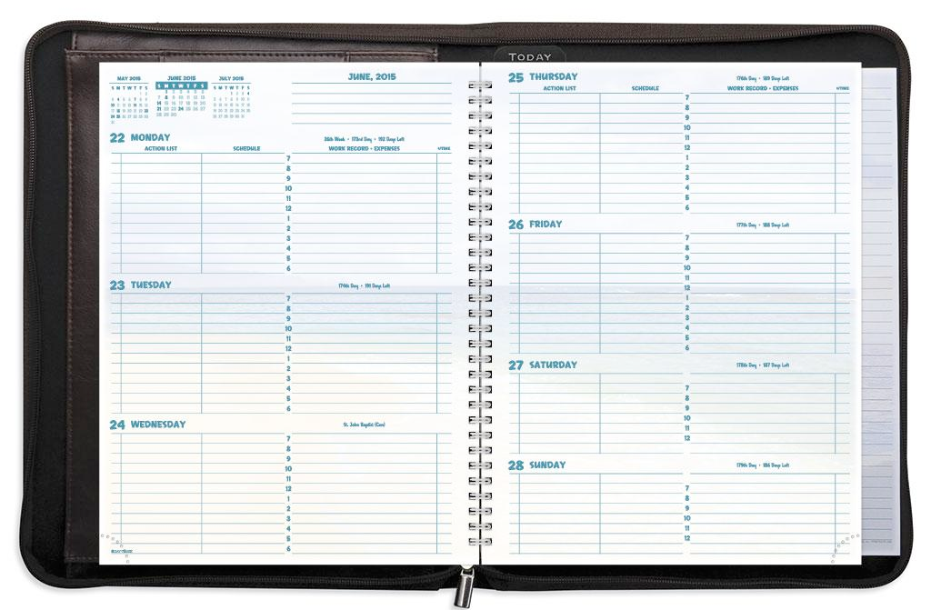
Tips for Better Time Management
Create a weekly to-do list and a daily plan
Prioritize
Assign a time limit to each task
Use a calendar
Stay organized

Slide 7
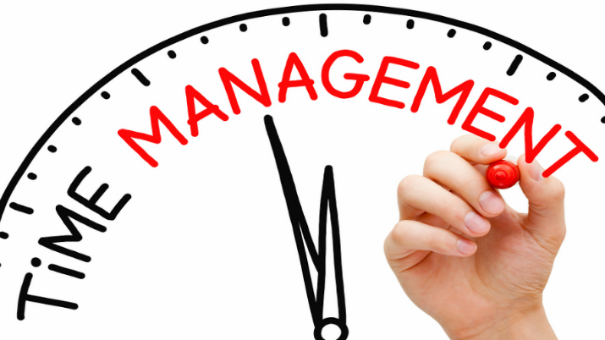
Tips for Better Time Management
Know your deadlines
Learn to say “NO”
Target to be early
Have a clock visible to you
Set reminders
Eliminate distractions

Slide 8

Grab 15
Identify a project you’ve been avoiding and spend just 15 minutes a day on it.
This tool can help you sidestep the common obstacle of just getting started on a project.

Slide 9
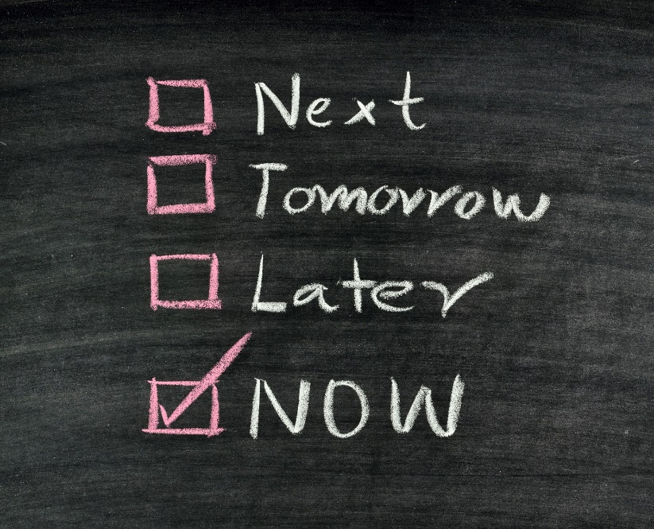
Do the Hard Thing First
If you have more than one thing you need to accomplish in a given day, tackle the one you least want to do first.
This will make your load feel lighter and helps avoid procrastination.

Slide 10

Use Breaks Wisely
The time between work, school, and activities can be used to complete tasks.
Use the Pomodoro Technique by workingin short intervals and take short, regular, timed breaks or "Pomodoros."
For example, you might use a timer to work in 25-minute sprints, broken up by 5-minute breaks away from your workspace. Every fourth Pomodoro, take a longer break.
Notes:
The Pomodoro Technique was developed in the 1990s and named after the tomato-shaped timer. Use the timer on your phone!

Slide 11

Fill Your Energy and Excitement Quota in Positive Ways
Everyone needs to be energized and to “mix-it-up” sometimes!
Vary your activities throughout the day whenever possible.

Slide 12
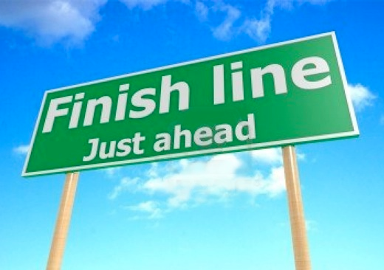
Finish Fully & Get Closure
Make a habit of finishing each task fully.
Bringing closure to as many “open tasks” as possible will increase your ability to think more clearly.
What are some examples of this?

Slide 13
No Temporary Parking Places
How much time do you spend looking for your keys (cell phone, wallet, etc…) everyday?
Establish as many permanent resting places as possible so your energy isn’t used up remembering where you put them!

Slide 14

Take Time Off
It's important to take time for yourself.
Many scholars have studied the effects of meditation on reducing effects of stress-induced conditions such as back pain, irritable bowel syndrome, and insomnia.
Meditation can take place anywhere you can find a few minutes of quiet
Notes:
Long study sessions or chunks of time working on assignments should be broken up with time away from screens or textbooks. You need to give your mind a rest.
The National Institutes of Health suggests meditation makes the brain's ability to process information more efficient.
Search for free meditation apps in your smartphone's app store.

Slide 15
A Word About Energy
Evaluate your energy level at different times of day.
Schedule tasks when you have the energy level to match.
If you are a “morning person,” seize the early hours to study and do assignments that require focus.
If you are an “evening person,” make sure that you are being productive and not sacrificing sleep for extra hours to socialize.
Losing sleep is the easiest way to sabotage your energy level!

Slide 16
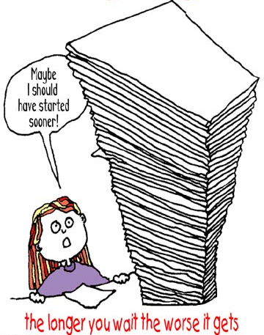
Procrastination
Is the action of delaying or postponing something.
Can you relate?

Slide 17

Why Do You Procrastinate?
Perfectionism
Fear of Failure
Confusion
Task Difficulty
Poor Motivation
Difficulty Concentrating
Task Unpleasantness
Lack of Priorities
Notes:
Refer to the Procrastinator Screening handout for definitions of each.
Pause PowerPoint to take and score the Procrastinator Screening.

Slide 18
The Procrastination Cycle
Event: I have a big project assigned at the beginning of the semester
Thought: I have plenty of time
Feeling:
Initial – denial
Later – overwhelmed, panic
Behavior: Call off work, miss class, others?

Slide 19
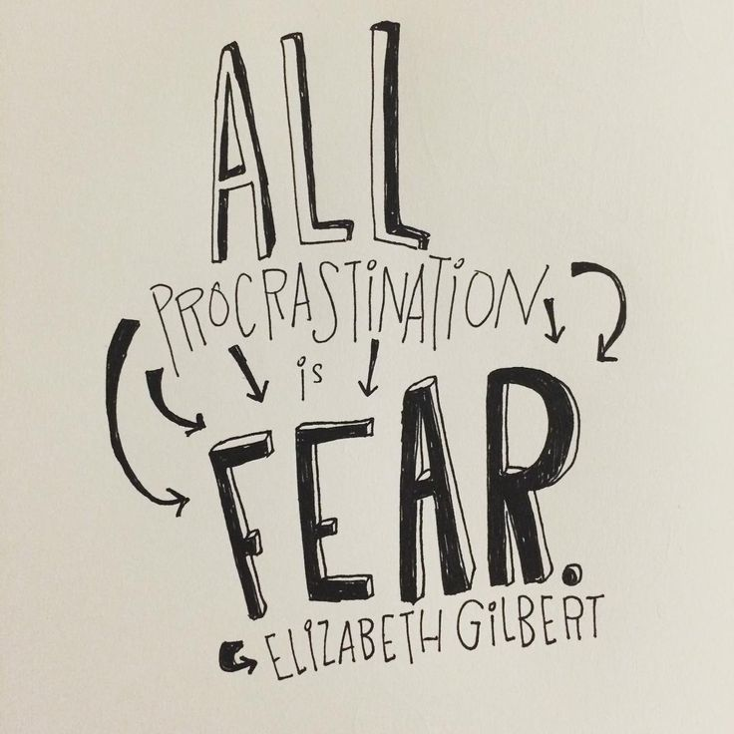
Overcoming Procrastination
Win the mental battle by committing to being on time.
Set and keep deadlines.
Organize, schedule & plan.
Divide a big job into smaller ones.
Find a way to make a game of your work or make it fun.
Reward yourself when you’re done.
Tell your friends and family to remind you of priorities and deadlines.
Learn to say “no” to time wasters.

Slide 20
4 Easy Steps
Prioritize
Make a schedule
Revisit and revise your plan
Set a goal for yourself

Slide 21

Jorie Schwartz jschwartz12@cscc.edu

