Slide 1
Social Justice, Diversity and Inclusion in the Classroom
Practical Solutions for Addressing
Conflict and Incivility
Mary M. Lewis, Ph.D., ABPP

Slide 2
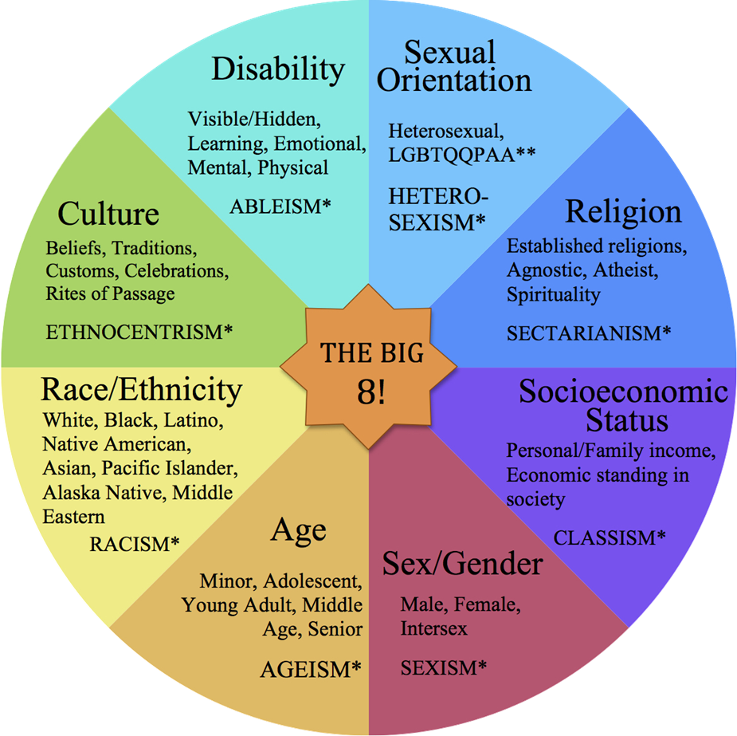
Why It Matters
“Elephant in the room”
Improves intergroup relations
Facilitates positive attitudes of other cultures
Exposes and fights stereotype threats
Identity (of student and faculty) impacts learning
Demonstrates openness
http://education.cu-portland.edu/blog/news/teaching-social-justice/

Slide 3
But My Classroom Doesn’t Apply Because….
ALL classrooms should be aware of and open to conversations on diversity and inclusion.
Classroom setup (physical and otherwise) can be welcoming or alienating, and send messages about power & privilege (which impacts learning)
Unwritten cultural norms may not be explicitly stated or consistent
Isms (racism, sexism, etc) are present and influential in all settings
Unequal governmental regulation (can be direct or indirect; e.g, Poverty, Access to Healthcare, Labor Laws, Civil Rights, etc.) influences student success

Slide 4
Social Justice Topics
Inter-social Treatment, such as….
Racism
Sexism
Ageism
Heterosexism
Etc.
Unequal Governmental Regulation (can be direct or indirect), such as…
Poverty
Death Penalty
Environmental Rights
Access to Healthcare
Labor Laws
Civil Rights
Access to Education

Slide 5
Some Advice for Exploring Social Justice/Diversity
Make getting to know students a key component of any social justice teaching.
Value students’ lives, identities, and lived experiences, e.g.,
Asset-based views of unfamiliar identity groups
Commit to avoiding and challenging stereotypes
Sense of openness and cultural humility
Let students define their own identities
Know that not all students feel the same way about these issues.
Familiarize yourself with the material before teaching.
Keep your administrator in the loop.
http://www.cultofpedagogy.com/social-justice-resources/

Slide 6
Brave Spaces: Common Ground Rules
Agree to Disagree
Don’t take things personally
Challenge by Choice
Respect (students and their experiences)
No attacks
Show support while encouraging deeper level of analysis/critical thinking

Slide 7
Why Don’t Professors Discuss Social Justice/Diversity in Classrooms?
Students are Resistant to the Topic
Teachers are Worried About Classrooms “Out of Control”/Negative
Fear of Offending Anyone
Teachers Worry Speaking Out Leads to Negative Outcomes (e.g., evals, job)
Lack of Knowledge
http://www.vox.com/2015/6/3/8706323/college-professor-afraid

Slide 8
Managing Difficult Dialogues & Incivility
DO NOT:
Do Nothing/Ignore
Sidetrack the Conversation
Appease the Participants
Terminate the Discussion (e.g., put a condition on how the dialogue “should” be discussed or conducted, tabling the discussion, ask participants to contact them after the workshop or class, or tell participants to “calm down” or “discuss this rationally.”)
Become Defensive

Slide 9
Managing Difficult Dialogues & Incivility
DO:
Define expectations/ground rules at the outset
Decrease Anonymity
Actively Listen and Reflect
Seek Feedback from Students
Encourage Active Learning
Deal with Troublesome Behaviors (When They Occur)
Model Respectful and Empathic Behaviors – especially times you make mistakes

Slide 10
Additional Tips
Facilitate and model active listening behavior
Be aware of verbal and non-verbal cues
Understand that active participation is exhibited in a number of ways
Set limits (e.g., “one-minute” rule or “rule of two”)
This is not a debate (e.g., where the goal is to “win”); it is a discussion (e.g., the goal is understanding)
Have students reflect at the end (e.g., “one-minute paper”)
Be patient! No change may occur immediately; the process is as crucial as the goal.

Slide 11
Discussion

Slide 12
Resources
http://www.socialstudies.org/standards/strands
http://www.cultofpedagogy.com/social-justice-resources/
http://www.facultydiversity.org/page/Support
http://www.edudemic.com/6-videos-use-social-justice-lessons/
http://www.whiteaccomplices.org/
http://www.tolerance.org/classroom-resources

