Slide 1
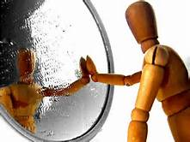
Seeing Yourself in Those You Serve
Service Learning and the Dental Hygiene Program.
Serving Diverse Communities Conference
Columbus State Community College
3/31/2017
Constance Clark, M.Ed., RDH
Daniel B. Collins, DDS, MPH

Slide 2
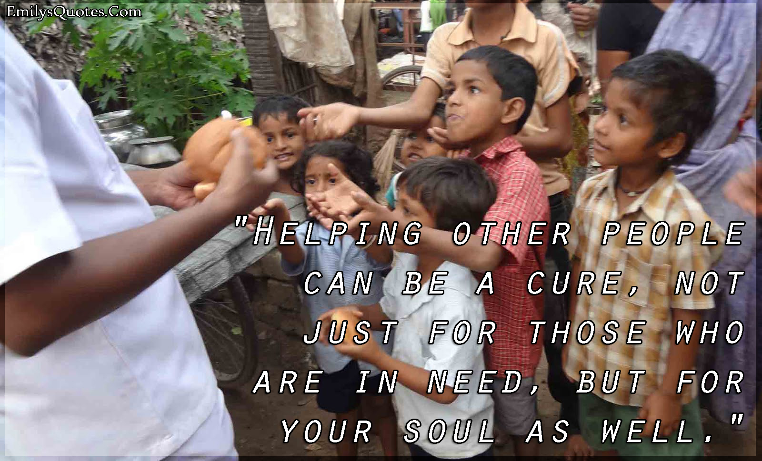
What is Service Learning?
We will be discussing:
What is service learning?
What is different about a Service Learning Class?
What are the expected outcomes from Service Learning?
How the students change?
How are the outcomes measured?

Slide 3
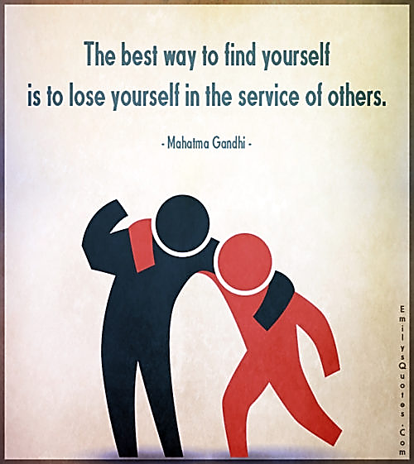
Activity
Silent Card Pass
Answer in one short sentence/phrase describing what you think of when someone says ‘Service Learning’.
Pass the card to your left.
Read previous answers and add your own.
When card returns to the start we will share some of the ideas expressed, and how others answers may have changed your thoughts.

Slide 4
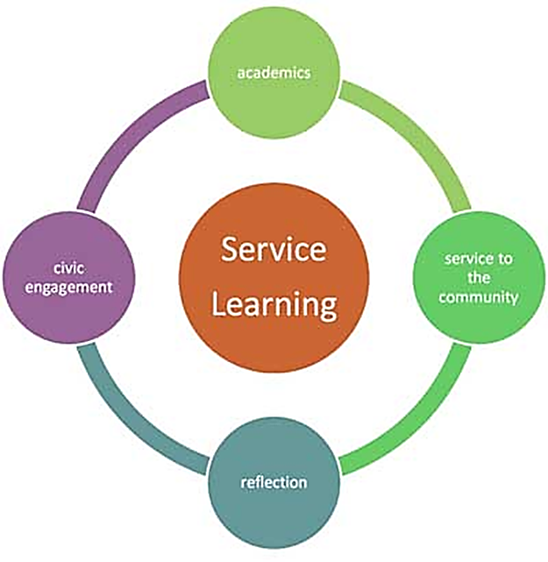
What is Service Learning
“a teaching and learning strategy that integrates meaningful community service with instruction and reflection to enrich the learning process, teach civic responsibility, and strengthen communities.” (Learn and Serve)

Slide 5
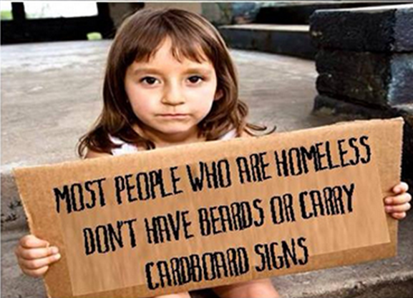
A Service-Learning class has:
COMMUNITY ENGAGEMENT:
Uses experiential strategies characterized by student participation in an organized service activity
SERVICE:
Engages in service that meets identified community needs
ACADEMICS:
Connects service to specific learning outcomes
REFLECTION:
Provides structured time for students to analyze and connect the service experience to learning

Slide 6
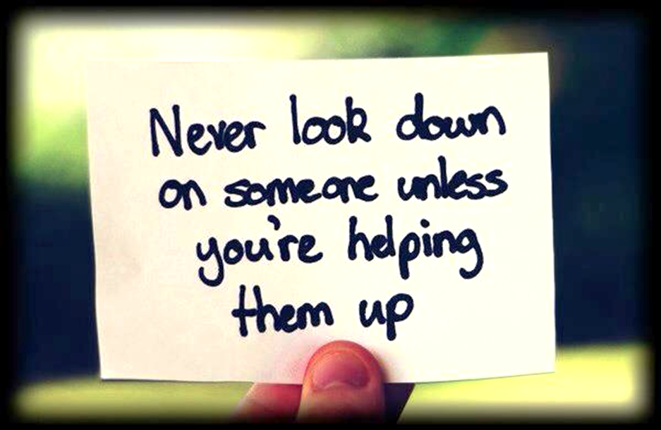
What is different about a Service Learning Class?
Inclusive experiences.
Challenges and rewards in integrating discussions of diversity in the classroom.
Identifying on-campus or off-campus organizations that address a social justice topic or need.
Real world application.
Notes:
Inclusive learning fosters an atmosphere where all participants feel comfortable enough to add to the discussion, voice their own thoughts and ideas and ask a variety of questions. An inclusive learning environment embraces the fact that everyone has a different style of learning and learns at their own pace

Slide 7

Community Engagement
Our Partners
Faith Mission of Lutheran Social Services
Columbus Public Health/PrimaryOne Health
  Dental/Physician’s Care Connection
Columbus Public Health School-based Dental Sealant program
Nationwide Children’s Hospital

Slide 8

Community Engagement
Dental Sealant Program Columbus Public Health
Dental caries (tooth decay) is the single most common chronic childhood disease. (Healthy People 2000, 2010, 2020)
Even though tooth decay can be prevented, 51 percent of Ohio schoolchildren had a history of tooth decay in their primary (baby teeth) or permanent teeth.
Fortunately, 49 percent of Ohio’s schoolchildren had a dental sealant on at least one permanent (adult) molar. (ODH)
Charlotte-Mecklenburg Schools
Notes:
How do we identify what engagement needs to happen? Example.

Slide 9
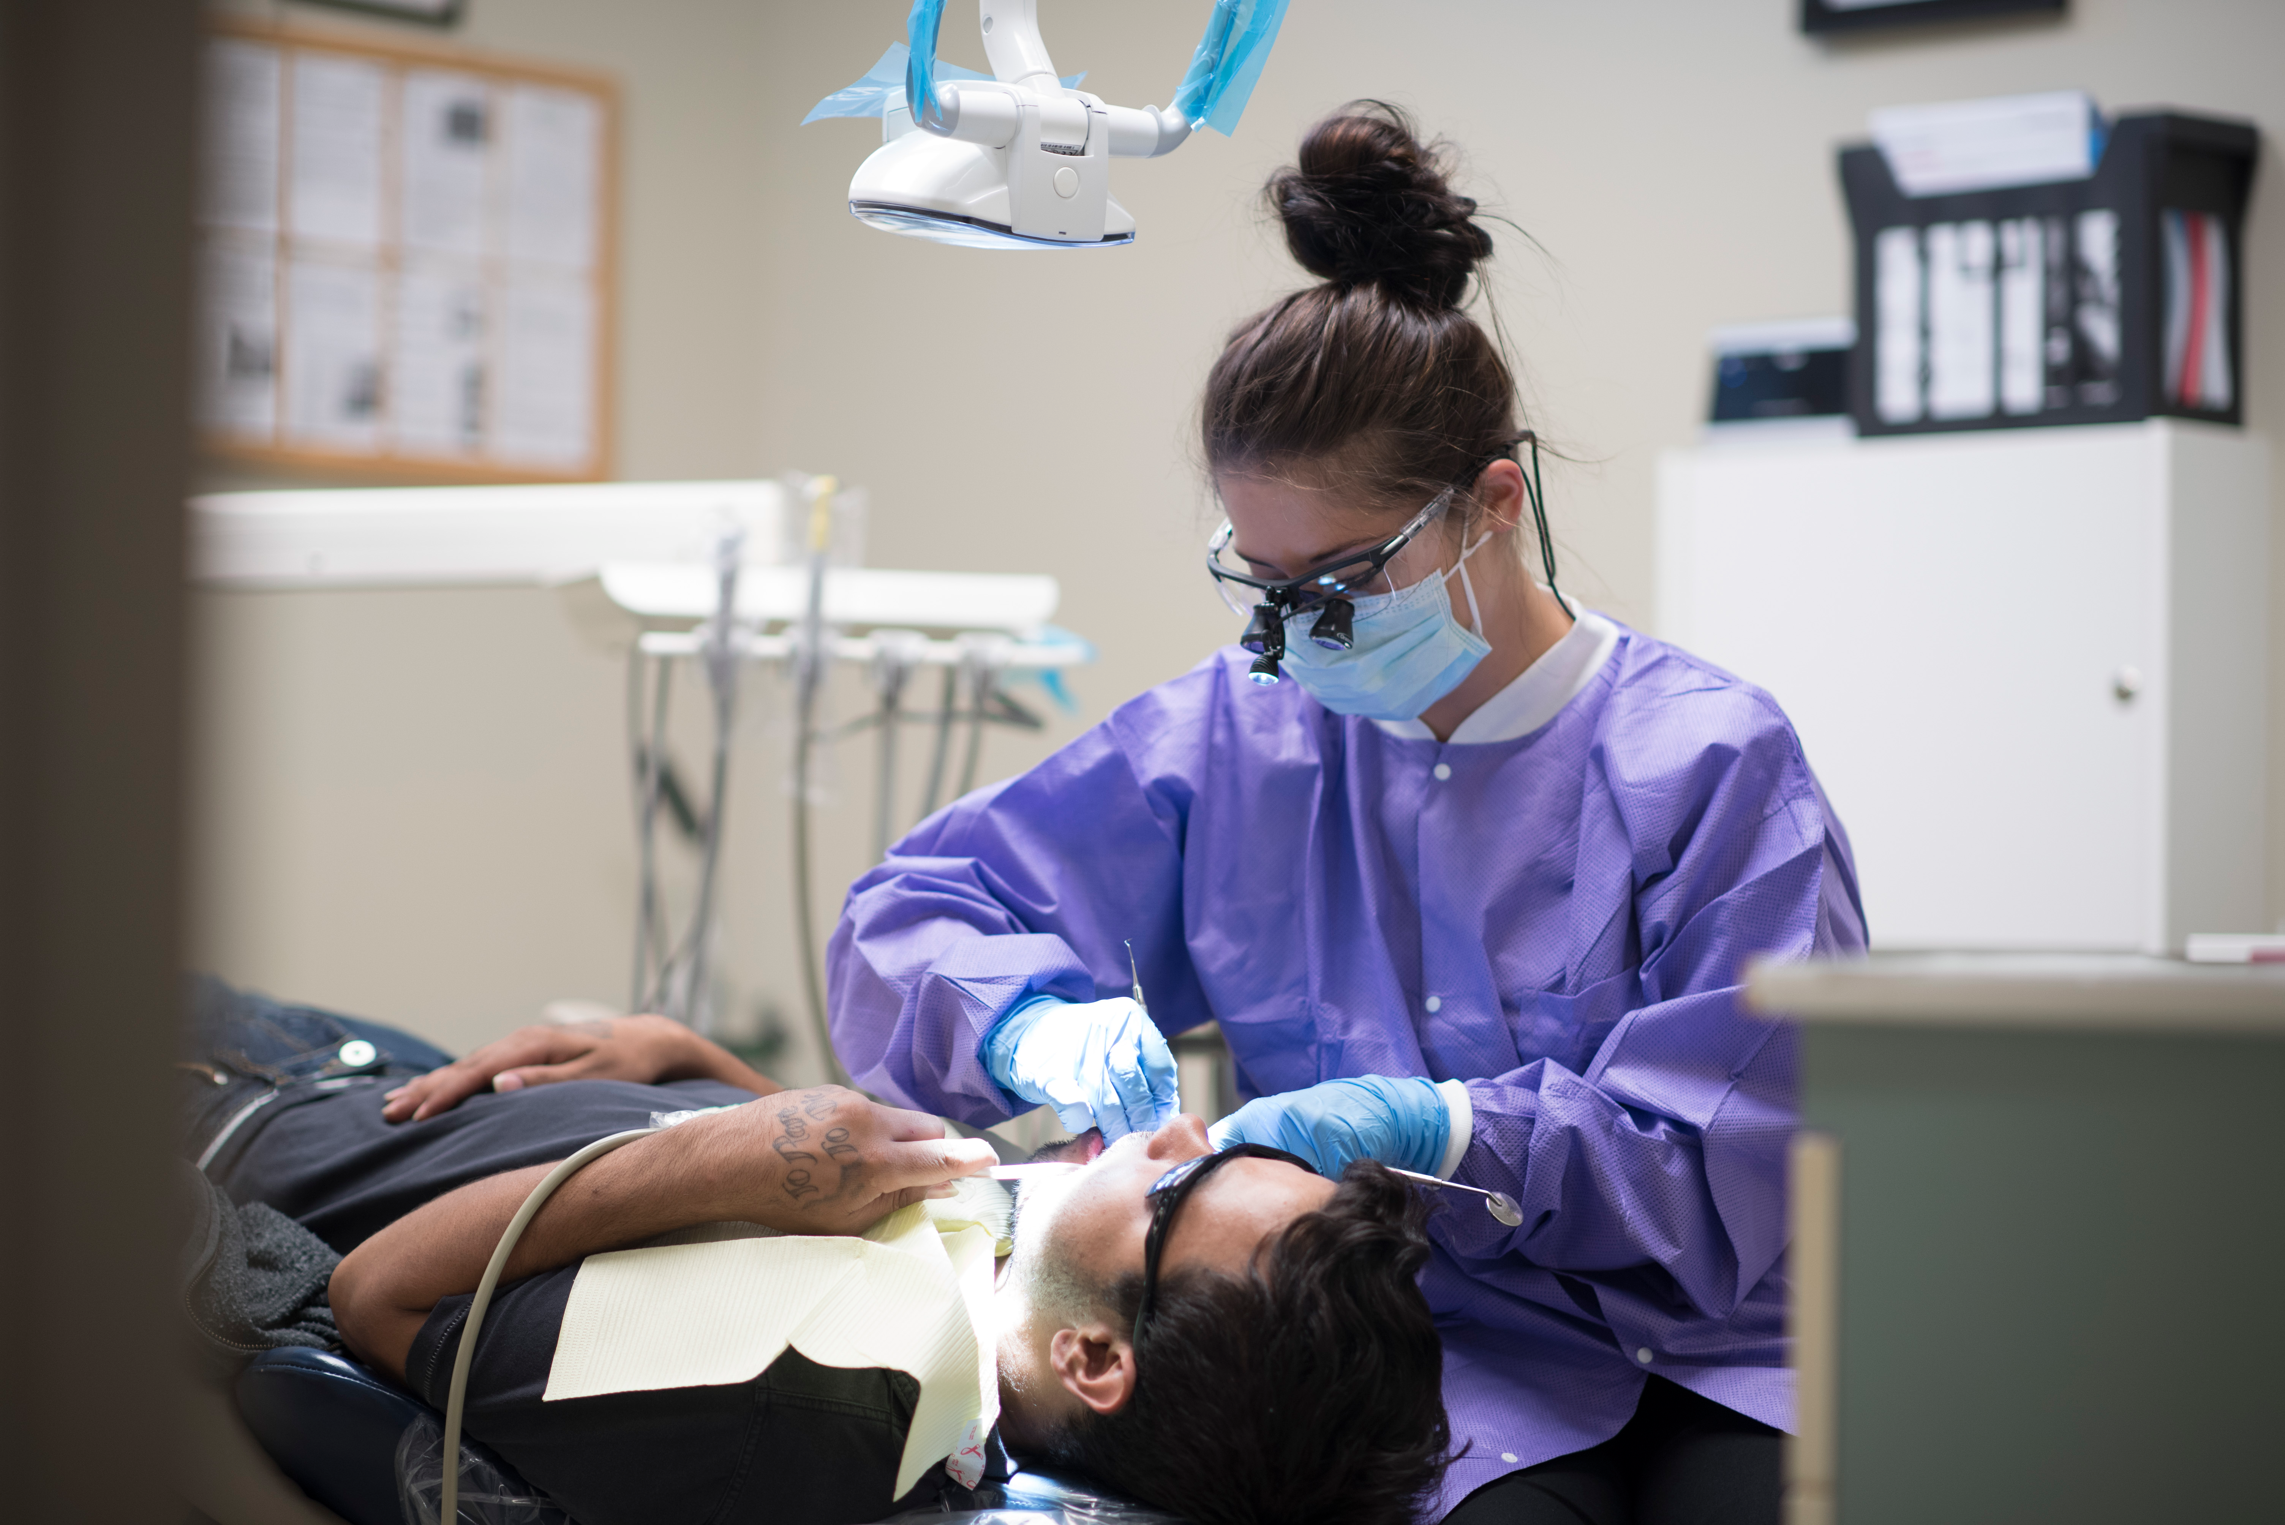
Service
Faith Mission of Lutheran Social Services
The homeless face multiple obstacles to health care, dental care in particular.
Students provide dental cleanings.
Needs of individual patients vary greatly.
Many are medically compromised
Notes:
Faith Mission is expanding their ability to provide dental treatment, but currently they rely solely on volunteers and our students. Limitations due to space and cost of faculty supervision.

Slide 10

Academics
Commission on Dental Accreditation
Standard 2.17
  Competence in managing a diverse patient population
  Communication skills for success in a multi-cultural environment
Standard 2.12
  Competence in assessing needs of special needs patients

Slide 11
Academics
Pediatric Notebook
Create a pediatric notebook. This is not original work. Students may include pamphlets, articles, pictures, etc. that will enhance the overall presentation…... The notebook should include a variety of topics related to pediatric care. At least 20 topics should be included. The included information should be factual and evidence based. The information should be easy to read and enhanced with pictures. Graduates have indicated the notebook was very helpful to the parents of children being treated. While the dental hygiene student is attending to a child, the parents can view the notebook to learn about care of the pediatric patient.
Notes:
One of the most interesting findings of our study is the positive effect that participating in service has on all the academic outcomes: growth in critical thinking and in writing skills and college GPA (grade-point average). Vogelgesang & Astin, 2000.

Slide 12

Reflection
Online Journaling
“Faith mission is a very rewarding experience, because we get the opportunity to help those in need. Each of my visits at faith mission were very positive experiences!” Michelle B.
“This rotation made me realize that I not only gain clinical skill to make me become a more competent practitioner but also become more knowledgeable about the community health issues and the service and social responsibility in this profession.” Mindy N.

Slide 13
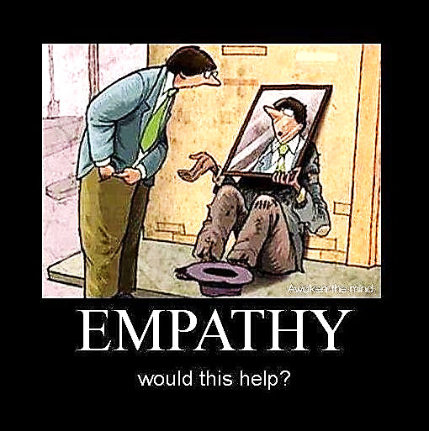
Activity
Can you see yourself in those you serve?
When I see a person panhandling on the street or sleeping on the sidewalk or a doorway I think…….
  1.
  2.
  3.
https://www.youtube.com/watch?v=q-j36_9xPGY
https://www.youtube.com/watch?v=8eNPAH46oI8
Notes:
Reflect on things that come into your mind when you see this or comments you have heard others make, good or bad.

Slide 14


Slide 15
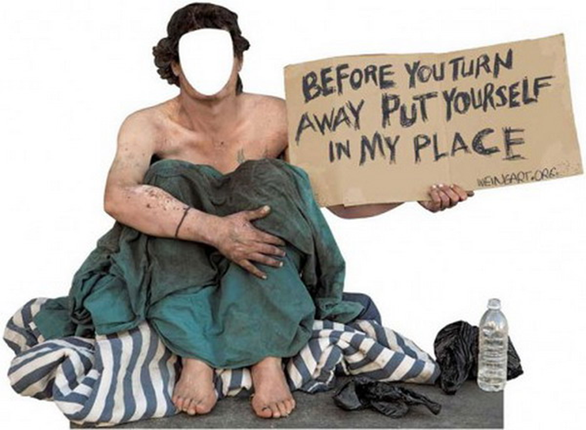
How do the students change?
Attitudes
“Program assistance is needed for these folks, for a variety of reasons which are not indicative of their desire to be healthy, their personal habits, or their character… Residential status is not representative of one’s humanity.” Samantha P.

Slide 16
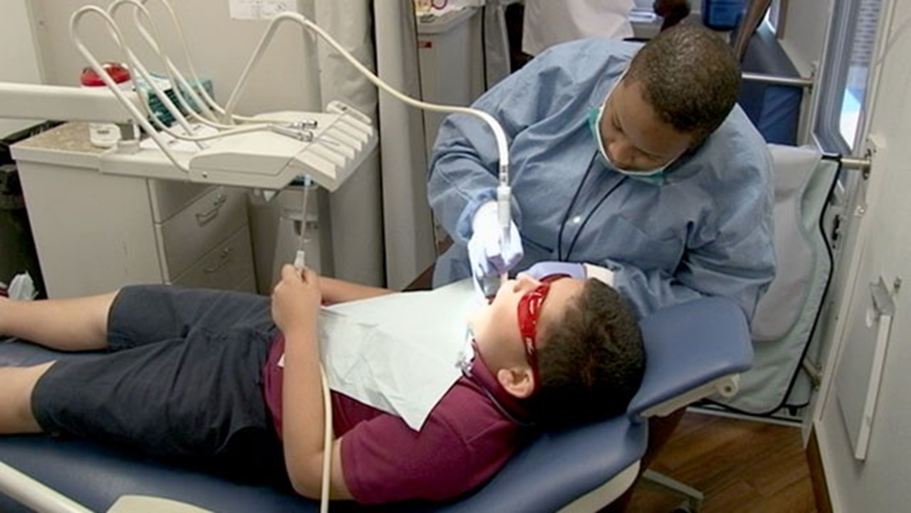
What are the expected outcomes from Service Learning?
Goals and Objectives
Children’s Hospital
  The student will be able to list and describe behavior management principles in dentistry to obtain and maintain children’s cooperative behavior during delivery of oral health care.
  The student will be able to describe the principles of effective communication that necessarily are tailored and compatible with a child’s mental and emotional development.
“My rotation at children's …was very rewarding and helped me learn a lot. My first patient had a fistula …. they wanted to extract that tooth. It was nice because she wanted me to be in there with her and watching the workers work with the children was awesome. They were so good with the kids and knew exactly how to talk to them and what to do to get them to cooperate.” John H.

Slide 17
“The Children's Rotation gives the students an opportunity to experience the diversity and socioeconomic differences that exist in our community. At the end of their rotation, students see how educating and customizing treatment for a child can help change the families perspective on the importance of dental health.”
Michell Ivory, RDH
Nationwide Children’s Hospital
Dental Clinic

Slide 18
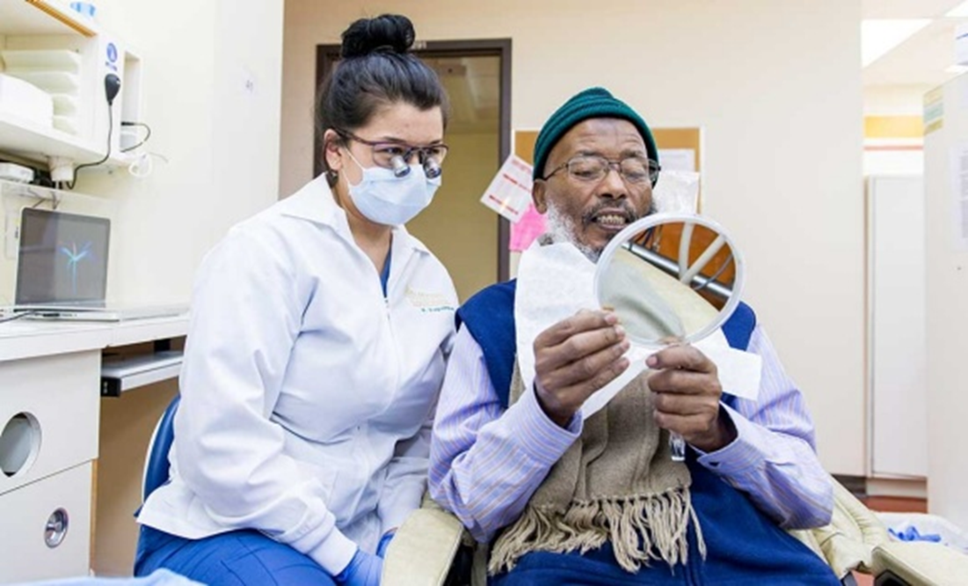
What are the expected outcomes from Service Learning?
Faith Mission of Lutheran Social Services
The student will experience providing treatment to the underserved population in a public health setting.
  “The patient was reluctant to share what medications that he was taking and then stumbled to explain what they were for. It was actually nice to feel confidant to say that I was familiar with the medications, and that they didn't have to explain if he didn't want to.” Kayla B.
  “I had … at Faith Mission ….. middle aged male who have not been to dental for a awhile and was taking medications for bipolar depression and schizophrenia.” Chanel S.
https://www.dal.ca/faculty/dentistry/news-events/news/2015/04/24/dental_hygiene_students_help_nova_scotia_s_immigrant_population.html

Slide 19

What are the expected outcomes from Service Learning?
Columbus Public Health
The student will experience providing treatment to the underserved population in a public health setting.
Demonstrate commitment to community service by participating in the rotation of the Columbus Health Department Sealant Program.
  “It was nice to meet the amazing staff, asking them, and observing the greatest services that they provide to prevent the epidemic caries disease and spread the facts about the significance of prevent it for the young kids and their family. I really would like to be with them in the future to be a part of that community service team who deserve the respect and provide the suitable support.” Bann G.

Slide 20
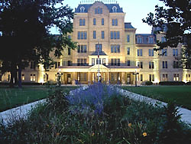
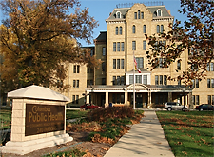
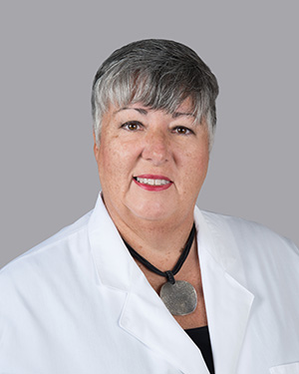
“This experience helps them begin the transformation from hygiene student to hygienist.
It is a pleasure to see the student engage the clinic staff in questions about real world application of their education.”
Deani Deskins-Knebel, DDS
Dental Director
PrimaryOne Health
Columbus Public Health

Slide 21

“My experience with the Columbus State dental hygiene students at the Dental Care Connection and our Primary One Dental Clinic has been very rewarding. The students have arrived well prepared, self-assured and ready to treat patients.
My hope is that their experience here was a “window to the world”, treating people of all cultures and diversities, and that the students gained some knowledge on how our clinic provides care for those who struggle to find affordable quality dental care for themselves
and their families.”
Deborah L. Ashcraft, CDA
Columbus Public Health

Slide 22
“You serve seniors and veterans, immigrants and indigent
Recoverees, survivors and the occasional malcontent
By Spring each patient becomes your opportunity
To give of your mind and skill to our vast community
Oh how you’ve grown, it was my pleasure to tag along
Make your future about ‘giving’ and our profession will stay strong”
Marilyn Nelson, RDH
Columbus Public Health
Notes:
In the Fall I see your apprehension
The unknown undoubtedly causing tension
You glance at a tray wondering “where do I start”
Breathe deep a few times to stop a racing heart
As you clean a mouth that has not been cleaned before
You sit closer to explain what the patient has ‘in store’
There can be tartar as thick and as hard as cement
And stain covering areas that will defy an instrument
You serve seniors and veterans, immigrants and indigent
Recoverees, survivors and the occasional malcontent
By Spring each patient becomes your opportunity
To give of your mind and skill to our vast community
Oh how you’ve grown, it was my pleasure to tag along
Make your future about ‘giving’ and our profession will stay strong

Slide 23
Community Service
Interpreter use
2-15 Graduates must be competent in communicating and collaborating with other members of the health care team to support comprehensive patient care.
Intent:
The ability to communicate verbally and in written form is basic to the safe and effective provision of oral health services for diverse populations. Dental Hygienists should recognize the cultural influences impacting the delivery of health services to individuals and communities (i.e. health status, health services and health beliefs). Students should understand the roles of members of the health-care team and have educational experiences that involve working with other health-care professional students and practitioners.
Examples of evidence to demonstrate compliance may include:
• student experiences demonstrating the ability to communicate and collaborate effectively with a variety of individuals, groups and health care providers.
• examples of individual and community-based oral health projects implemented by students during the previous academic year
• evaluation mechanisms designed to assess knowledge and performance of interdisciplinary communication and collaboration

Slide 24
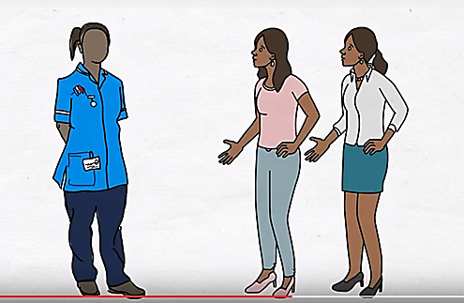
Community Service
Interpreter use
Students have opportunity especially at The Ohio State University College of Dentistry and at Columbus Public Health.

Slide 25

Interpreter interaction
What are some basic rules
Introduce yourself.
Always look at the patient, not the interpreter. Speak to the patient.
Don’t talk louder, talk more slowly.
Avoid idioms, and explain any technical language.
Speak in short segments, no long complicated sentences.
Remember the interpreter may have to explain ideas in different terms because there is no equivalent to the English word used.
Remember the interpreter is telling the patient exactly what you are saying.
Avoid condescension.
Be patient. They are being patient with you.

Slide 26
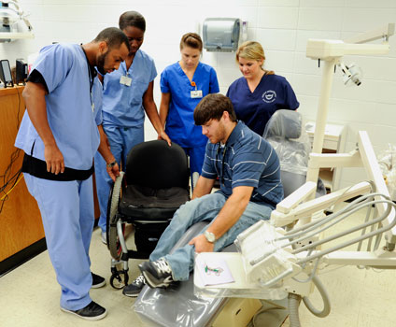
Expected Outcomes
Experience
Faith Mission 3 half days for 3 semesters
  Average 4.5 patients over program
Columbus Public Health 2 half days for 2 semesters
  Average 5 patients over program
Children’s Hospital 3 half days for 2 semesters
  12 child or adolescent patients over program
Can account for ~20% of patient contact requirement

Slide 27
Expected Outcomes
Measuring or Assessing
Journal Reflection
Observation
Exit interview prior to graduation

Slide 28
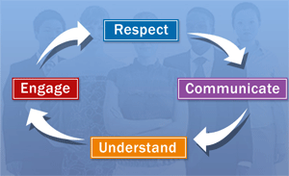
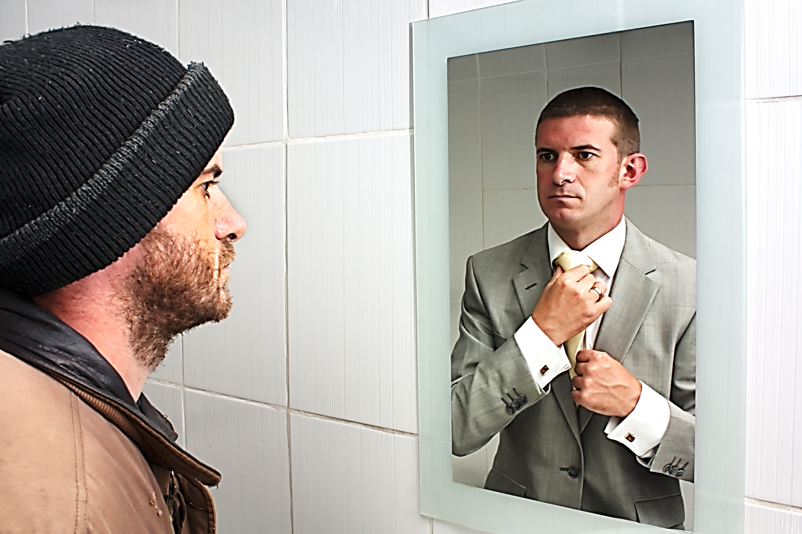
Summary
Ultimately looking for a change in attitude
Can you see yourself donating your time in the future?
  Why?
Do you think that your experiences have changed your perspective?
  How?

Slide 29

Questions?
Thank you for your attention
Connie and Dan

Slide 30
References
Vogelgesang, L., & Astin, A. (2000). Comparing the effects of community service and service-learning. Michigan Journal of Community Service Learning, 7(1), 25-34.

