Slide 1
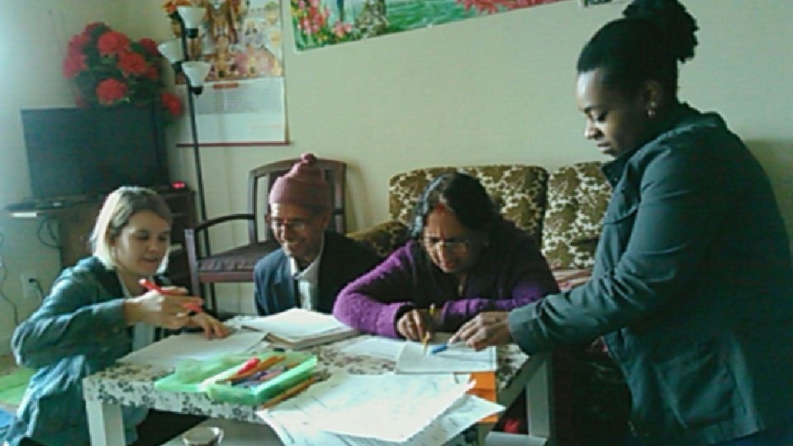
Exploring a Long Term Service Project with Refugees
Rizz Dickson, Amy DeLorenzo & Reilly Linehan
they/them/their she/her/hers he/him/his
Notes:
A group of second-year Interpreter Education Program (IEP) students have been engaged in a long-term service-learning project that spans Autumn 2016 and Spring 2017. In partnership with Community Refugee and Immigration Services (CRIS), IEP students provide tutoring in basic English literacy and U.S. Civics to assist refugees with passing their U.S. Naturalization Test. This workshop will bring together multiple perspectives for a roundtable discussion about the challenges and successes of this long-term project. Perspectives will include: refugee recipients of service, student participants, the course instructor, the Americorps Vista Service-Learning Coordinator, and the Service-Learning Advocates who have been assisting with the project. Participants will learn about the urgent need for service in refugee communities, and explore potential opportunities for serving refugees through service-learning projects.
Three learning objectives for participants:
1. Participants will understand how service-learning can be mutually beneficial for our community and our students.
2. Participants will examine an example of a two-semester service-learning project with second-year IEP students.
3. Participants will understand the unique experience of serving refugee communities.

Slide 2

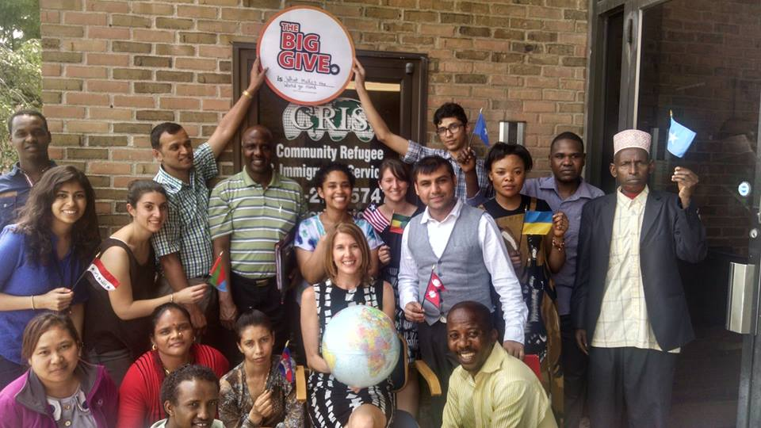
Community Refugee & Immigration Services
Narad Nepal & Erika Crawford
Notes:
II. Overview of CRIS program - Narad (5-10 min)

Slide 3
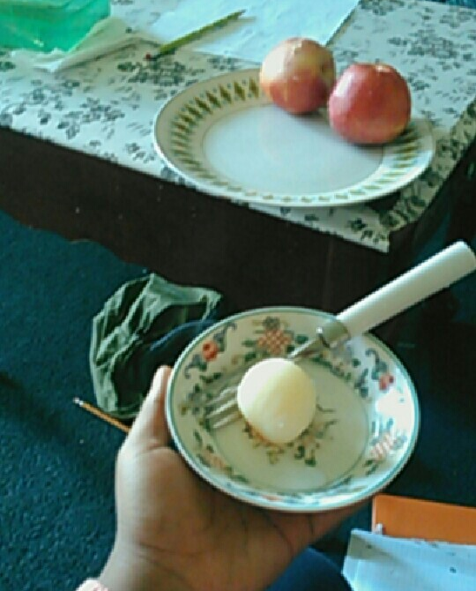
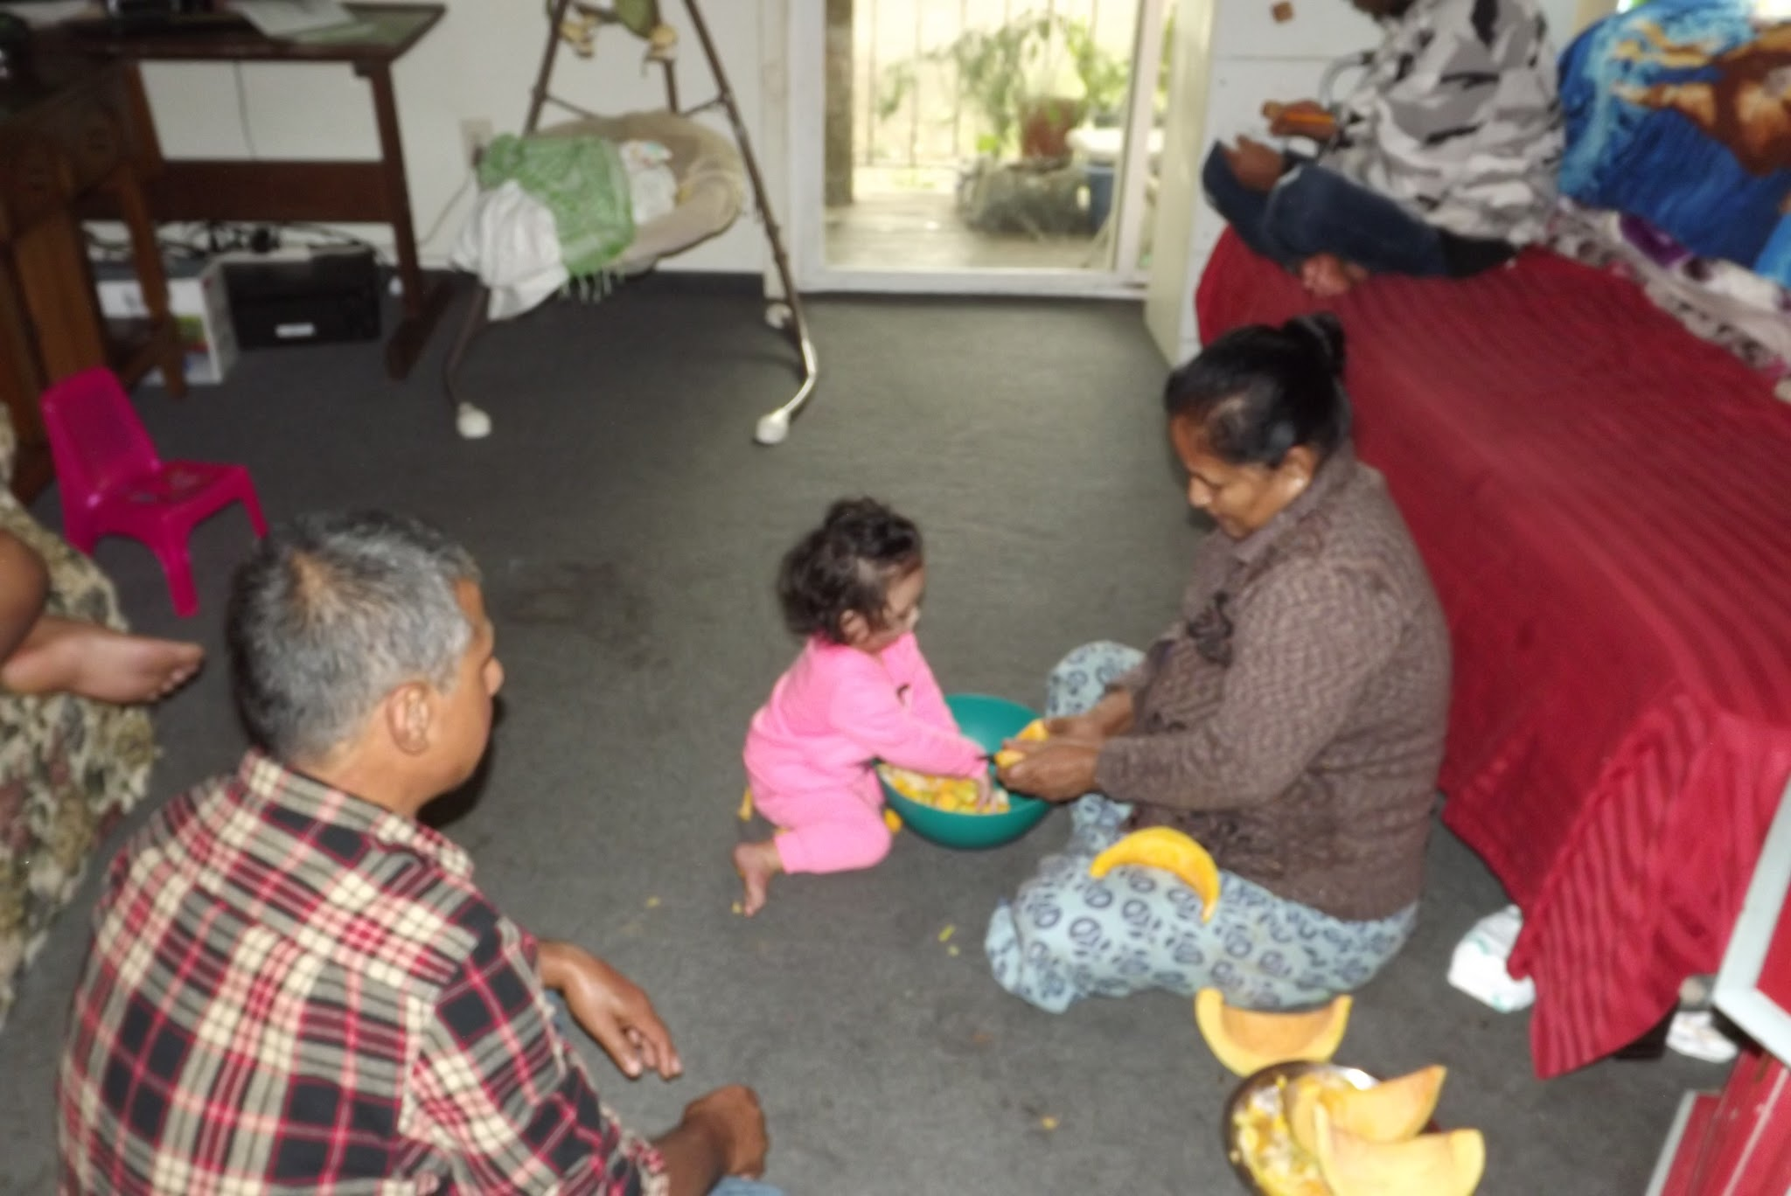
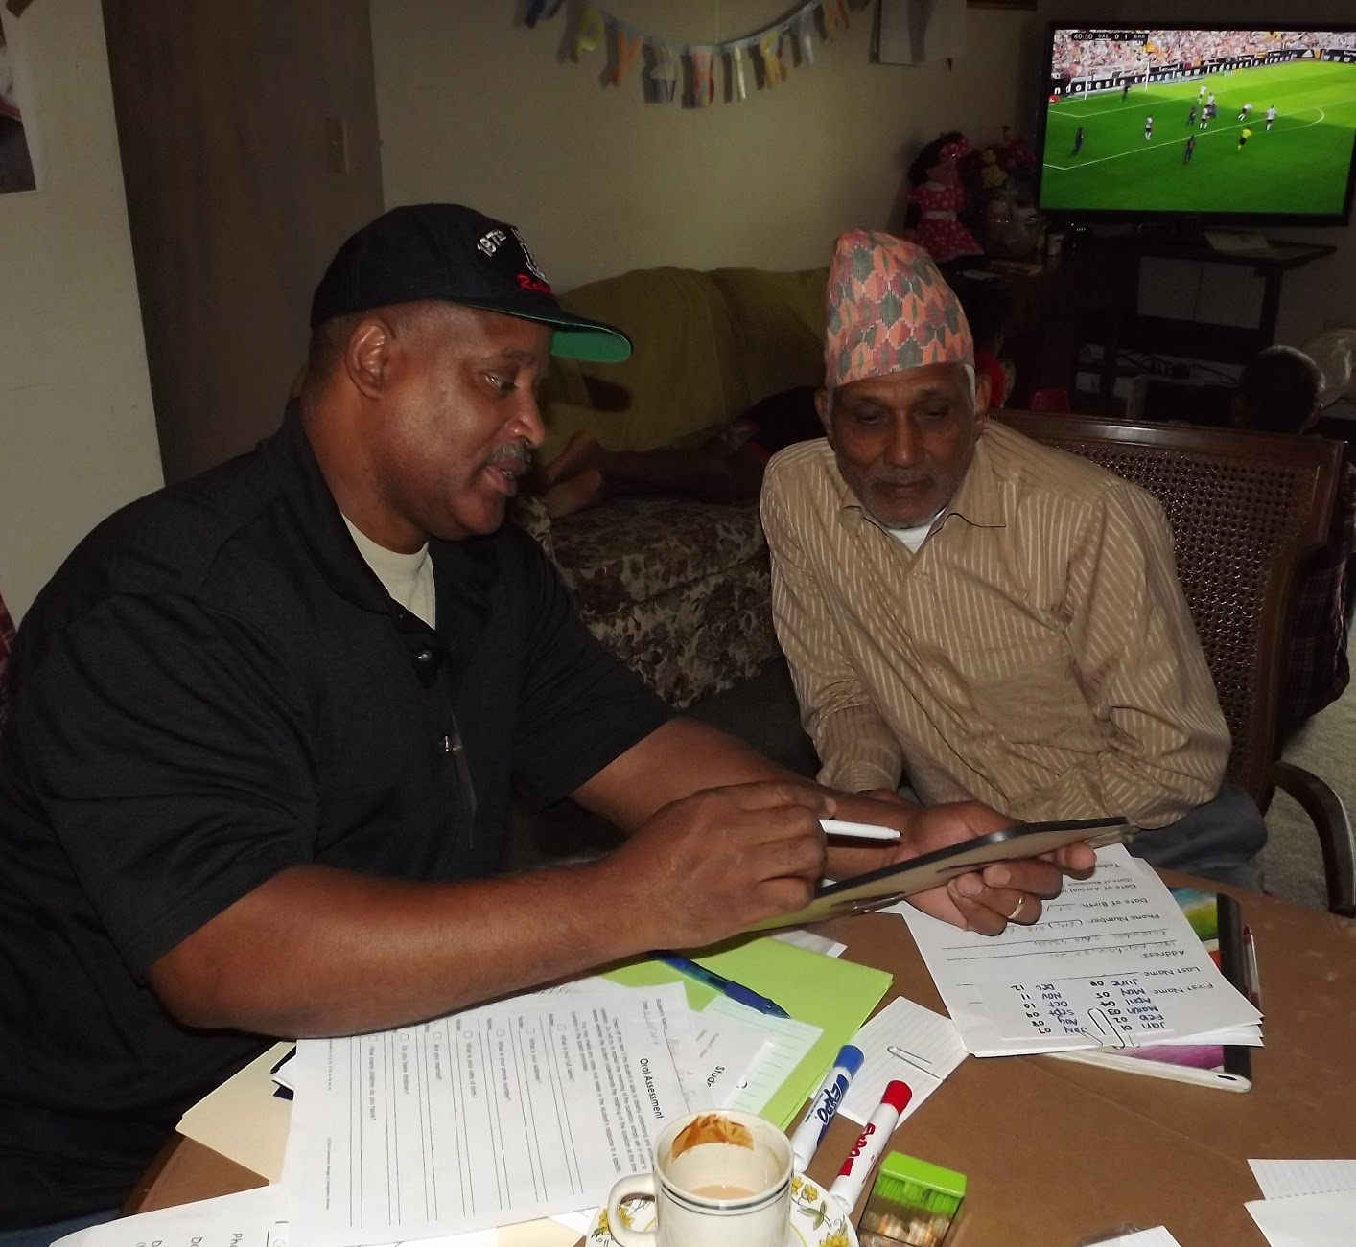
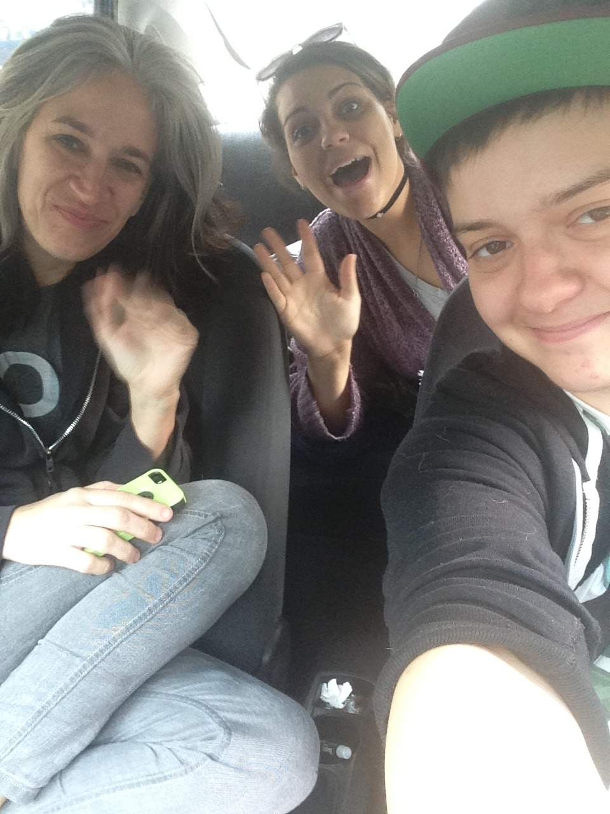
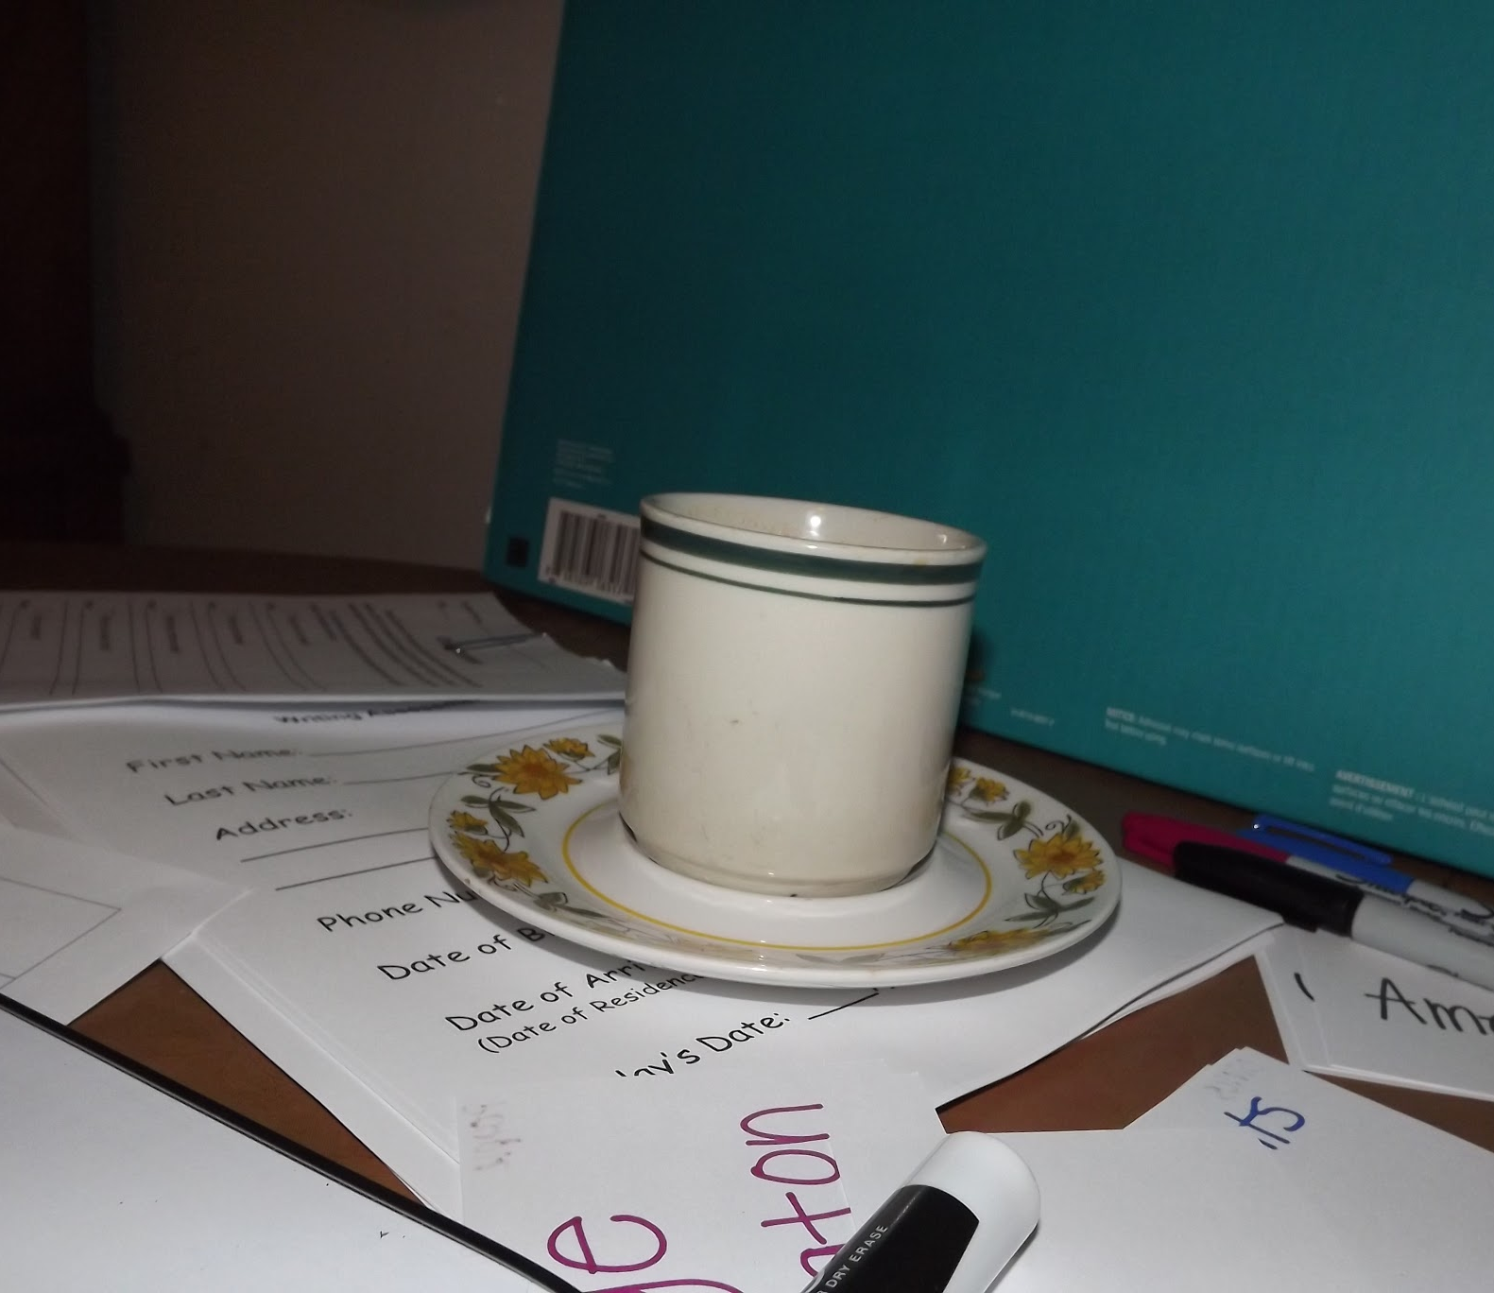
IEP 2403 & 2404
Notes:
Overview of what we did (10 min) - Rizz, Amy and Reilly
The classes involved
The community partner
The type of service
The connection between the service and learning objectives in the courses
The SLA’s responsibilities
Pictures of students in service
The Service-Learning Advocates have been responsible for serving alongside students and refugees, helping to coordinate the students’ schedules with the refugee’s schedules in order to find a time that works for them all to meet each week for U.S. Civics tutoring, following up with CRIS to make sure we are providing a high quality of service, troubleshooting service issues with students that involve language and cultural barriers, developing and facilitating reflection in class on a number of topics, including cultural humility, poverty, food insecurity, gentrification, trauma, navigating heatlhcare systems as a person with a language barrier, culturally bound syndromes and refugee advocacy.

Slide 4
Briefly introduce yourself and your connection to this service-learning project.
Notes:
III. Q&A of SLA’s, SL students, service recipients (both non-profit and individual refugees) (30 min)
Reilly is going to answer the question first and then ask the questions

Slide 5
Why is there a need for this type of service?
Notes:
III. Q&A of SLA’s, SL students, service recipients (both non-profit and individual refugees) (30 min)
Reilly is going to answer the question first and then ask the questions

Slide 6
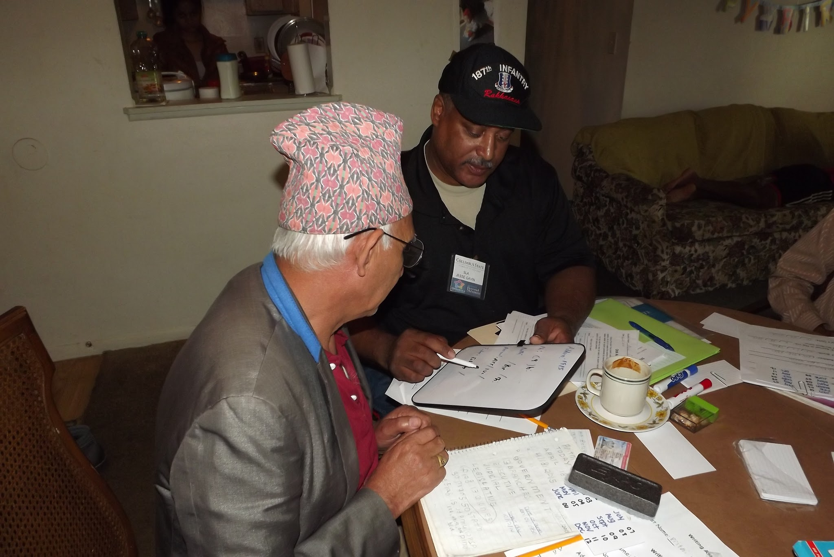
From your individual or organizational perspective, what are the most significant challenges of this service-learning experience?
Notes:
III. Q&A of SLA’s, SL students, service recipients (both non-profit and individual refugees) (30 min)
Reilly is going to answer the question first and then ask the questions

Slide 7
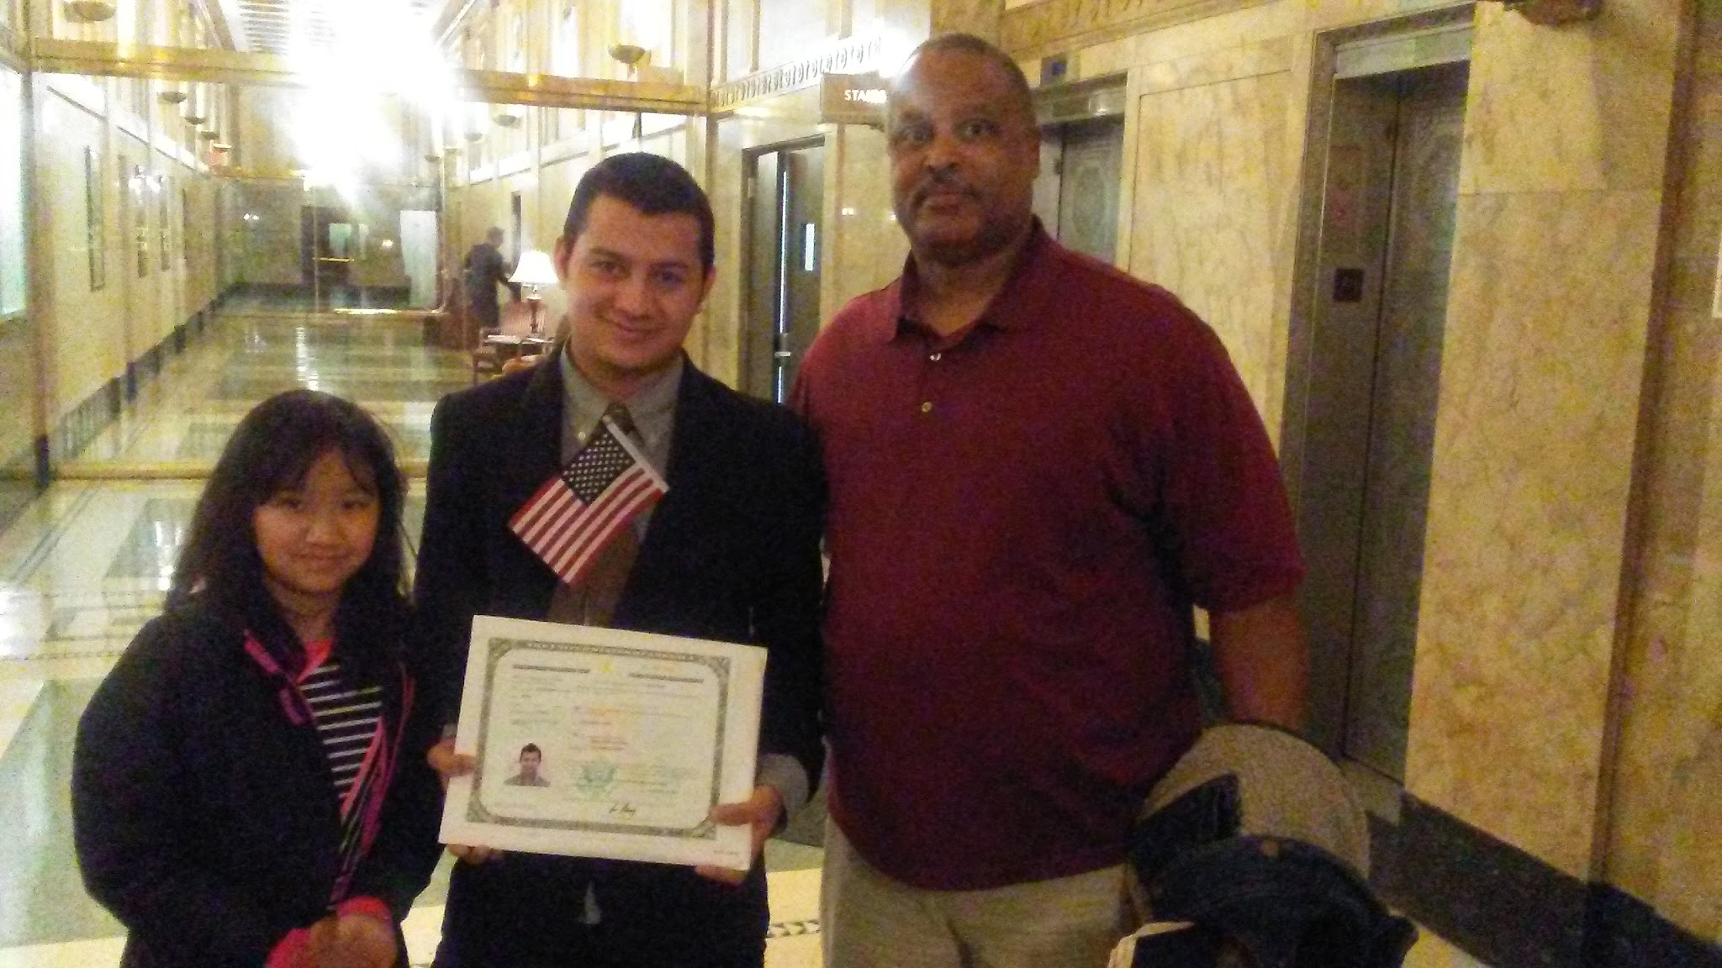
From your individual or organizational perspective, what are the most significant successes of this service-learning experience?
Notes:
III. Q&A of SLA’s, SL students, service recipients (both non-profit and individual refugees) (30 min)
Reilly is going to answer the question first and then ask the questions

Slide 8
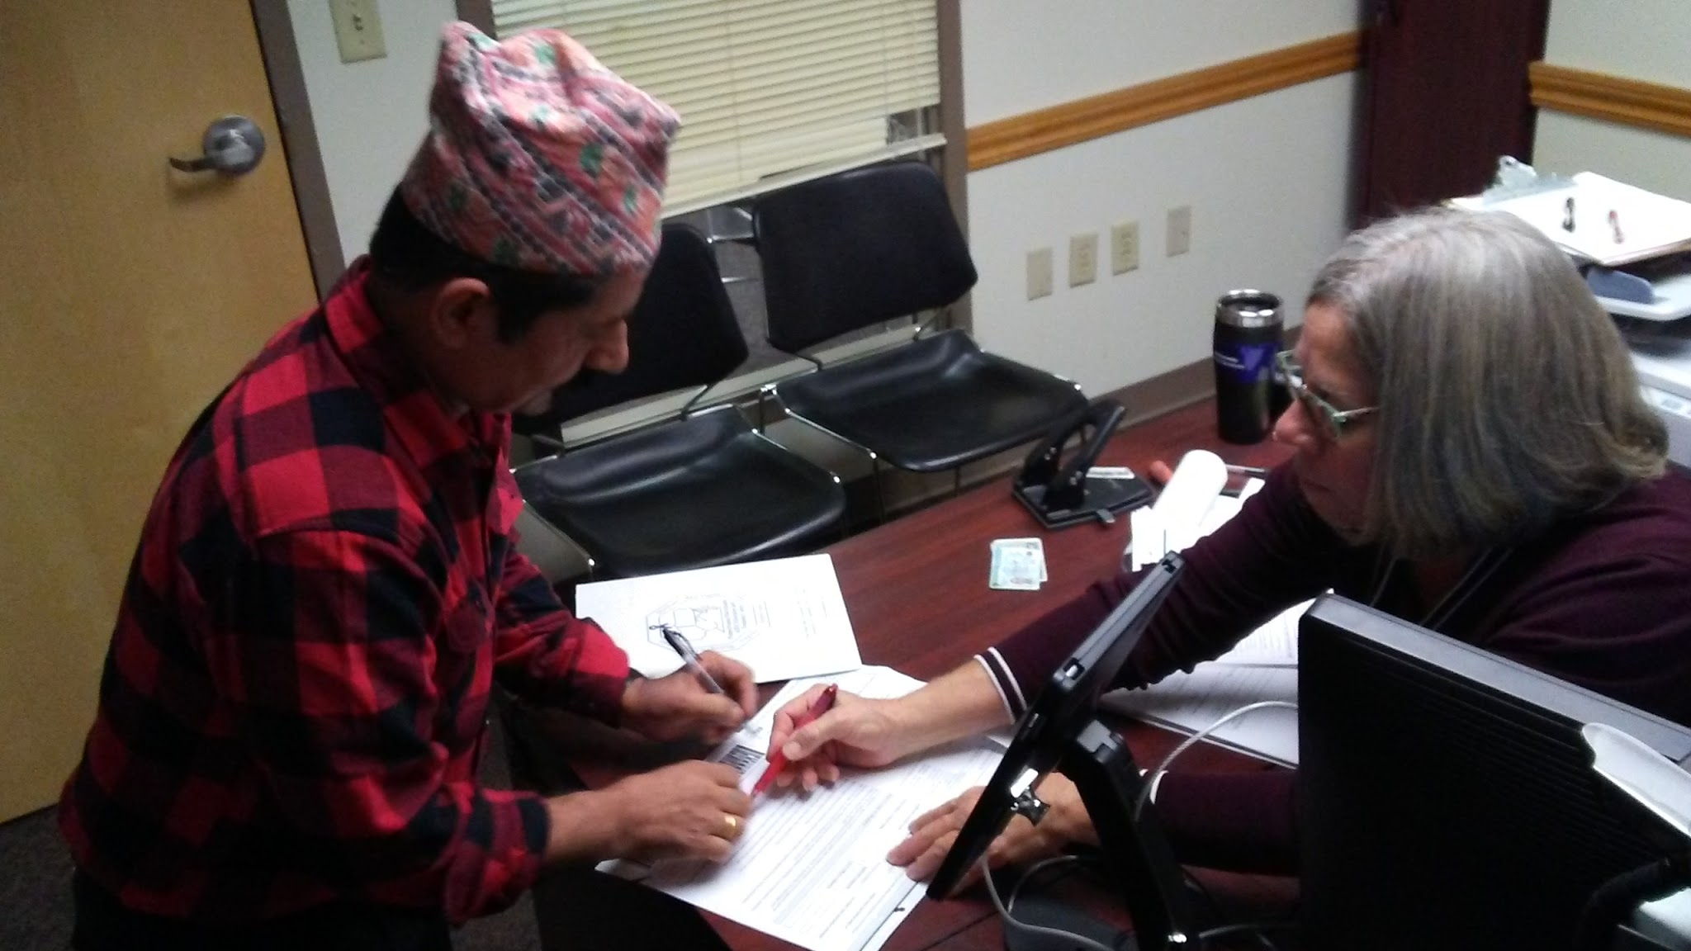
What have you or your organization learned through this service-learning experience?
Notes:
III. Q&A of SLA’s, SL students, service recipients (both non-profit and individual refugees) (30 min)
Reilly is going to answer the question first and then ask the questions

Slide 9
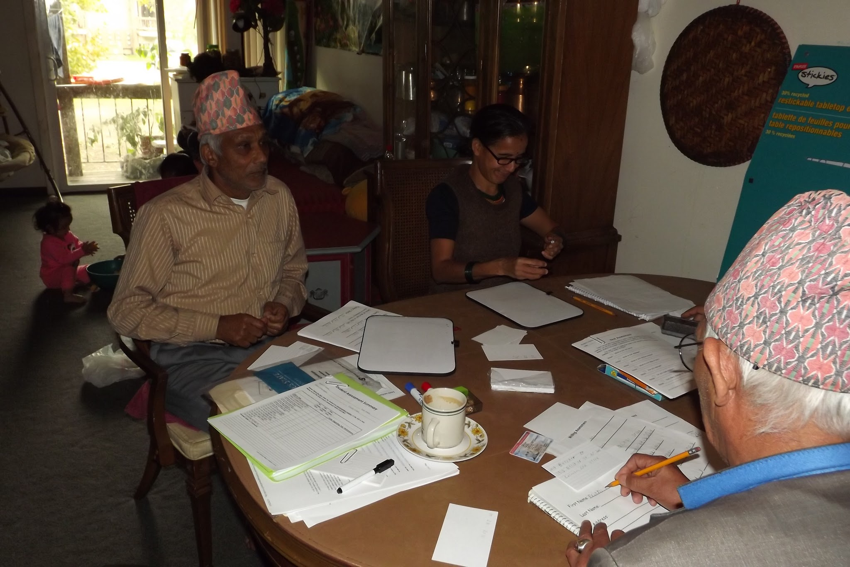
What recommendations do you have for improving this service-learning experience for all involved?
Notes:
III. Q&A of SLA’s, SL students, service recipients (both non-profit and individual refugees) (30 min)
Reilly is going to answer the question first and then ask the questions

Slide 10
?
QUESTIONS?
sladvocates@cscc.edu
?
Notes:
IIII. Q&A (10 min)
A group of second-year Interpreter Education Program (IEP) students have been engaged in a long-term service-learning project that spans Autumn 2016 and Spring 2017. In partnership with Community Refugee and Immigration Services (CRIS), IEP students provide tutoring in basic English literacy and U.S. Civics to assist refugees with passing their U.S. Naturalization Test. This workshop will bring together multiple perspectives for a roundtable discussion about the challenges and successes of this long-term project. Perspectives will include: refugee recipients of service, student participants, the course instructor, the Americorps Vista Service-Learning Coordinator, and the Service-Learning Advocates who have been assisting with the project. Participants will learn about the urgent need for service in refugee communities, and explore potential opportunities for serving refugees through service-learning projects.
Three learning objectives for participants:
1. Participants will understand how service-learning can be mutually beneficial for our community and our students.
2. Participants will examine an example of a two-semester service-learning project with second-year IEP students.
3. Participants will understand the unique experience of serving refugee communities.

