Slide 1
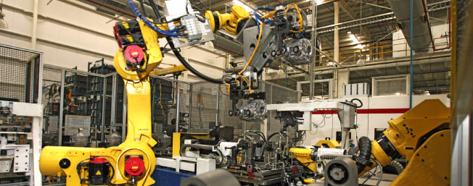
Modern Manufacturing Work Study

Slide 2
Manufacturing and the Future:
In the next decade, there will be a need for more than 3.4 million manufacturing jobs.
Because of an aging workforce and continued job creation, 2.0 million of those jobs – nearly 60% – will go unfilled because prospective employees lack interest or essential skills.
Study by Deloitte and the Manufacturing Institute

Slide 3
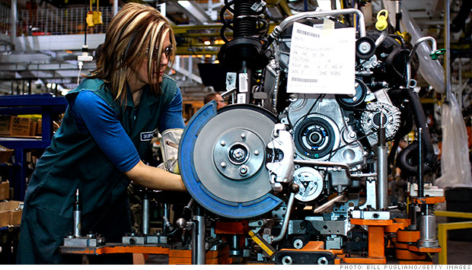
Working together to make manufacturing happen:
Engineering Technicians
Engineers
Maintain manufacturing equipment
Troubleshoot and resolve electrical and mechanical equipment failures
Installation of new equipment
Design
Research
Development
Notes:
Stamping presses/dies, plastic injection molding presses/dies, casting dies, overhead cranes, lasers
Conveyors, lifts, robots, servo systems, PLCs, CNCs

Slide 4
The Program: Work Study
An Associates of Applied Science in Electro-mechanical Engineering Technologies at Columbus State paired with three semesters of job experience
CSCC
Electro-Mechanical Engineering Technologies
Career in Industry
High School

Slide 5
Path to Industry
High School
College
Work Study
Career
College credits
earned
during H.S.
Summer Advance Automation Institute
Basic DC Electronic Systems
Basic Digital Sys.
Intro to Eng. Tech.
Eng. Graphics
Manufacturing
Plant Tour
CSCC
IST Experience
Electro-Mechanical Engineering Associates Degree
First
Semester
Second
Semester
Summer
Semester
Fourth
Semester
Fifth
Semester
First Year Exp.
English
Math
Basic Mech. & Drives
Motors & Control Logic
Physics
Control Logic & PLCS
Robotics
Intro to Welding
Basic AC Elect. Sys.
Computer Appl.
Tech. Writing
Manu. Mat. & Processes
CAD I
Data Acquisition Sys.
Machine Tools
Social & Behavioral Sci.
Humanities
Interviews
BEGIN
WORK
STUDY

Slide 6
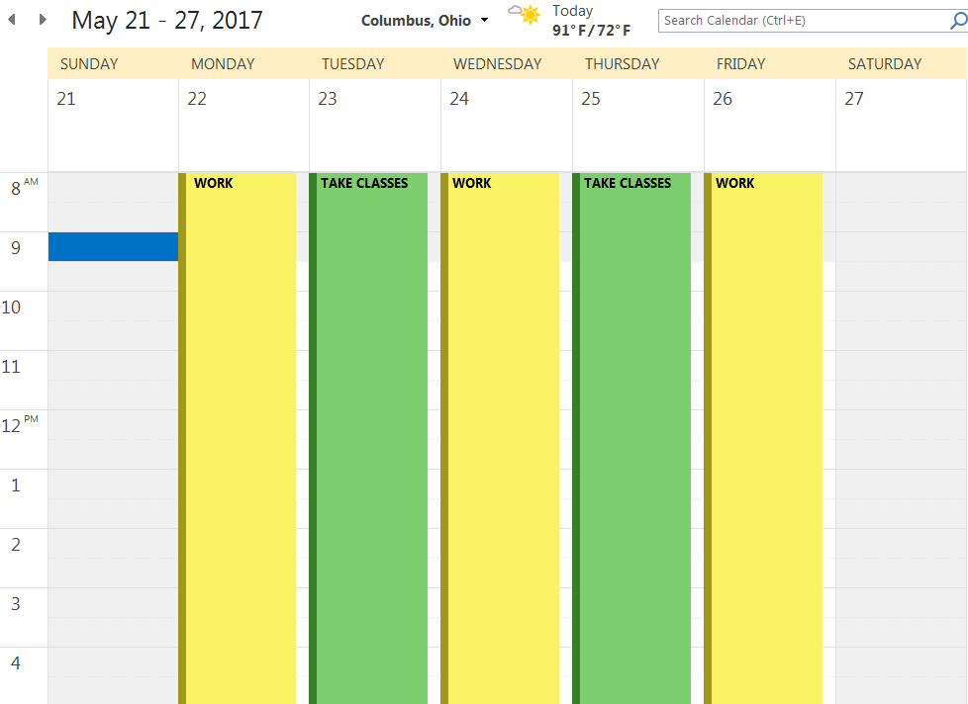

Slide 7
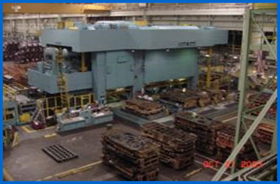
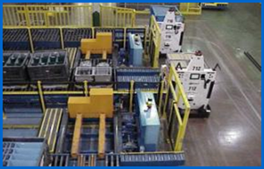
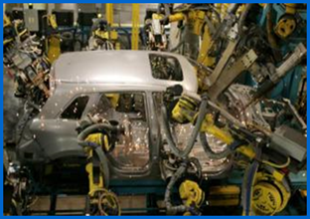
Why Pursue the Work Study Program?
The knowledge and hands-on experience gained will prepare you for the workforce
Build your resume
It’s paid!
Opportunity for future employment

Slide 8
Columbus State Community College

Slide 9
Columbus State Community College
Large college, small college feel!
Enrollment: 25,000 students
Average Class Size: 19 students (Engineering class can be as small as 12 students per class)
Urban Vibe:
Downtown Columbus (although we have branch campuses too!)
Diverse student/employee population
Notes:
More than 89 countries are represented in our student body

Slide 10
Dollars and Cents:
Pathways help students emerge from college with less debt because:
They earn a salary during the internship
Have employability upon graduation
May be eligible for tuition reimbursement once hired full time for future degree

Slide 11
Industry Partners

Slide 12
AUTOTOOL Overview

Slide 13
Student Experience
Project based
Bulk of our work is in the automotive industry working on lines for models that won’t hit the market for 2 years
50% Honda and Honda suppliers
Other 50% spread out through the rest of the automotive industry
Green-energy

Slide 14
Students will get experience in every step of the process
Mechanical design
Electrical Design
Robot Programming and Integration
Writing programs for CNC
Mechanical Assembly
Electrical Build
Watch an idea become a finished product
Notes:
* Starting salary: $13.00
o Average Salary for Mechanical Engineering Department: $62,000.00
o Average Salary for Electrical Department: $57,000.00
o Average Salary for Fabrication Department: $40,000.00

Slide 15
Autotool eligibility requirements

Slide 16
AUTOTOOL VIDEO

Slide 17
Honda Overview

Slide 18
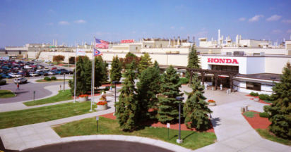
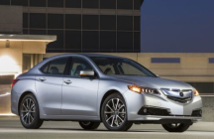
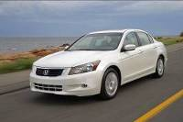
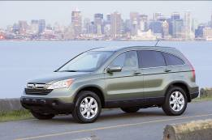
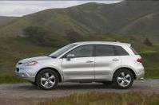
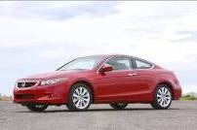
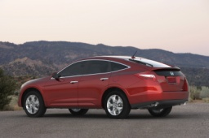
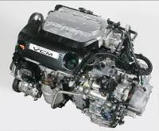
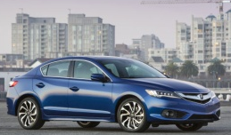
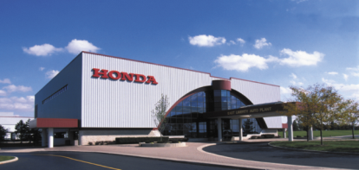
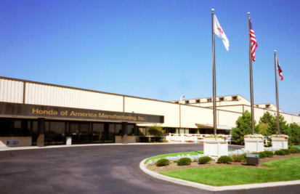
Products & Production
Honda of America Mfg.
Acura TLX
Accord Sedan
CR-V
Acura RDX
Accord Coupe
Accord Crosstour
L4 engines V6 engines
Acura ILX
Regional Headquarters
Sales & Distribution
Research and Development
Production (parts included)
Jet Business
Notes:
Automobiles | Powersports | Power Equipment | Marine | Racing | Robotics Technology | HondaJet
You can see from the legend at the left, that American Honda is our North American regional headquarters.
In the 50 years since American Honda was first established, Honda has expanded operations in North American in order to achieve our commitment to develop and build our products in the markets they are sold.
Today, Honda’s North American operations include:
production and engineering facilities, (red triangles)
sales offices, parts and product distribution centers (green circles)
and research & development operations (blue squares)
This map shows all of these and even includes Honda’s recently-established jet engine and aircraft business, whose locations are shown with the pink circles.

Slide 20
Student Experience
Hands-on assignments focused on learning and applying knowledge
Job shadow other professionals
Work with a mentor
Complete Individual Projects assigned by supervisor
Attend Training courses
Final Presentation

Slide 21
Eligibility Requirements
Enrolled in Associate’s degree in Engineering Technology
GPA: 3.0 or above
Sophomore level (Summer after Freshman year)
Ability to work part time (24 hours/week)
Must provide your own transportation to and from work; must have a valid driver’s license
Must commit to 3 semesters (contingent on performance and GPA)
Unlimited work authorization in the United States

Slide 22
Manufacturing recruiting video
Notes:
Honda’s Vision - Develop a new pipeline of potential candidates for technician positions
Benefit to Honda-
To provide Honda qualified students for development and assessment toward full-time employment consideration.
To provide college students with practical hands-on experiential learning.
Benefit to Student-
Gain hands-on work experience in your field of study
Discover your likes and dislikes
Evaluate company culture
Paid co-op position (starting at $16.33 per hour)
Experience and networking will build your resource pool
The knowledge you will gain is invaluable in your career and will prepare you for the workforce
Consideration for future employment opportunities

Slide 23
Bachelors Partnerships
Miami University
BS in Engineering Technologies
Franklin University
BS in Applied Management
Ohio University
BS in Applied Management

Slide 24
If you are interested:
Apply to Columbus State
Fill out a FAFSA
Submit ACTs or Take COMPASS Placement
Meet with Nichole

Slide 25
Thank You! Questions?

