Slide 1


Logistics Engineering Technology
Logistics Engineering Technology
An interdisciplinary STEM Program beginning January 2017!

Slide 2
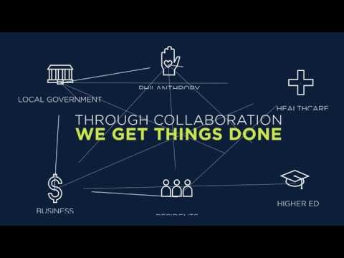

Slide 3



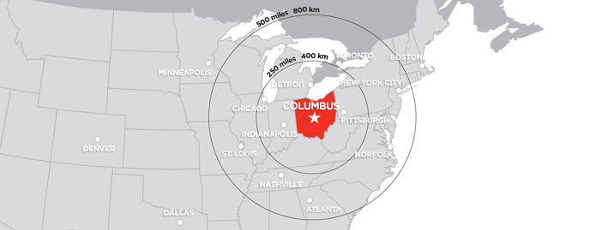




What do these companies have in common?

Slide 4

Central Ohio Logistics
Columbus’ logistics industry employ nine percent of the region’s workforce or 80,000
Central Ohio is home to 4,000 logistics organizations
The top 5 logistics companies employ more than 19,000 individuals.
The logistics field is projected to grow by more than 22% from 2010 to 2020.
Awarded $50 mill Smart Cities Grant from DOT

Slide 5


Slide 6
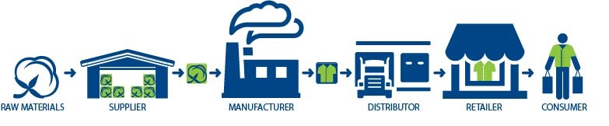
What is Supply Chain Management?
The management of the chain of supplies
System of people, processes, and technology involved in coordinating the flow of products and services from raw materials to the end user.

Slide 7
Why a New Degree?
Rapid industry change and growth
Growth in e-commerce
New technologies: robotics, automation, radio frequency identification (RFID), driverless vehicles
Increasing customer demands
Increasing reliance upon data analytics and tracking
Critical need for employees with technical and critical thinking skills

Slide 8
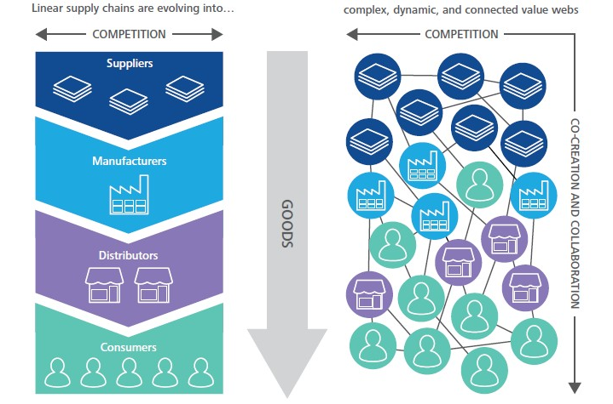
Growing Reliance on Tech and Data
The use of technology and data is critical in getting products to customers as quickly and efficiently as possible.

Slide 9
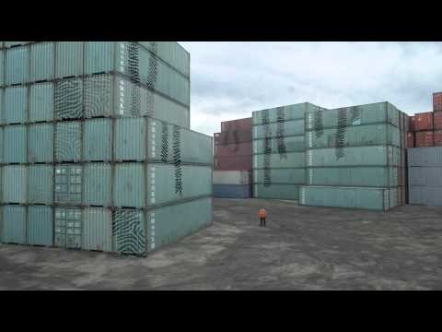
Harness the Power of Technology

Slide 10
Logistics Engineering Technology
Multi-disciplinary STEM program combining
Logistics
Warehousing
IT in Logistics
Engineering
Industrial Engineering
Engineering Graphics
IT & Computer Science
Programming Logic
Computer Networks
Inventory Management
Motors, Controls, and PLC’s
Excel & Database Fundamentals
Supply Chain Principles
Data Acquisition Systems
Project Management

Slide 11
What Can I Do with a Degree in LET?
Industrial Engineering Technicians
Operations Analyst
Systems Specialist
Supply Chain Manager
Logistics Engineering Technicians
Interpret engineering drawings or diagrams
Plan the flow of work or materials to maximize efficiency
Address problems related to production, materials, safety, or quality
Modify equipment or processes to improve resource or cost efficiency
Oversee or inspect production or distribution processes
Maintain databases of logistics information
Interpret data on performance measures and logistics
Optimize service levels, maintain supply-chain efficiency, or minimize cost

Slide 12
Program Highlights
Blended delivery model with both in-person and online courses
Hands-on laboratory experience
Opportunities to tour logistics and distribution facilities
Can be completed part-time or full-time
Embedded internship program
Courses taught by faculty with years of professional experience

Slide 13
LET might be for me if…
Background in math and science
New technologies
Collaborate with others to solve problems
Improve and design efficient systems
Analyze and interpret data
Work in a fast-paced growing industry
Enjoy both STEM and business contexts

Slide 14
Getting started with LET
You can begin taking courses for LET now!
The LET degree is anticipated to launch January 2017
Meet with a faculty member or academic advisor to plan your course schedule

Slide 15
Logistics & Supply Chain at CSCC
A.A.S. in Supply Chain Management
20+ years
LINCS Training & Certification Program
Autumn 2015
A.A.S. Logistics Engineering Technology
Launching January 2017
Hybrid-delivery model (~50-75% online courses)
Choose from eight, 1-credit online self-paced courses
SCPro Fundamentals Certification with fee waiver
Entry- and mid-level SCM workers and individuals in career transition
Fully-online program
Working adults, primarily in SCM
Certificate program also available
Funded by the Department of Labor
STEM Focus: supply chain technologies, industrial engineering, and IT
Funded by the National Science Foundation
Multi-disciplinary program

Slide 16
What questions do you have?
Monique Carney
Program Coordinator
mcarney8@cscc.edu
614-287-2233
Tara Sheffer
Program Coordinator
tsheffer@cscc.edu
614-287-5903
Lee Blyth
Lead Faculty
lblyth@cscc.edu
614-287-5175
Jeremy Banta
Instructor
jbanta1@cscc.edu
614-287-2559

