Slide 1
Service-Learning Advocates:
What do they do?
Rizz Dickson, Reilly Linehan, Jesse Gavin, Starr Cobryn , & Chloe Greenlee

Slide 2
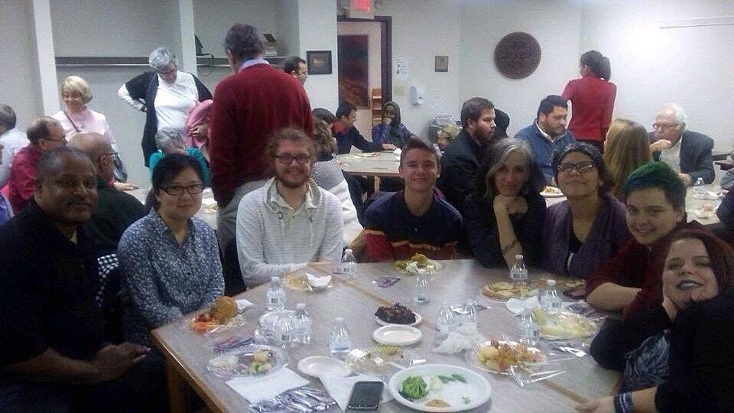
Introductions

Slide 3
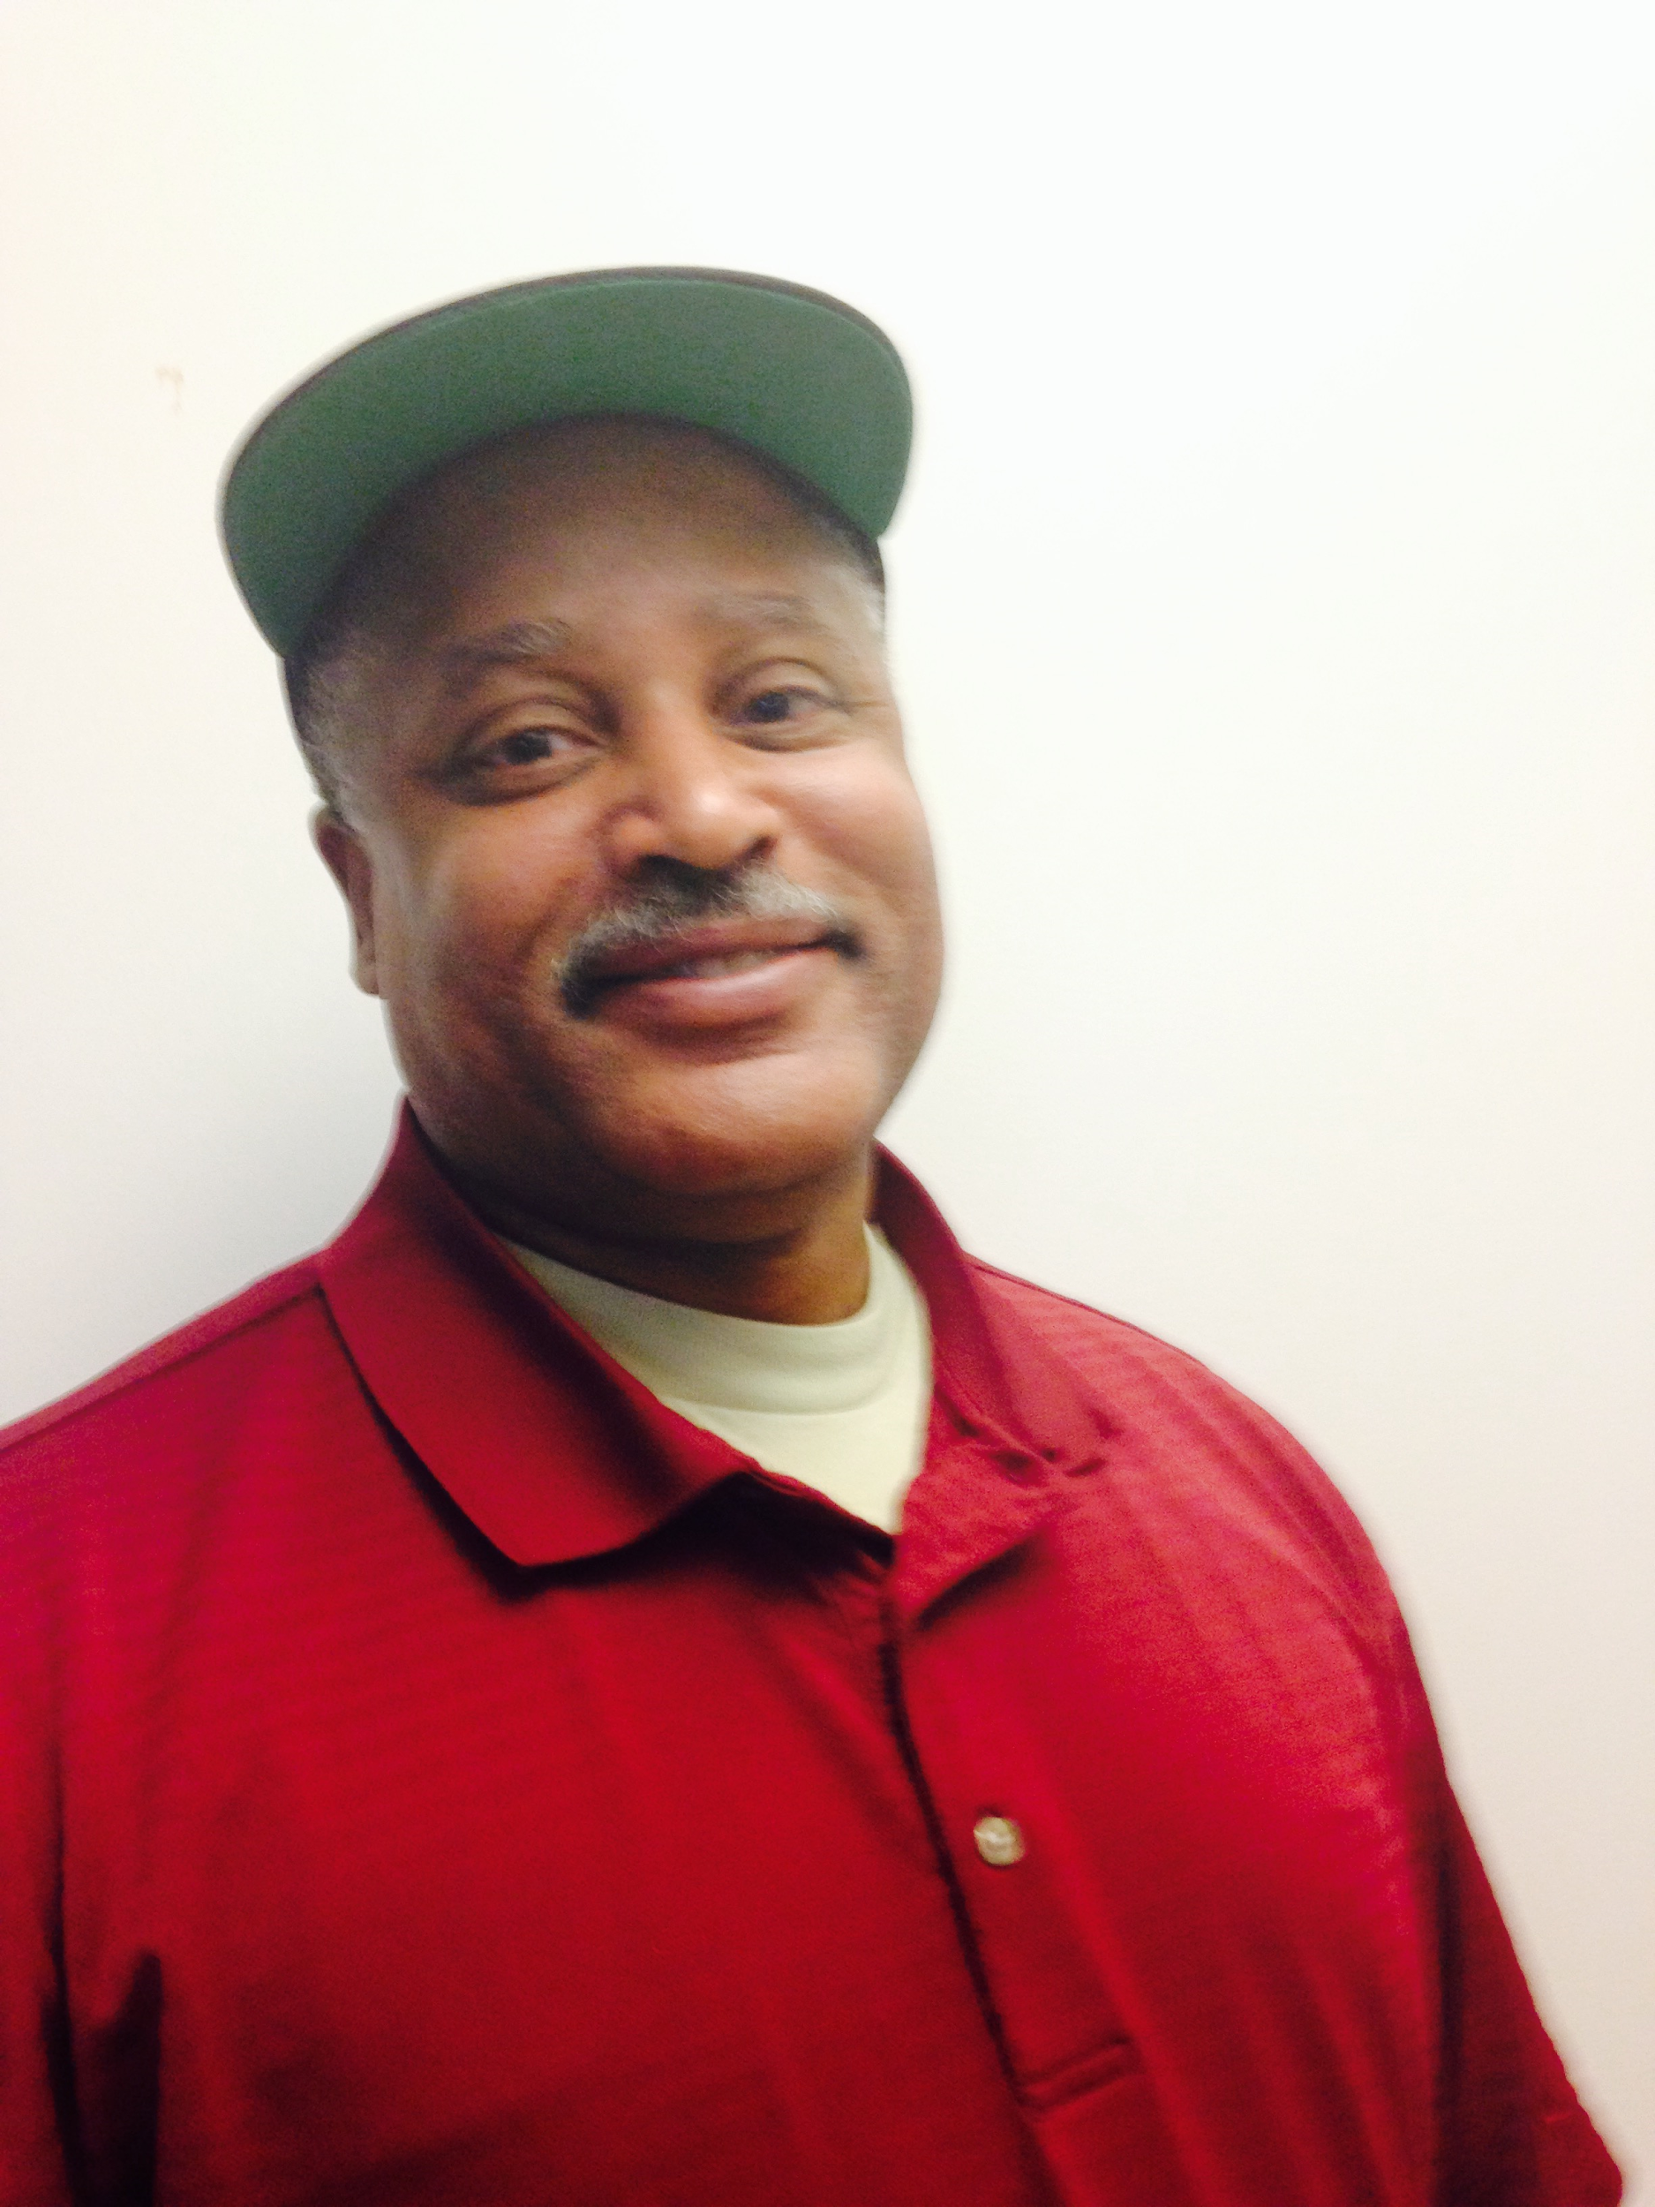
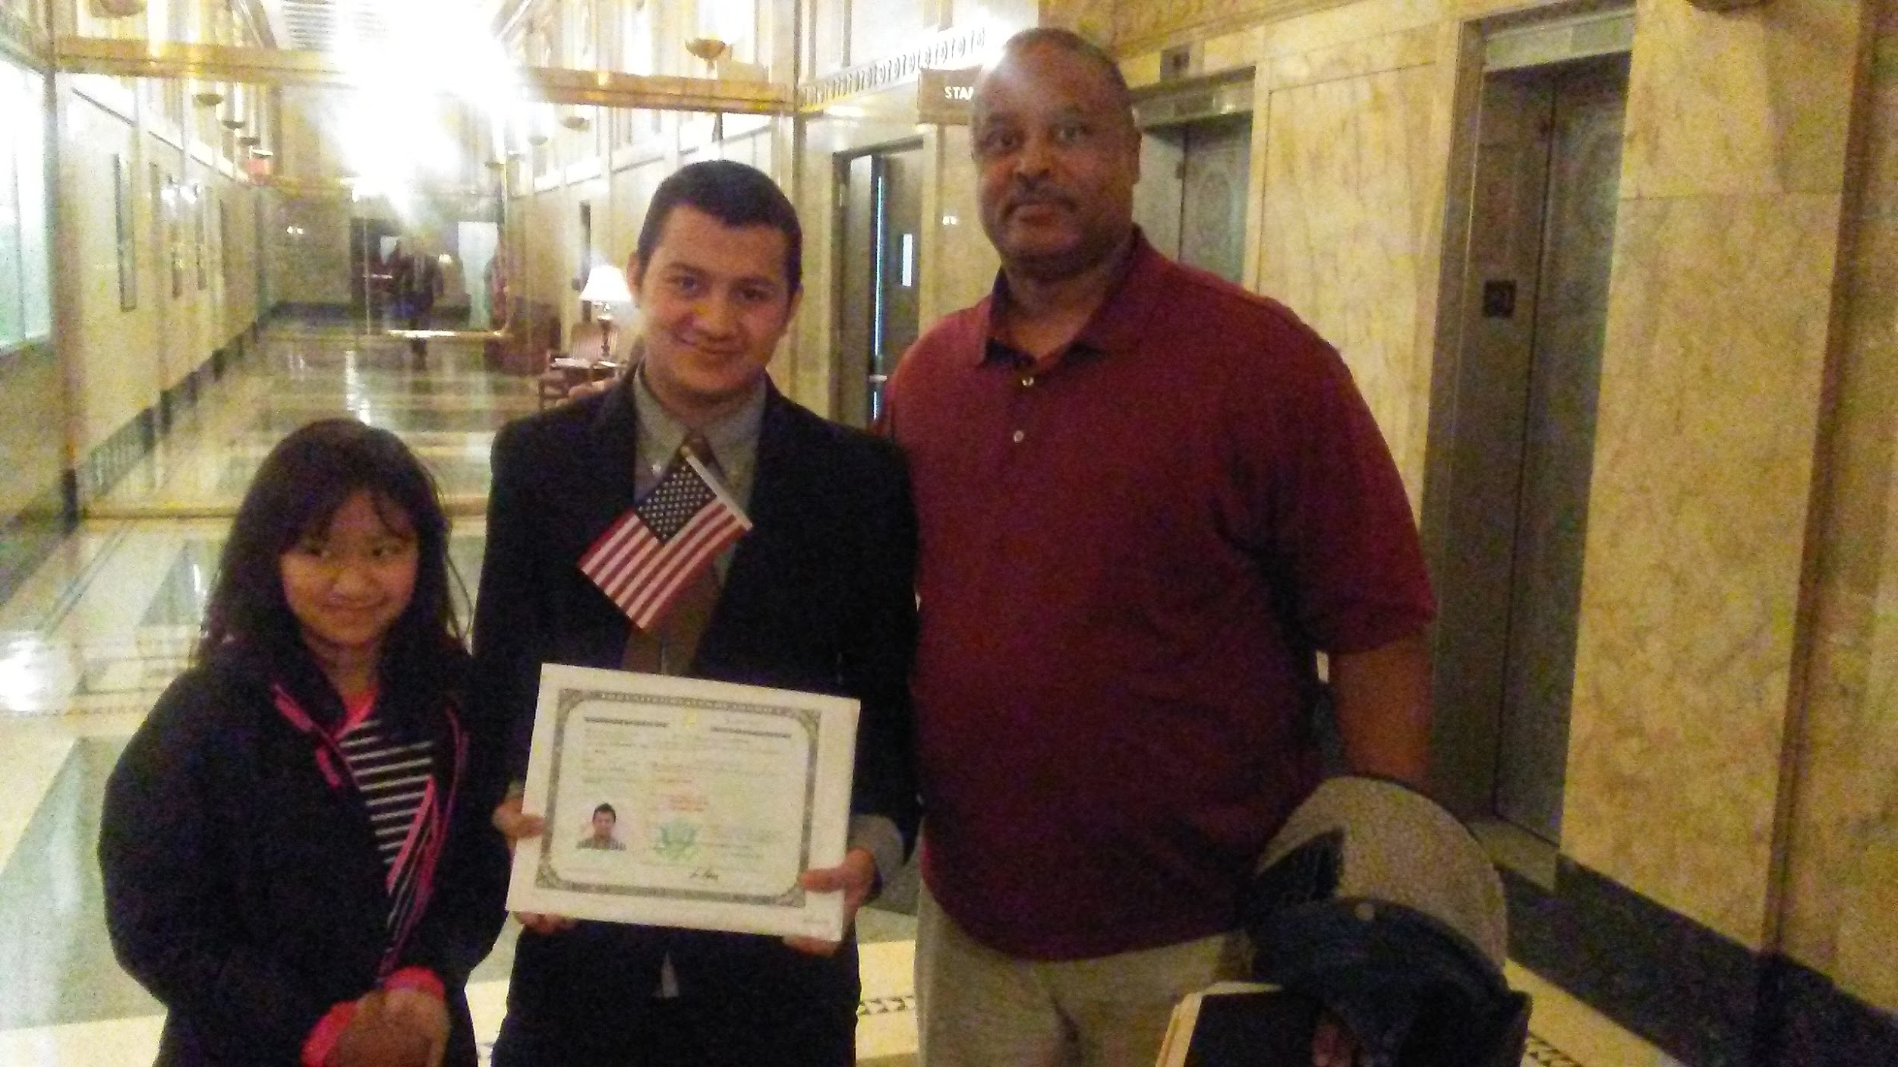
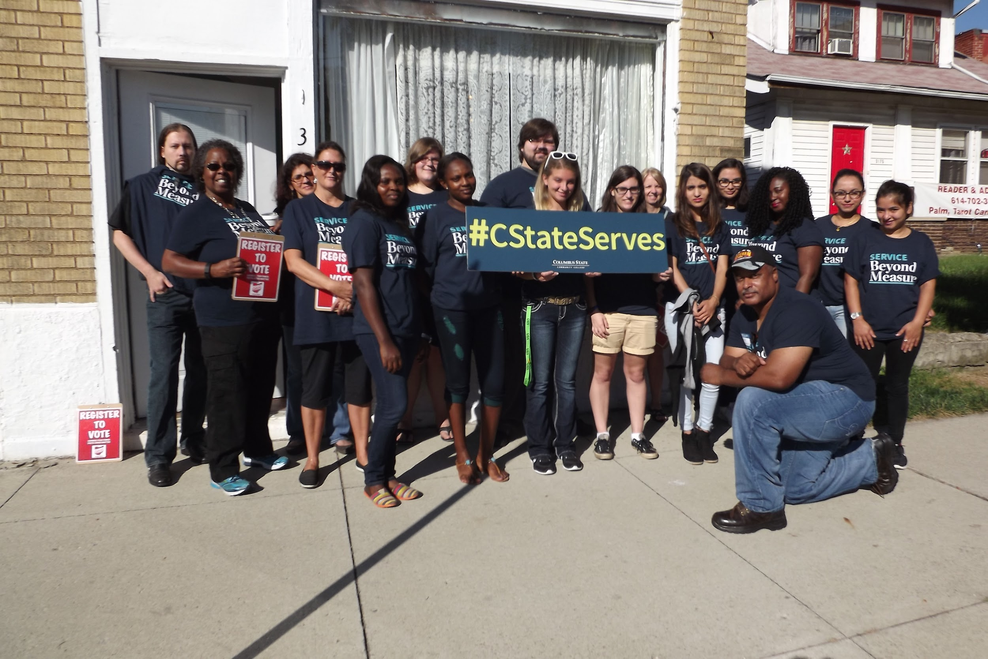
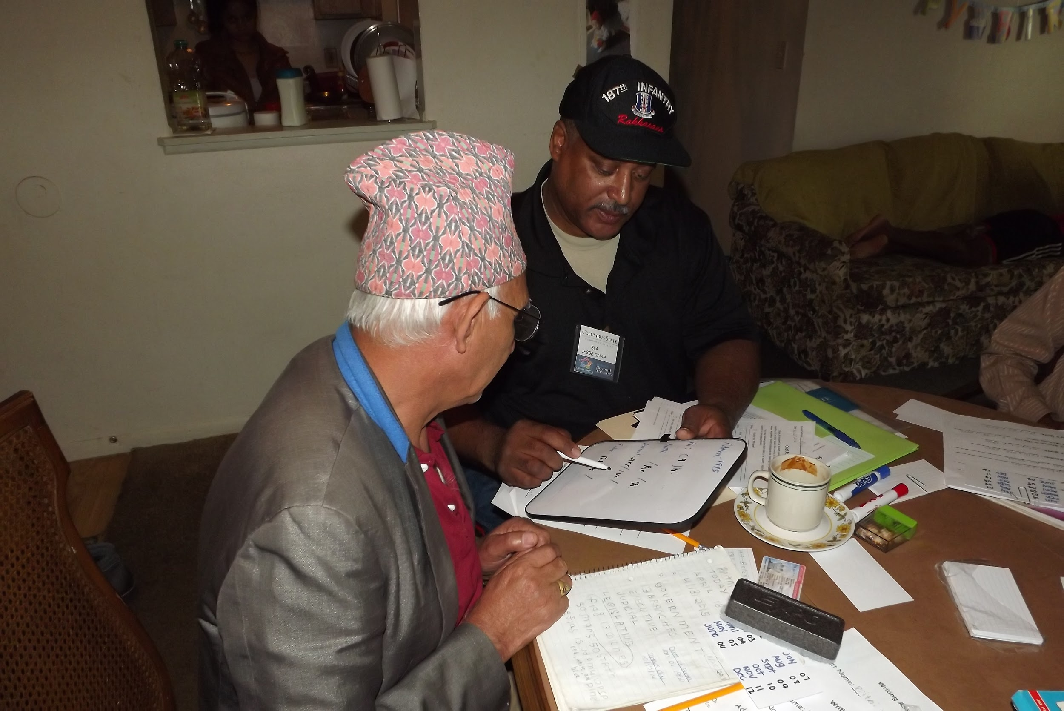
Jesse Gavin
He, him, his
Notes:
Service-Learning Advocate
Gender pronouns: he/him/his
Fun fact: Jesse does more before 8am than most people do all day :D

Slide 4
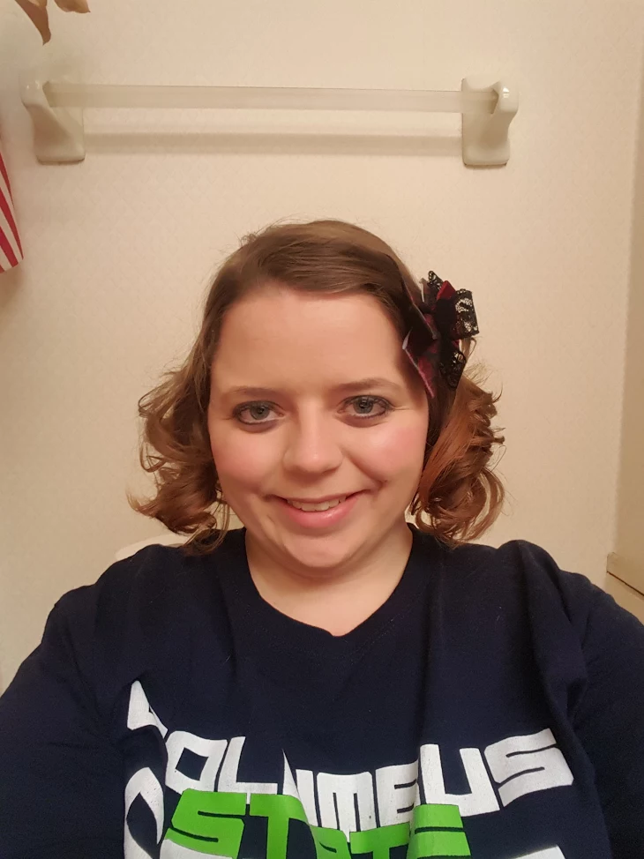
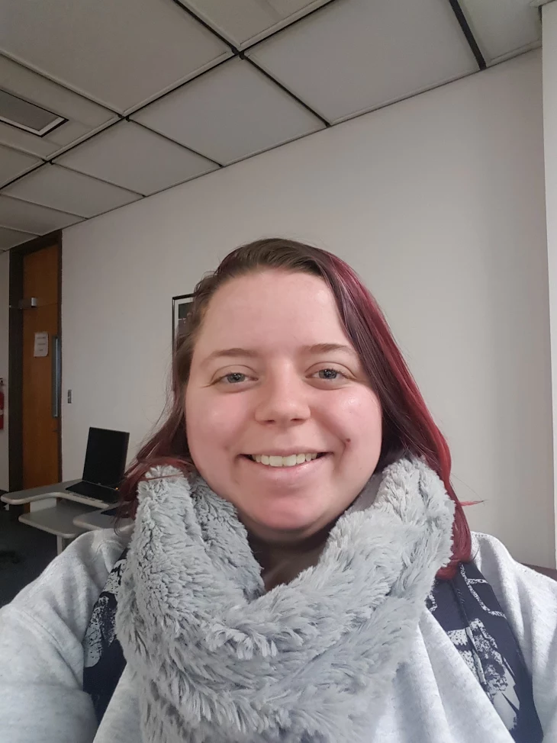
Starr Cobryn
she/her/hers
Service-Learning Advocate

Slide 5
Reilly Linehan
he/him/his
Service-Learning Advocate
Notes:
Don’t forget your fun fact!

Slide 6
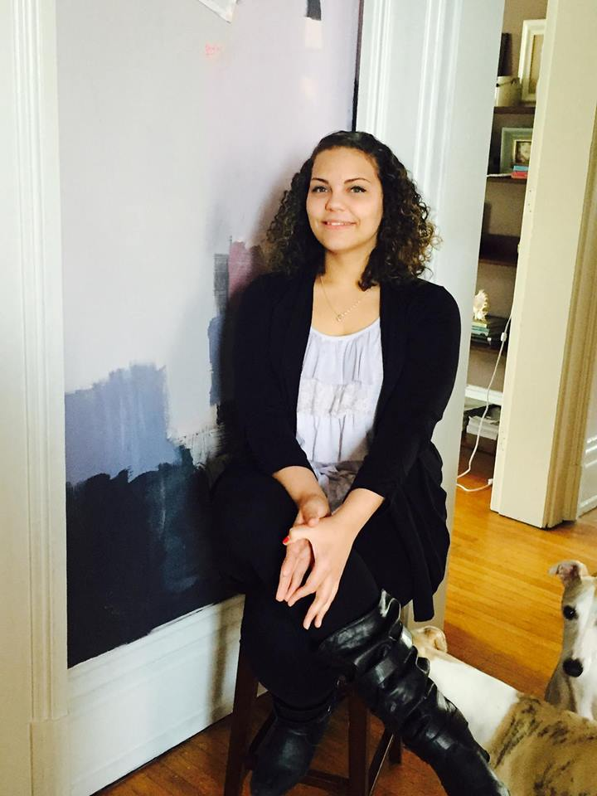
Chloe Greenlee
she/her/hers
Service-Learning Advocate
Notes:
Name:
Gender Pronouns:
Fun Fact:

Slide 7
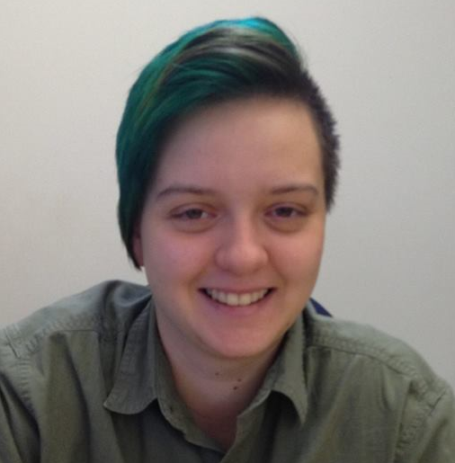
Rizz Dickson
they/them/their
AmeriCorps VISTA
serving as a Service-Learning Coordinator

Slide 8
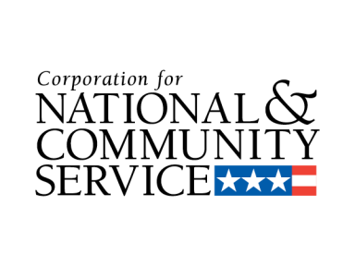
How did we get here?
Notes:
The work that the Service-Learning Advocates and I do is funded by three organizations: The Corporation for National and Community Service, Ohio Campus Compact and Columbus State Community College.
The Corporation for National and Community Service is a U.S. federal government agency that engages more than five million Americans in service through AmeriCorps State and National, National Civilian Community Service Corps, Senior Corps, AmeriCorps VISTA and many other national service initiatives. The goal of AmeriCorps VISTA is to fight poverty by strengthening the capacity of community organizations through administrative and organizational indirect service. AmeriCorps VISTA members serve low-income communities by developing initiatives like after school reading programs, creating food pantries and community gardens, building a social media presence for non-profits, and a number of other important initiatives that increase the ability of community organizations to eliminate poverty.
Ohio Campus Compact is a statewide non-profit coalition of 40 college and university presidents and their campuses working to promote and develop the civic purposes of higher education. Columbus State is an active member of Ohio Campus Compact, or OCC. Connect2Complete is one program that OCC runs in partnership with several colleges and universities, including Columbus State. The goal of Connect2Complete is to improve low-income student retention and graduation rates through a unique combination of peer advocacy and community engagement activities. Last year, I served as an AmeriCorps VISTA member by helping to institutionalize the peer advocacy component of this program in the newly formed Student Advocacy Center at Columbus State. I was able to help define the work of a new department of campus. I supervised 12 student employees as they did the direct work of connecting low-income students at Columbus State to resources like subsidized housing, food stamps, child care assistance, affordable transportation, and healthcare.
This year I moved into supporting service-learning at Columbus State in order to fulfil the community engagement portion of the Connect2Complete program. Columbus State instructors have implemented service-learning projects and courses for several years, but have not yet been granted a sustainable or renewable budget to continue to expand service-learning at Columbus State. My main goal has been to provide instructor support in create service-learning classes and projects at Columbus State that focus on teaching students about poverty and providing marginalized students in these classes with safer spaces to process their service experiences. Instructors at Columbus State often are not paid for the time they put into designing service-learning classes, which deters many from being able to commit to service-learning the ways they would like to.
At Columbus State, I serve under Nancy Case in Community and Civic Engagement because my primary objective is to create and help sustain community and campus partnerships for instructors. I try to ensure that the partnerships are mutually beneficial for students and the community service recipients. I am able to do this through a talented and dedicated team of student employees, known as the Service-Learning Advocates. Each Service-Learning Advocate is partnered with a different service-learning class and works with the lead instructor in that class to develop community and campus partnerships and facilitate peer led reflection before, during and after they complete their service. Some of these classes have official service-learning designations, some are in the process of getting this designation, and some prefer to have a service-learning project in the class, but do not seek to have an official designation.

Slide 9
Identify the needs of nonprofits and other community-based organizations
Provide one-on-one instructor support in incorporating service and social justice
into courses
Coordinate service-learning opportunities for students
Facilitate reflection for students before, during and after service opportunities
Verify and keep track of records of student service hours
Educate students, faculty, and staff on service-learning and social justice
Collect student and non-profit feedback on service experiences in order to
improve them
Research local community issues in order to develop solutions through service in
partnership with nonprofits and instructors
Encourage appropriate student behavior at service opportunities
Create advertising for service-learning for instructors as needed
Staff service-learning events as needed
Other duties as assigned
Service-Learning Advocate Job Responsibilities

Slide 10
Why do we need Service-Learning Advocates &
a Service-Learning Coordinator at Columbus State?
Building and maintaining community partnerships that actually meet the needs of both our surrounding community and service-learning students takes time and hard work.
There is currently not a renewable budget for service-learning at Columbus State.
Instructors do not get reassign time for the work they put into service-learning.
Instructors cannot be everywhere at once.
Peer leaders can be an effective way of getting marginalized students to persist in service, open up during reflection and be academically successful.

Slide 11
Supporting Data
Service-Learning is a good fit for C2C because a larger percentage of low-income students enroll in service-learning classes than the percentage of low-income students enrolled in the general student population at Columbus State.
In Autumn 2016, we worked with 233 students in 3 classes, PSY 2340-S, IEP 2403, & AUTO 2399.
PSY 2340-S had 7 sections, IEP 2403 had 1 section & AUTO 2399 had 1 section.
41% of these students were Pell-eligible.
In comparison, 28% of the general student population was Pell-eligible in Autumn 2016.

Slide 12
Supporting Data
Low-income students in the service-learning classes we partnered with in Autumn 2016 were more likely to succeed in their course work than low-income students in the general student population at Columbus State.
81% of the Pell-eligible students in the service-learning classes we partnered with completed 67% of their courses with a D or better.
In comparison, 71% of Pell-eligible students in the general student population completed 67% of their courses with a D or better.
77% of the Pell-eligible students in the service-learning classes we partnered with completed 75% of their courses with a D of better.
In comparison, 66% of Pell-eligible students in the general student population completed 75% of their courses with a D or better.

Slide 13
Supporting Data
Low-income students were more likely to succeed in the service-learning classes we partnered with than non low-income students.
In Autumn 2016, 92% of our Pell-eligible students completed the Service-Learning class they were enrolled in with a D or better.
In comparison, 81% of non Pell-eligible students completed the Service-Learning class they were enrolled in with a D or better.

Slide 14
Supporting Data
Low-income students in the service-learning classes we partnered with were more likely to take more credits and successfully complete them in Autumn 2016 than non low-income students.
In Autumn 2016, Pell-eligible students enrolled in the service-learning classes we partnered with attempted to take an average of 9.75 credit hours and on average completed 8.17 credit hours.
In comparison, non Pell-eligible students enrolled in the service-learning classes we partnered with in Autumn 2016 attempted to take an average of 8.53 credit hours and on average completed 6.77 credit hours.
Notes:
This research is supported by empirical evidence that service-learning is a successful low-income student retention tool.

Slide 15
Let’s hear from the Service-Learning Advocates about their work

Slide 16
Which class did you work with as a Service-Learning Advocate?

Slide 17
Who is the lead instructor you work with?

Slide 18
Who are the campus and community partner(s) you work with?

Slide 19
What service do Columbus State students offer the community through your class?

Slide 20
How does the community benefit from the service your students provide?
Notes:
Why do we do this?

Slide 21
How do students benefit from the service-learning experience in your class?

Slide 22
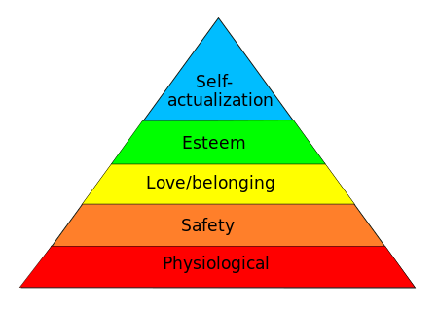
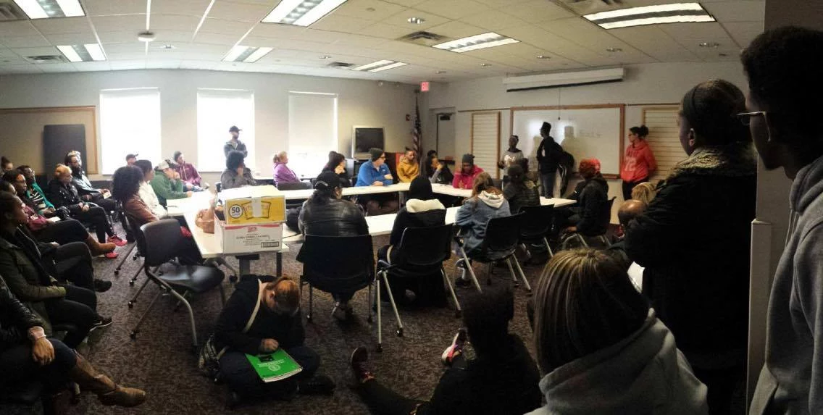
How does service teach the course content for the class you support?

Slide 23
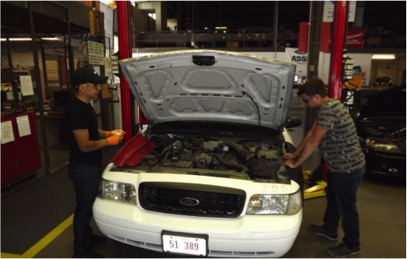
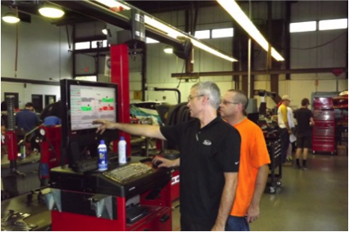
How does service teach the course content for the class you support?

Slide 24
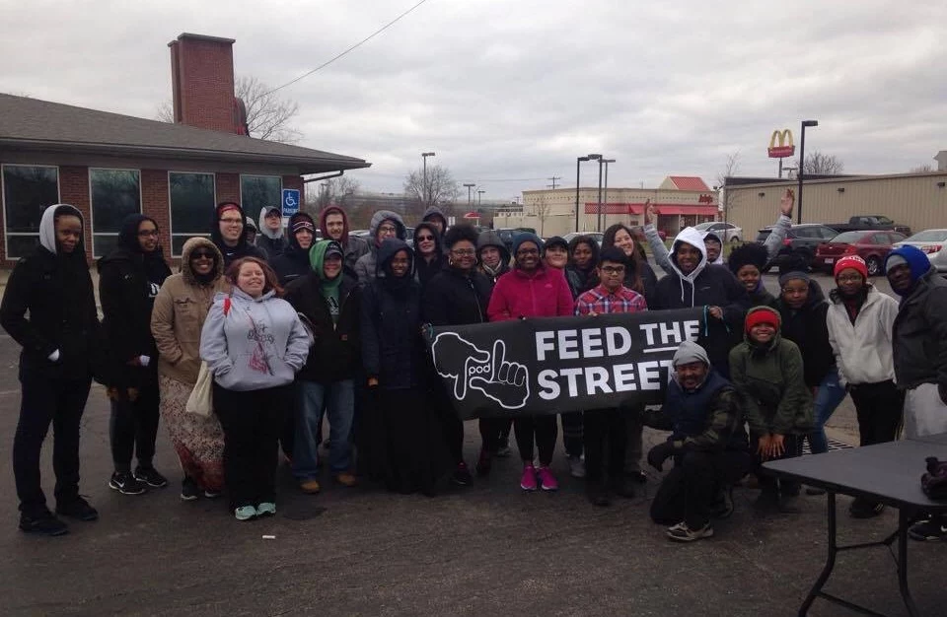
How does service teach the course content for the class you support?

Slide 25
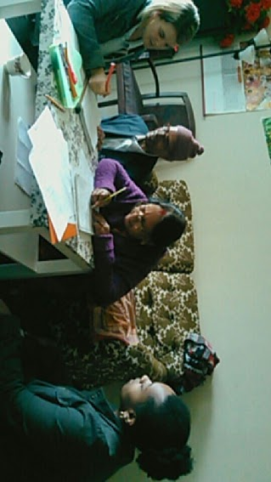
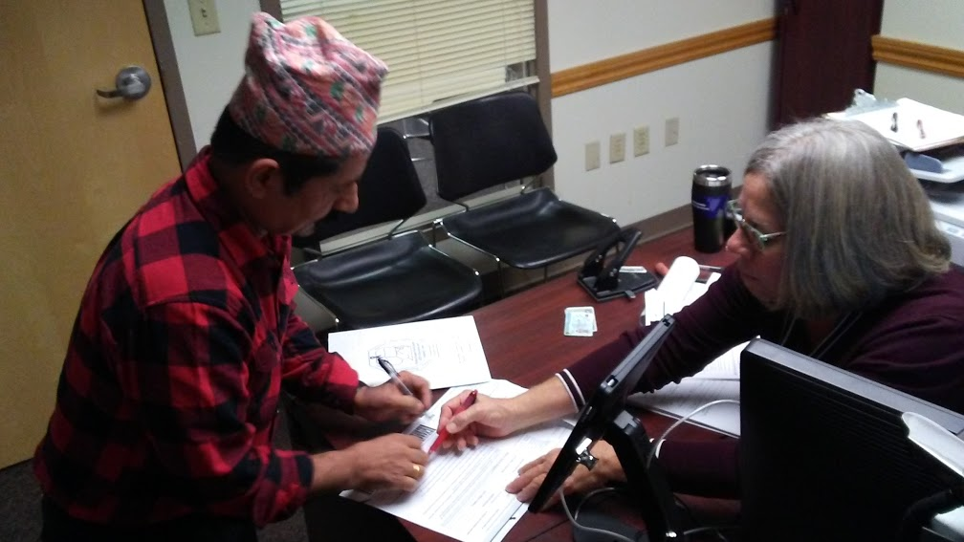
How does service teach the course content for the class you support?

Slide 26
How have you helped build a community or campus partnership for your instructor?

Slide 27
What is your favorite part about being a Service-Learning Advocate?

Slide 28
What have you learned from being a Service-Learning Advocate?

Slide 29
What is the most challenging part about being a Service-Learning Advocate?

Slide 30
What recommendations do you have to improve this work moving forward?
Notes:
Recommendations for the SLA position
Recommendations for service-learning support at Columbus State

Slide 31
Questions?
Contact the Service-Learning Advocates at sladvocates@cscc.edu

