Slide 1

New Student Orientation
autumn 2023 nursing program

Slide 2

Welcome
Congratulations on your acceptance to the Nursing Program at Columbus State Community College. The Associate Degree Nursing Program is just one of several programs in the Nursing Department, and we are thrilled and honored that you have chosen Columbus State Nursing as the first step of your journey. You will find that despite the rigorous curriculum of the program, we will be there with you every step of the way and are here to help. We wish you nothing but success on your journey throughout our program and after.
Welcome to the Nursing Program!
Sincerely,
Columbus State Nursing Faculty & Staff

Slide 3
Covid – 19 Information
The Nursing Department is making every attempt to keep our students informed of the latest information available regarding how the pandemic is affecting our curriculum. Information changes day to day and hour to hour. Please use the provided link to keep up to date on the college wide information that dictates the Nursing Department.
https://www.cscc.edu/about/coronavirus/#latest
At the time this presentation is being created, the college has lifted mask mandates. Courses are planning to run in person as noted on your section listing on the website.
Please be aware that changes to the delivery of the curriculum can change quickly.

Slide 4
Required documentation to begin the program
Please make sure you refer to the deadlines you received in the mail or it is available online under orientation.
Missing any deadlines on this document will result in not entering the Autumn 2023 classes.
There be NO extensions or exceptions!
If you miss any deadline you will need to reapply at the next application period.
Please note, deadlines are for the proof of completion not beginning a process.
  -For example, the deadline for your Fingerprint and Drug Screen Results mean the results must be received by the Nursing Department by that date. IT IS NOT the date to have the screen started. The recent background checks have been taking 7-45 day to obtain results.
  Therefore, DO NOT WAIT UNTIL THE LAST MINUTE TO BEGIN.

Slide 5
Program Outcomes
“Upon completion of the Associate Degree in Nursing, the graduate will be able to:
  1. Implement safe, patient centered care in the professional role of the registered nurse.
  2. Utilize nursing judgement supported by best current evidence and quality improvement measures in providing nursing care for patients across the life span.
  3. Collaborate effectively with patient, family, nursing, and inter-professional team.
  4. Apply informatics and technology to communicate and manage patient care.”
  (ADN Program Student Handbook, pg 10)

Slide 6
Concept Based Curriculum
“Student understanding is improved when students focus on broad concepts that cross environmental settings, the lifespan, health and illness.” (Giddens & Wright, 2012)
Because of this, and in an attempt to avoid content saturation (increasing/overwhelming quantities of information), the Nursing Department teaches a Concept Based Curriculum. A Concept Based Curriculum works by teaching essential nursing concepts, such as ‘pain’ or ‘oxygenation’, and then relating representative samples of client situations or problems as a way of teaching each concept.
The outcome is that the student should be able to grasp and understand the concept, and then apply said concept to patient situations.

Slide 7
Plan of Study Review
On the following slide, you will find a breakdown of the Nursing Plan of Study. The Nursing Program Sequence includes 16 credit hours of General Education courses, 14 credit hours of Basic Education courses, and 34 credit hours of Technical Education credit hours for a grand total of 64 credit hours. It is extremely important that the plan of study is followed sequentially and precisely. Failure to do so may result in the student falling out of sequence.

Slide 8
Plan of Study – Autumn Start
SEMESTER 1 (AUTUMN) | G/T/B | CR
COLS 1100 | B | 1
NURS 1871 | T | 6
NURC 1104 | B | 2
NURS 1140 | T | 1
BIO 2300 | G | 4
TOTAL |  | 14
SEMESTER 2 (SPRING) | G/T/B | CR
NURS 1873 | T | 8
NURS 1141 | T | 1
BIO 2301 | B | 4
TOTAL |  | 13
SEMESTER 3 (SUMMER) | G/T/B | CR
NURS 2864 or 2872 or 2866 (1) | T | 3
PSY 1100 | G | 3
ENGL 1100 | G | 3
Open Basic & Related* See Slide | B | 3
TOTAL |  | 12
SEMESTER 4 (AUTUMN) | G/T/B | CR
NURS 2864 &/or 2872 &/or 2866 (2) | T | (2x3) 6
NURS 2042 | T | 1
PSY 2340 | G | 3
STAT 1350 | G | 3
TOTAL |  | 13
SEMESTER 5 (SPRING) | G/T/B | CR
NURS 2873 | T | 8
BIO 2215 | B | 4
TOTAL |  | 12
OPEN BASIC AND RELATED* Select one:
CHEM 1111, 1113, 1171,1172, 1200
COMM 1105, 1110
ENGL 2367, 2767
HIST 1111, 1112, 1151, 1152, 1181, 1182, 2223, 2224
HNTR 1153
HUM 1270
MATH 1116, 1148
PHIL 1130
PSY 2331
SOC 1101
Total General Education Credits (G) | 16
Total Basic and Related Credits (B) | 14
Total Non-Technical Credits (G+B) | 30
Total Technical Credits (T) | 34
TOTAL CREDITS | 64

Slide 9
Plan of Study – Spring Start
SEMESTER 1 (SPRING) | G/T/B | CR
COLS 1100 | B | 1
NURS 1871 | T | 6
NURC 1104 | B | 2
NURS 1140 | T | 1
BIO 2300 | G | 4
TOTAL |  | 14
(SUMMER SEMESTER)
NO CLASSES REQUIRED
SEMESTER 2 (AUTUMN) | G/T/B | CR
NURS 1873 | T | 8
NURS 1141 | T | 1
BIO 2301 | B | 4
TOTAL |  | 13
SEMESTER 3 (SPRING) | G/T/B | CR
NURS 2864 &/or 2872 &/or 2866 (2) | T | (2x3) 6
PSY 1100 | G | 3
STAT 1350 | G | 3
NURS 2042 | T | 1
TOTAL |  | 13
OPEN BASIC AND RELATED* Select one:
CHEM 1111, 1113, 1171,1172, 1200
COMM 1105, 1110
ENGL 2367, 2767
HIST 1111, 1112, 1151, 1152, 1181, 1182, 2223, 2224
HNTR 1153
HUM 1270
MATH 1116, 1148
PHIL 1130
PSY 2331
SOC 1101
SEMESTER 4 (SUMMER) | G/T/B | CR
NURS 2864 or 2872 or 2866 (1) | T | 3
Open Basic & Related* See Next Slide | B | 3
PSY 2340 | G | 3
ENGL 1100 | G | 3
TOTAL |  | 12
SEMESTER 5 (AUTUMN) | G/T/B | CR
NURS 2873 | T | 8
BIO 2215 | B | 4
TOTAL |  | 12
Total General Education Credits (G) | 16
Total Basic and Related Credits (B) | 14
Total Non-Technical Credits (G+B) | 30
Total Technical Credits (T) | 34
TOTAL CREDITS | 64

Slide 10
NURS Course Section Interpretation
When looking at course sections, if there are not days or times listed this could mean 2 things:
  CL: this means that the clinical placements have not yet been determined and you will be notified at a later date.
  LE: usually means this is lecture content presented asynchronous, meaning in a recorded format.
Be sure to look at dates on each line. Some lines are for one day or a group of days only. If it is for the entire semester it will have the dates from week 1 through week 16.
See next slide for an example of interpreting an NURS course section

Slide 11
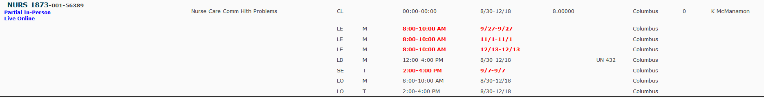
NURS Course Sections – How to Read
https://www.cscc.edu/academics/courses/ (This is my preferred area to look at sections.)
Ex.) NURS 1873 AU21
CL: with no times or days means meeting times are not yet established and you will receive communication when this is available. All courses will use this method.
LE: M 8-10 only on 9/27. This is Exam 1 that will be done in-person
LE: M 8-10 only on 11/1. This is Exam 2 that will be done in-person
LE: M 8-10 only on 12/13. This is Exam 3 that will be done in-person
LB: M 12-4 with dates 8/30-12/18 means it will meet in-person for the whole semester
SE: T 2-4 only on 9/7. This is the HESI proctored exam that will be done in-person
LO: M 8-10 for the whole semester is lecture that will be done live on a Zoom session during those hours
LO: T 2-4 for the whole semester is seminar that will be done live on a Zoom session during those hours

Slide 12
Review of Nursing Student Handbook
  It is of utmost importance that students newly admitted to the Nursing Program fully read and understand the entirety of the Associate Degree Nursing Program Student Handbook. You will be expected to be familiar with all policies included in the Associate Degree Nursing Program Student Handbook.
  All of the information in the handbook is of high relevance, but not all of the information included in the handbook will be addressed in this presentation.
  Please refer to the Associate Degree Nursing Program Student Handbook for Autumn 2023.

Slide 13
Review of Nursing Student Handbook
Code of Conduct:
  Students are required to display ethical and professional behavior at all times and during all activities (including social media).
  Students must display moral and ethical responsibility and accountability for their actions and behaviors.
  Students are required to adhere to the policies and procedures put forth in course syllabi, CSCC ADN Program Student Handbook, CSCC Code of Conduct and any CSCC policies, procedures and requirements in the CSCC Catalog.
  Students displaying any unethical or unprofessional behaviors are subject to serious disciplinary action by the Nursing Program, the college, the Ohio State Board of Nursing and/or other applicable authorities which may result in dismissal from the program.
  (ADN Program Student Handbook, pg 17)

Slide 14
Review of Nursing Student Handbook
Social Media:
  “Postings on social networking sites may be subject to the same professional and ethical standards as any other personal interactions. Harassment, bullying, and discrimination are prohibited by Columbus State Policy 3-43 and Policy and Procedure 7-10. Complaints or alleged violations of these policies and procedures will be referred to the Office of Equity and Compliance and/or the Office of Student Conduct.” (ADN Program Student Handbook, pgs 23-24)
  All students accepted into the Nursing Program at Columbus State Community College are expected to read and adhere to the National Council of State Boards of Nursing recommendation on “A Nurse’s Guide to the Use of Social Media”. Please click the cloud below to review.
‘A Nurse’s Guide to the Use of Social Media’ by NCSBN

Slide 15
Review of Nursing Student Handbook
Examinations:
  The Nursing Program and Department upholds the highest standard of integrity in regards to testing. Please review and understand all policies and procedures regarding examinations.
  It is expected all examinations be taken as scheduled on the course calendar. Examinations given in Nursing are generally multiple choice and computer scored. The examination booklet, computer answer sheet, and/or other documentation must be returned to the instructor at the completion of the examination time. The answer response on the computer answer sheet or computer test is considered the official answer response for grading. Exam questions may not be copied by students. Exams are the property of Nursing and are not returned to the students. Students are prohibited from discussing examination information with anyone other than the faculty.
  (ADN Program Student Handbook, pg 27)

Slide 16
Review of Nursing Student Handbook
Attendance:
  “Students are expected to prepare for and attend all course learning activities. Attendance at course orientation and clinical orientation is required. Students who miss either orientation will be dropped from the course. Each course has activities designed to enable students to meet the course objectives that are essential for student learning. Course teaching-learning strategies vary by course and may include live lecture, lecture capture, seminar, lab and clinical. Students are expected to participate and complete all course activities as indicated on the syllabus and calendar. Absences or not completing course activities may result in a lack of success in the course and the Nursing Program.” (ADN Program Student Handbook, pg 21)
  “Students late or absent from clinical due to an emergency are required to notify the clinical agency and instructor at least one hour prior to scheduled start time.” (ADN Program Student Handbook, pg 22)
  “Attendance at course orientation and clinical orientation is required. In the event orientation is missed the course faculty will determine if the student is eligible to remain in the course.” (ADN Program Student Handbook, pg 21)

Slide 17
Review of Nursing Student Handbook
Communication:
  When communicating with any faculty and/or staff at Columbus State via email, ONLY emails from a Columbus State email address will be addressed. This is a security precaution.
  Faculty are available during their posted office hours. You may email faculty with question or concerns. Faculty will make every effort to respond within 2 business days. Saturday, Sunday, and holidays are not business days. Please plan for the 2 business day allowance of time as you seek assistance with assignments or questions related to your course.

Slide 18
Review of Nursing Student Handbook
Concerns and/or Complaints
  “A student complaint is an expression of dissatisfaction about the nursing program expressed in writing submitted to the Nursing Department Chairperson, and resolution of student complaint is a written response from the Nursing Department Chairperson to the written complaint, outlining activities to address the complaint, if warranted.” (ADN Program Student Handbook, pg 31)

Slide 19
Review of Nursing Student Handbook
Advising:
  A nursing faculty advisor is assigned to each Nursing student upon entry to the first semester in Nursing. The advisor is available to assist and advise students regarding academic concerns and nursing career planning.
  During Autumn 2023, you will be assigned a Nursing faculty advisor. As a student, it is your responsibility to contact your advisor with any questions or concerns pertaining to your progress throughout the Nursing Program.

Slide 20
Review of Nursing Student Handbook
Nursing Program Technology:
  “Nursing students are required to be knowledgeable with computers. It is advisable for students to own a computer. If the student does not have a computer, CSCC has a Computer Commons located in the Center of Technology and Learning (TL) building, room 116. Students can walk to the front desk, sign their name and a lab assistant will assign them a station. Students are asked to show their college student ID card. The educational Resource Center also has computers for student use. The Nursing Program also has a student computer lab in Union Hall room 429. Students use word processing programs in all courses and need a program installed that is compatible with Microsoft Word. Some courses use Microsoft PowerPoint for presentations, so this software may also be required. The course syllabi will also list course specific computer requirements. Students also have access to CSCC student email and should check their email frequently. The course management system is BlackBoard and instructors use this in many ways to communicate and deliver information. BlackBoard orientation is highly recommended for those with limited exposure.” (ADN Program Student Handbook, pg 29)
  Click the cloud to be directed to the page with the BlackBoard Orientation.
BlackBoard Orientation

Slide 21
Staff Introduction
Staff:
  Dr. Tammy Montgomery –Chairperson
  Kathy Eichenberger – Program Coordinator
  Angie Lennon – Clinical Coordinator
  Catherine Underwood – Program Coordinator
  Steve Pletcher – Simulation Coordinator

Slide 22
Faculty Introduction
NURS 1873:
Jill Ritchey – jritche1@cscc.edu
Katelyn Zag – kzag@cscc.edu
Heather Less – hless@cscc.edu
Megan Jackson – mjackson135@cscc.edu
NURS 1871:
Kim Stein – kstein@cscc.edu
Kim Pennell – kpennell@cscc.edu
NURS 2864:
Kathy McManamon – kmcmanam@cscc.edu
Tara Pepple – tpepple@cscc.edu
NURS 2866:
Dr. Tara Rohr – trohr1@cscc.edu
Wendy Cook – wcook7@cscc.edu
NURS 2872:
Dr. Patty Allen – pallen13@cscc.edu
Alison Romanowski – aromanowski@cscc.edu
Melissa Hyde – mhyde@cscc.edu
NURS 2873:
James Hofe – jhofe@cscc.edu
Edna McQuesten – emcquest@cscc.edu
Jackie Miller – jmiller@cscc.edu
Listed above are the full-time faculty at the heart of the Nursing Program at Columbus State, paired with the courses they lead. These are the same faculty members that will be assigned as your advisors.

Slide 23
NURS 1871
NURS 1871 – Fundamental Concepts of Nursing Care will be the first clinical course of the Nursing program. Please take note of the following information pertaining to this course:
PLEASE NOTE: There will NOT be clinical the first week of the semester.
  If you are in the traditional track, you will be expected to attend lecture, seminar, lab and clinical each week. Lecture is on Tuesdays, 8A-10A; Seminar is on Tuesdays from 10A-12P or 12P-2P; Lab is on Wednesdays from 8A-10A or 10A-12P. You will also be required to attend sixty hours of clinical over the semester. Clinicals are on one of the following days: Thursday, Friday, and Saturday.
  If you are in the blended track, you will be expected to spend a minimum of four hours per week actively engaging in course content and working on online assignments (this does not include study time such as assigned reading). You will spend two hours in Lab per week on Wednesday 12-2P or 2-4P. You will also be required to attend sixty hours of clinical over the semester. Clinicals are on one of the following days: Thursday, Friday, and Saturday.
  Students must have uniforms by week one of the program.
  Students must access BlackBoard prior to the first day of class in order to obtain information pertaining to the first day of class for NURS 1871 (including room assignments, reading assignments, etc.). Important and valuable course information will be available on BlackBoard as soon as it becomes available, which is usually 3 days prior to the first day of class. Please listen to and review this information prior to the first day of class.

Slide 24
NURC 1104
NURC 1104 – Basic Care Skills is a co-requisite to NURS 1871. Please take note of the following information:
  NURC 1104 is a skills-based course.
  NURC 1104 meets one day per week for lecture. NURC 1104 also meets three hours per week that consists of learning skills and competency checks in lab.
  You will be assigned a lab coach to assist with skills at the bedside. Your lab coach will stay the same throughout the semester.
  If you miss a lab, that lab must be made up. It is your responsibility to schedule a make-up time with your instructor.
  Students are expected, and have a responsibility to come to class prepared:
      Having completed reading, assignments, reviewed skills and have skills sheets available in class either with your laptop or printed and ready to participate
      Come to class on time
      Wear casual clothes. (If you chose to wear school uniform or scrubs, the attire needs to be laundered from your last clinical or work.) Follow nursing student handbook.

Slide 25
Additional NURS Clinical Courses Overview
Expected weekly in-class commitment:
1873: 2 hours lecture, 2.5 hours seminar, 4 hours lab, 10 hours clinical
2864: 1 hour lecture, 2 hours seminar, 4 hours lab, 8 hours clinical
2866: 2 hours lecture, 2 hours seminar, 4 hours lab, 6 hours clinical
2872: 2 hours lecture, 2 hours seminar, 8 hours clinical
2873: 2 hours lecture, 2 hours seminar, 2 hours simulation, 16 hours clinical

Slide 26
Pharmacology Courses
The current Nursing curriculum consists of three pharmacology courses – NURS 1140, NURS 1141 and NURS 2042. Please take note of the following information:
  All three pharmacology courses are web based (all instructional and laboratory sessions are completed in an online setting), regardless of whether you are in the blended or traditional track.
  All pharmacology tests must be taken in the testing center.
  You must pass your clinical course in order to move ahead to the next pharmacology course, as the previous clinical course is a pre-requisites to the next pharmacology course. Please refer to the ADN Student Handbook regarding Nursing Program Progression.

Slide 27
Uniforms & Dress Code
The Nursing Student Dress Code is extensive. We will cover general points in this presentation, however, we strongly advise you to become familiar with the dress code policy in its entirety, as you will be held accountable for such in lab and clinical. Failure to abide by any dress code policy set forth by Columbus State Community College Nursing Department can result in dismissal from clinical.
CSCC Nursing Student Uniform (ADN Program Student Handbook, pg 41-43)
  CSCC photo identification badge, watch with second hand and stethoscope.
  Navy blue lab jacket with CSCC nursing student patch is optional, and is the only additional part of the uniform to be worn. No other jackets, sweaters, or coverings may be worn.
  All white t-shirts may be worn under the uniform.
  Pregnant students may wear a white maternity uniform top to which a CSCC nursing student patch has been applied and navy blue maternity uniform pants.
  Uniforms are to be laundered after each clinical day.
  The CSCC Nursing Student polo shirt is worn in designated clinical areas per faculty instruction.
  Shoes must look professional with the uniform and be either white, gray, black, or navy blue. (full guidelines on p. 46 of the handbook)
  Socks or hosiery are required to be worn with the uniform.
  Please refer to the Nursing Skills Lab slide for specifics regarding appropriate attire during your lab experiences.

Slide 28
ADN BSN
The Columbus State Community College Nursing Program stresses the importance of furthering your education after obtaining an Associate Degree in Nursing. The Nursing Program has partnered with many Colleges and Universities to offer our students a seamless progression towards a Bachelor of Science in Nursing. For more information on pathways, please click the cloud below. You may also contact the Health and Human Services Advising Department, or email Katelyn Zag, Nursing Instructor at kzag@cscc.edu.
Columbus State Community College Preferred Pathways

Slide 29
Traditional vs. Blended Tracks
In order to be successful in the Nursing Program, it is important to understand the differences between the two tracks, and what will be required in each. The content you receive will be the same in both tracks; however, as different teaching and learning strategies are employed, there will be a notable difference in how the content is delivered.
  The traditional track is strongly structured and requires in-person attendance for all components of the course – lecture, seminar, lab and clinical.
  The blended track is asynchronous. The blended track delivers lecture and seminar assignments online, with the guidance of BlackBoard, and allows students to complete their work on their own time within a certain time frame. For students in the blended track, in-person attendance is still required for lab and clinical components of the course.

Slide 30
Nursing Skills Lab
The Nursing Skills labs are located on the 4th floor of Union Hall in rooms 432 and 435. The Nursing Skills lab is where you will practice and develop new skills discussed in lectures. The labs are managed and organized by Susan MacDowell and Wendy Cook. Listed below are rules and policies you should familiarize yourself with prior to your first time in lab:
  No flip flops, open toed shoes or high heels; no low cut shirts; no short skirts or shorts; wear student uniform for competencies.
  Wear white CSCC nursing student nametag to lab.
  No food or drink in the skills lab.
  Wash hands prior to handling mannequins.
  Leave beds and bedsides neat and clean.
  Mannequins can be moved carefully by two students.
  Open lab for practicing skills is available to all students in our program. Open hours are listed on the bulletin board outside UN 432 and on BlackBoard.
  Cell phones off in lab. No videotaping or photographs allowed in lab.
  Skills lab is to be used only by CSCC nursing students or nursing faculty and staff.

Slide 31
Health Records Office
If you have not submitted a previous health record to the Health Records Office, you must complete all items of the Nursing health record available on our website. Incomplete records are not accepted. Your health record must remain up to date to register for clinical courses. It is your responsibility to ensure your health record is complete for each registration period. Health record deadlines are listed on our website. Please make photocopies for your own file prior to submitting your updated documents to the health records office. Please click the cloud below to access the health records website.
How to submit a Health Record:
  You may choose to scan and email your documents in PDF format to healthrecords@cscc.edu Emails will only be accepted from your CSCC student email account (@student.cscc.edu) Photos are not accepted. You may not email to check on the status of your health record.
  Records can be submitted in person to Union Hall room 132.
  You may choose to fax your documents to (614)287-5386. Please click the cloud below to access our webpage for additional information, forms and deadlines. Detailed information on health record requirements is available under the Heath Record Fact sheet link.
  Please choose one mode of submitting your documentation. Submitting duplicate copies will slow down processing times.
  Records are processed in the order they are received. Completed health records received by the deadline will be processed within 1-5 business days. Completed health records received after the deadline may be processed within 5-10 business days.
Health Records

Slide 32
CPR Certification
The Nursing Office is located on the 5th floor of Union Hall. This is where your student mailboxes are located, as well as where you will drop off your updated CPR certification. In regards to your CPR certification, all students admitted to and continuing in Nursing must meet the following requirements for CPR:
  The student must be certified for 2 years by the American Heart Association or American Red Cross as BLS for Healthcare Provider.
  The student must present current CPR certification card or e-Card code to the Nursing Program Specialist. The e-Card code will be accepted via email.
    Email: keichenb@cscc.edu and/or cunderwood17@cscc.edu
  The student is responsible for maintaining current CPR certification throughout the program.
  In order for a student to register for a clinical nursing course, CPR certification must be current through the end of the last week of classes preceding final exam week of the semester the student is seeking to register. The block on registration will be removed once the student presents a current CPR certification card to the department specialist. If there are questions, please see the department specialist.
(ADN Program Student Handbook, pg 13)

Slide 33

Elsevier package– on-line/digital products & e-books
  You will purchase the required Elsevier products from the CSCC Bookstore approximately two weeks prior to the semester start.
  All your products (including all your required e-books) will be loaded onto an access code card.
  You are expected to have, in hand, the required Elsevier access code card by the first day of class.
  Hard copies of the Elsevier books are available for purchase from Elsevier at an additional cost.
  You may receive updates regarding products via email when available.
  Feel free to come to orientation without “opening” your package (inputting your access code from the card). Faculty and an Elsevier rep will be on hand to help you with creating your account (if need be), activating products & orienting you to the products.
  Once the Elsevier access code has been used, the Elsevier product is not returnable or refundable.
  Save your Elsevier Access Code card and receipts -bring them with you to the first day of your NURS 1871 course.
  This book package provides all you need for NURS 1871, 1140 & NURC 1104

Slide 34
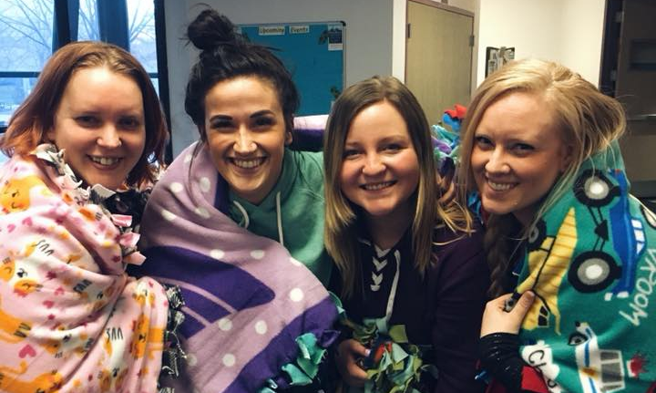
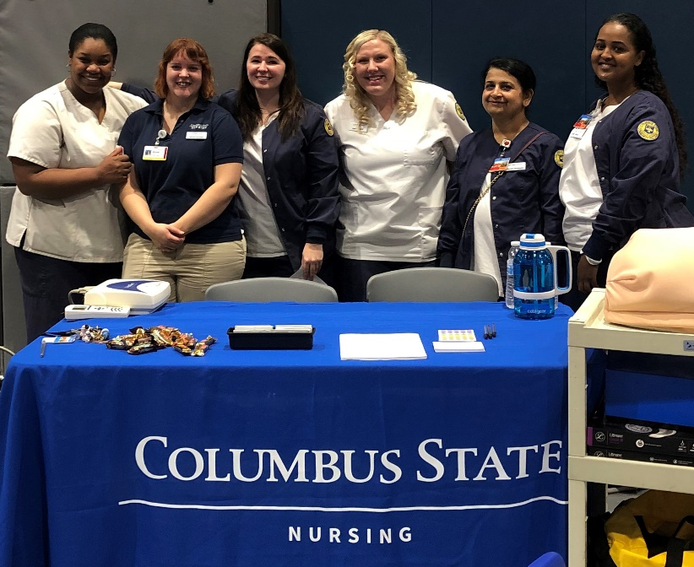
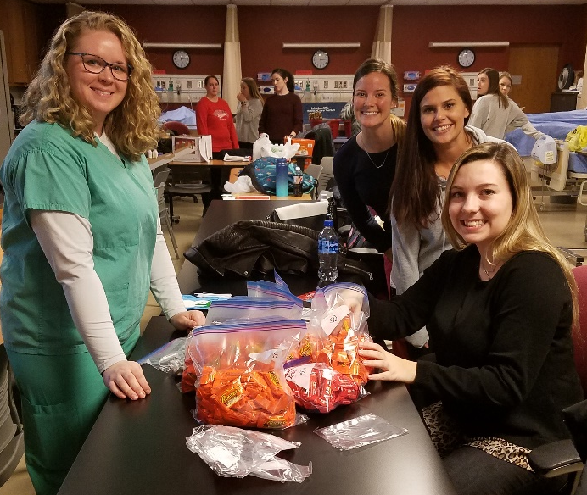
Mission Statement
To help develop the whole person, her/his professional role and responsibility for health care of people in all walks of life. To influence health care, to promote and encourage participation in community affairs.
STUDENT NURSES ASSOCIATION (SNA)
Join today!
Go to www.cscc.edu/connect
Sign in and search SNA
Learn leadership and management skills
Networking and Friendship development
Feel good about giving back to the community

Slide 35
Wrap Up
  If you have ANY questions about anything in this presentation, please do not hesitate to reach out to the Nursing Department, Kathy Eichenberger, at 614-287-2606 or email at keichenb@cscc.edu. We appreciate any feedback.
  In order to get credit for reviewing the orientation, please download, print and sign the Orientation Verification form. You may access the form by visiting the Nursing homepage and clicking on the Orientation – Autumn 2023 link on the right side of the page or you can use the copy you received in the mail.
  PLEASE NOTE: If you do not turn in this form, you will not receive credit for viewing this PowerPoint, which will disqualify you from beginning the Nursing course sequence in Autumn 2023.

